Slide 1
Provider Engagement
Live at Home and Community Based Care

Slide 2
Agenda
1
Introduction
2
Methodology – Supported Living
3
Methodology – Live at Home
4
Discussion

Slide 3
Introduction
The purpose of this session is to understand the key cost, policy and operational pressures within the market to support decision making at the Council on market shaping and uplifts. Whilst we have slides to present on benchmarking and cost modelling there will be a large part of the scheduled time to allow for direct market feedback around challenges and pressures.
Essex County Council has used a ‘cost of care’ model for Live at Home (LAH) services since 2016, and 2018 for Supported Living services.
The LAH model is based on the United Kingdom Homecare Association (UKHCA) model which was then refined following a consultation exercise with ECC contracted care providers. The Fair Cost of Care exercise, undertaken in conjunction with Laing Buisson in 2022 confirmed that this model was broadly in line with the market’s approach. The Supported Living model was based on the LAH work and engagement with the market at that time.
Frameworks exist for both domiciliary care markets (Live at Home) and supported living through which placements are directed.
The government’s Fair Funding Review (and subsequent multi-year finance settlements) have left upper-tier authorities like Essex County Council facing difficult ongoing financial pressures.
Our MTRS has a funding gap of £279m by 2029/30, which is more than double the position reported in the first iteration this time last year. The current year's budget was balanced through the use of £6.4m of reserves, and the funding gap for 2027/28 was estimated at £110m. We face some tough decisions to make sure every penny is spent where it is most needed, ensuring value for money for the people of Essex.

Slide 4
Inflation and Market Pressures
Social care providers as a whole have been exposed to market pressures over the past five years and beyond. Through this period we have experienced austerity, Covid, and subsequent high inflation to wages. The main contributors to these pressures are wage increases and general inflation to goods and services.
National Living Wage
Social care services are sensitive to changes to National Living Wage with many support staff being paid at or around the level of NLW. Increases to this therefore mean enforced increases in cost to providers in order to comply for some staff grades.
Since 2018 the NLW has increased from £7.83 to £12.71 as of April 2026. This is an equivalent increase of nearly 50% in that time.
CPI Inflation
The other metric we review is the Consumer Price Index (CPI) which reflects general inflation in the economy for goods and services.
Since 2018 the cumulative effect of inflation is in excess of 29%, which impacts providers in respect of what they buy to support services they deliver. This affects different categories differently, so in residential care where they are purchasing food and consumables for adults they will be exposed to these increases more than in supported living or domiciliary care where it primarily impacts business purchases.

Slide 5
Supported Living

Slide 6
Supported Living
Supported living services are commissioned primarily through our Supported Living Framework, and as of September 2026 this includes 187 providers, 50 of whom are eligible for delivery of complex needs services.
The framework works on a fixed rate for non-complex services and a separate rate for complex services – in year these are £23.40 and £25.96 respectively.
Key Issues
Voids across services
Recruitment (and international recruitment pathways)
Progression and move on into lower needs accommodation

Slide 7
Cost of Care Models
Two models are used by ECC to calculate rates currently. The model on the left is the non-complex model, and the one on the right is for complex placements with the additional lines added highlighted.
Careworker costs | Gross Pay | Hourly rate for contact time
 |  | Careworkers' travel time
 | NI & Pension | Employer's NI | 12.7%
 |  | Pension contrib | 2.0%
 | Other wage related on-costs | Holiday pay | 10.7%
 |  | Training time | 2.2%
 |  | Sickness/Maternity pay | 5.0%
 |  | Notice & suspension pay | 0.3%
 | Travel | Mileage reimbursement | £ -
Gross Margin | Business costs | Scheme Manager/Snr Support Staff/Team Leaders | 18.8%
 |  | Staff recruitment | 4.0%
 |  | Management/Office Team | 6.0%
 |  | Insurance (Statutory Registration Fees) | 1.0%
 |  | Rent, rate and utilities | 2.4%
 |  | IT & telephony | 1.7%
 |  | PPE and consumables | 1.0%
 |  | Stationery and postage | 0.0%
 |  | Equipment hire (governance costs) | 0.0%
 |  | Other business overheads | 9.0%
 | Profit | Profit / surplus | 3.0%
 | ECC cost of care
Careworker costs | Gross Pay | Hourly rate for contact time
 |  | Careworkers' travel time
 | NI & Pension | Employer's NI | 12.7%
 |  | Pension contrib | 2.0%
 | Other wage related on-costs | Holiday pay | 10.7%
 |  | Training time | 2.2%
 |  | Additional training for Complex Needs | 2.5%
 |  | Sickness/Maternity pay | 5.0%
 |  | Notice & suspension pay | 0.3%
 | Travel | Mileage reimbursement | £ -
Gross Margin | Business costs | Scheme Manager/Snr Support Staff/Team Leaders | 18.8%
 |  | Additional management oversight | 1.8%
 |  | PBS and Specialist Support teams | 3.3%
 |  | Staff recruitment | 4.0%
 |  | Management/Office Team | 6.0%
 |  | Insurance (Statutory Registration Fees) | 1.0%
 |  | Rent, rate and utilities | 2.4%
 |  | IT & telephony | 1.7%
 |  | PPE and consumables | 1.0%
 |  | Stationery and postage | 0.0%
 |  | Equipment hire (governance costs) | 0.0%
 |  | Other business overheads | 9.0%
 | Profit | Profit / surplus | 3.0%
 | ECC cost of care

Slide 8
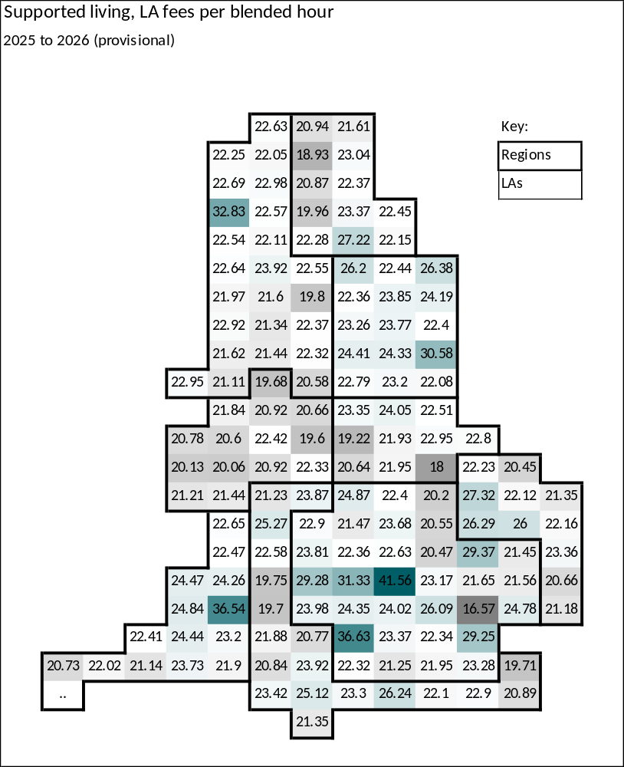

National Comparisons
Supported living: £ per blended hour | External providers for supported living - national | Essex County Council
Local authority average fee 2025 to 2026 (provisional) | £22.95 | £23.36
Local authority average % increase 2025 to 2026 (provisional) | 5.6% | 7.3%
Nationally, Essex County Council has above average rates for supported living services. This is a shift from prior years, and demonstrates the work that has been done to invest in the market as it matches the wider strategic direction of the Council.
ECC currently benchmarks 44th out of the 153 local authorities included within the data set.
*Data is taken from the Market Sustainability Improvement Fund Fees 2025-2026 data
https://www.gov.uk/government/publications/market-sustainability-and-improvement-fund-2025-to-2026-care-provider-fees

Slide 9
Supported Living Rates
The below charts show a comparison of rates paid in supported living services by different local authorities. They are split into ‘geographical’ and ‘statistical’ comparators.
This information is taken from the DHSC Market Sustainability and Improvement Fund (MSIF): Provider fee reporting 2025 to 2026, local authority data tables.
Among geographical comparators, Essex has the 3rd highest rates for supported living services.
Among statistical comparators, Essex has the 4th highest rates for supported living services.

Slide 10
Live at Home

Slide 11
Methodology – Live at Home
Essex County Council has used a ‘cost of care’ model in Live at Home services since 2016. This model was based on engagement with the market at that time and has been updated annually to calculate uplifts linked to each years National Minimum / Living Wage figure.
Between April 2022 October 2022​ ECC was required by Government to complete a national Fair Cost of Care exercise alongside other Local Authorities. This covered Live at Home (+18) and residential and nursing (+65), the results of which are published on our provider hub. The median result of the exercise was within our pricing matrix available to providers through each year’s annual refresh, but the average fee rates selected by providers have been below this.
The £4m funding provided by Department of Health and Social Care (DHSC) for 2022/23 was primarily used to invest in our Live at Home market as this had been where there were supply issues, and this decision aligned to our market strategy, ensuring more people can be supported and remain within their own homes for longer.​ We now have good capacity and supply across all of Essex in this market.
​

Slide 12
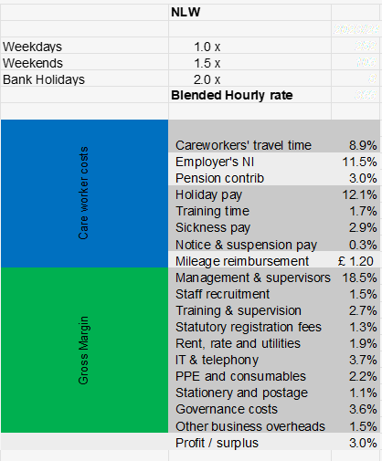
Model analysis
The LAH costing model is linked directly to the current National Living Wage (NLW) rate and updated in April of each year.
The ECC hourly rate within the model is based on a blend of weekdays, weekend and bank holidays premiums.
Each cost line within the costing model is then calculated based on a percentage of NLW, as shown in the table to the right.
Note that this is based an “average” provider in 2016, we are aware that average hours per provider have grown and therefore most submitted bids at the point of tender at a lower price point than the current cost of care suggests – providers costs may be lower or higher against each line depending on their overheads and staffing contracts.

Slide 13
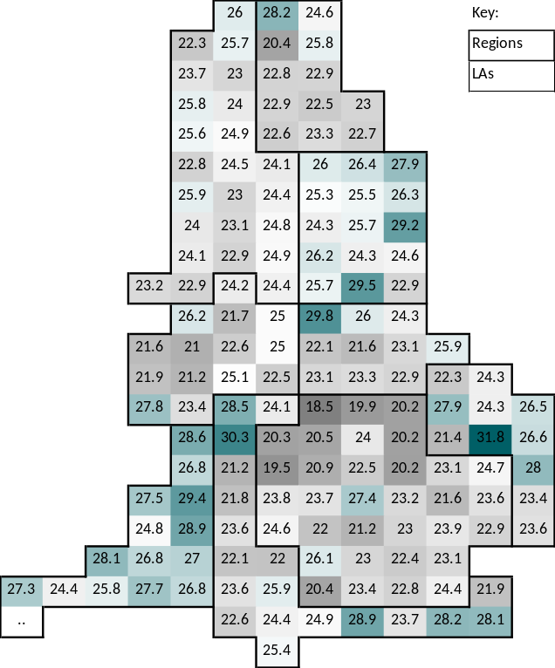
Home Care Rates
Homecare: £ per blended hour | External providers for Homecare - national | Essex County Council
Local authority average fee 2025 to 2026 (provisional) | £25.05 | £28.04
Local authority average % increase 2025 to 2026 (provisional) | 5.3% | 6.4%
Key Essex Data
2025-26 Rates (Provisional)
£28.00
Essex County Council homecare average fee benchmarks favourably against the average national fee and the average % uplift for 2025-26 and also for previous years.
This information is taken from the DHSC Market Sustainability and Improvement Fund (MSIF): Provider fee reporting 2025 to 2026, local authority data tables.

Slide 14
LAH 2025 framework – price review process
Under the new LAH framework the Council has committed to carrying out an annual price review. The review
will consider the rates for new packages in the context of wider market and inflationary pressures. The
Council may elect to apply an uplift to the price matrix points for new packages, with a further option
to apply an uplift to existing packages.
In a change to the price review process under the LAH 2021 framework where providers had the opportunity
to select a different price point for new packages, the default position is that there will not be a price selection
process.

Slide 15
Questions for providers
Does this cost structure feel right and reflect your organisation’s cost structure?
What are your views on the annual uplift approach of price points being uplifted as opposed to a price selection process?
We have been piloting mini-competitions for packages with longer hours of care i.e. those with more than 2 hours of care per visit – do you have any feedback on this? Could this approach be expanded in any way?
What has been the impact of the Employment Rights Bill on your organisation, for example the Statutory Sick Pay from day 1 requirement?
Are there any changes in legislation or ways of working that we need to be aware of that haven’t been covered in this session and may impact on your cost structure?

Slide 16
Any Questions/Feedback

