Slide 1
Supported Living - Demand Bulletin
June 2023
Procurement Services Realising Essex's potential through our suppliers

Slide 2
Demand Overview
Trend
Total | 108 | -
No Option Identified | 52 | +16
Shared | 78 | +11
Self-Contained | 30 | -11
Complex | 30 | +2
Non-Complex | 78 | -1
Headlines:
108 people are actively seeking accommodation in Essex which is the same number as from the previous report
48% of active referrals do not yet have an option identified
The majority of demand is for non-complex services (72%)
72% of adults are seeking shared accommodation and 28% want self-contained
Demand is higher in younger age groups (59% under 35 years old). There has been a slight increase in adults aged over 35 from the previous reporting period

Slide 3
Learning Disabilities and/or Autism (LDA) Demand

Slide 4
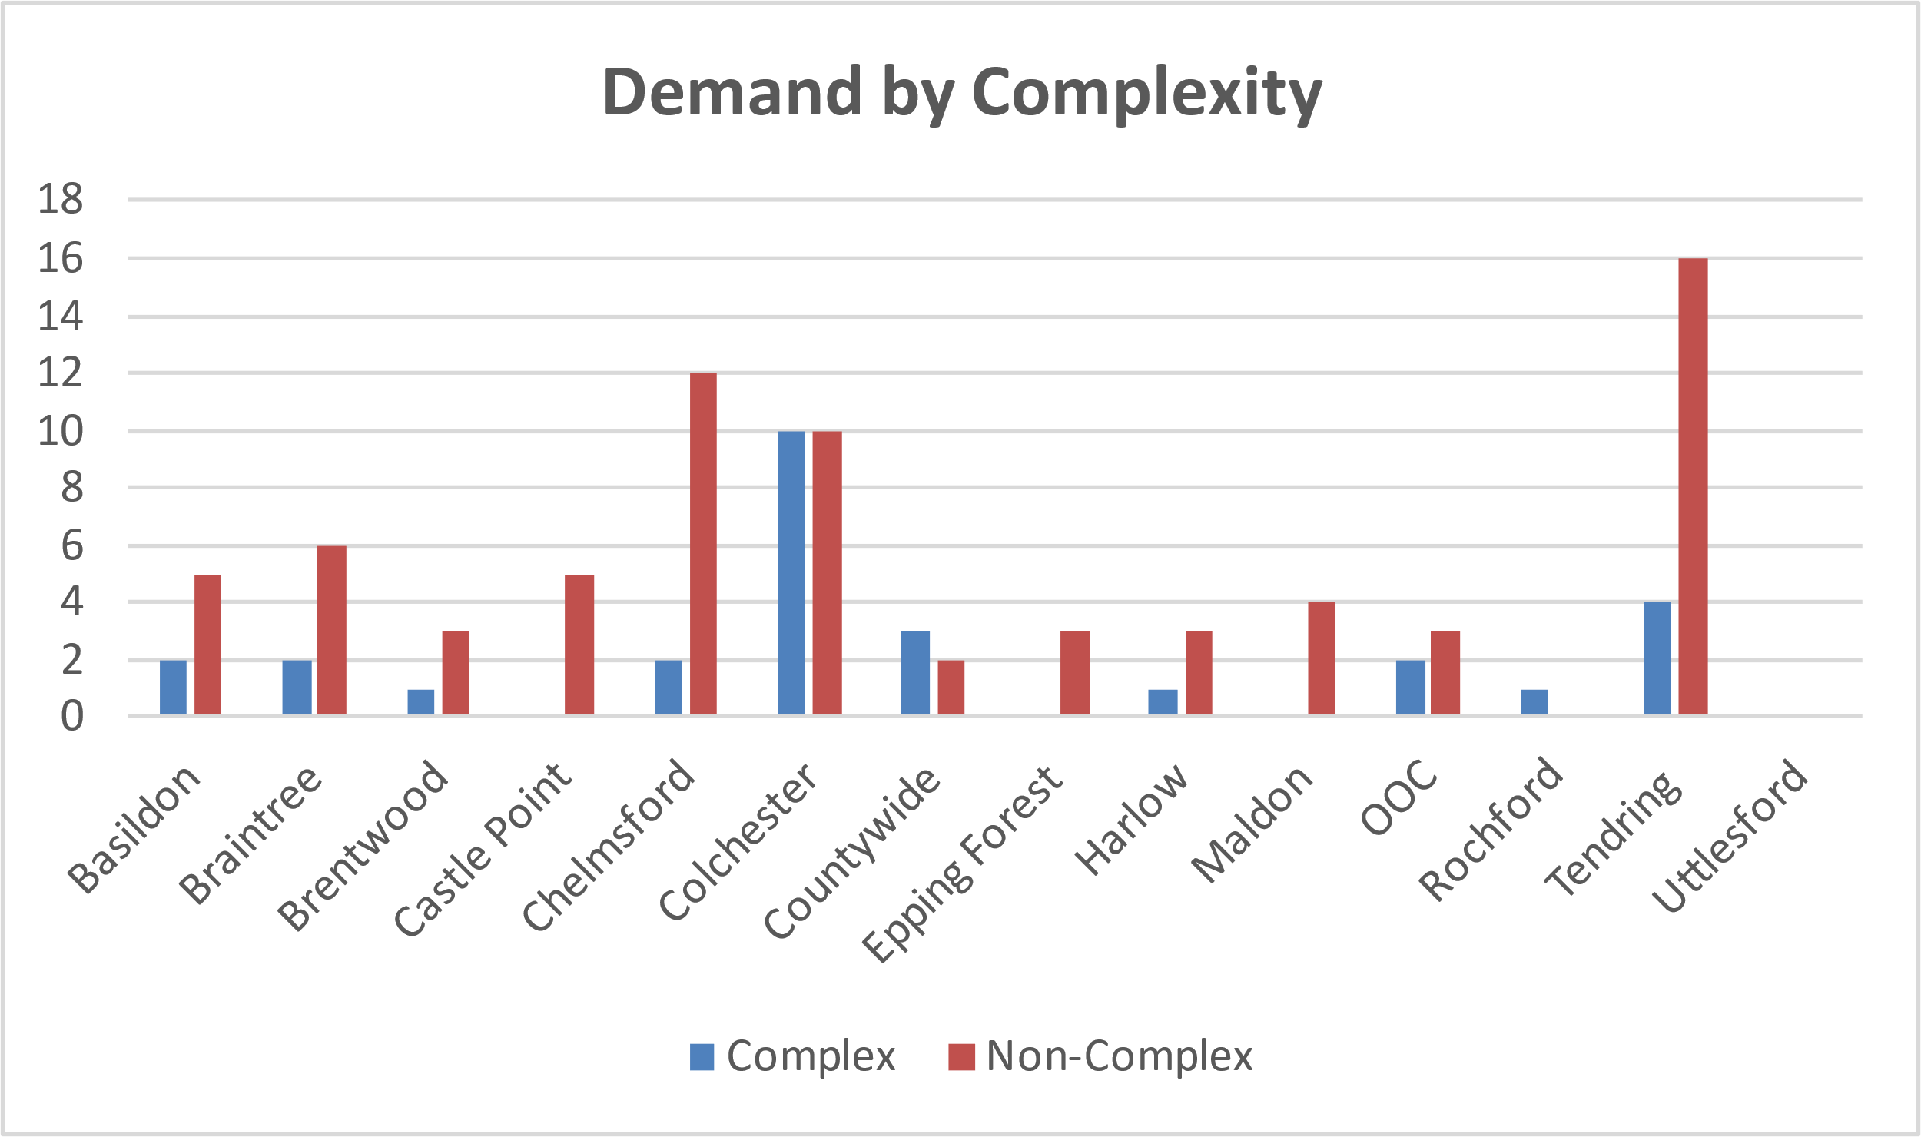
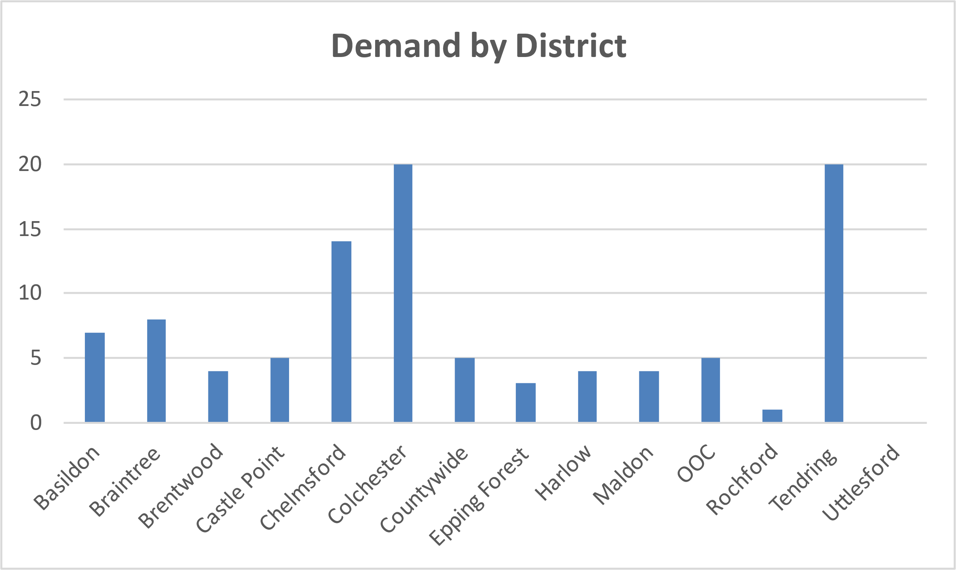
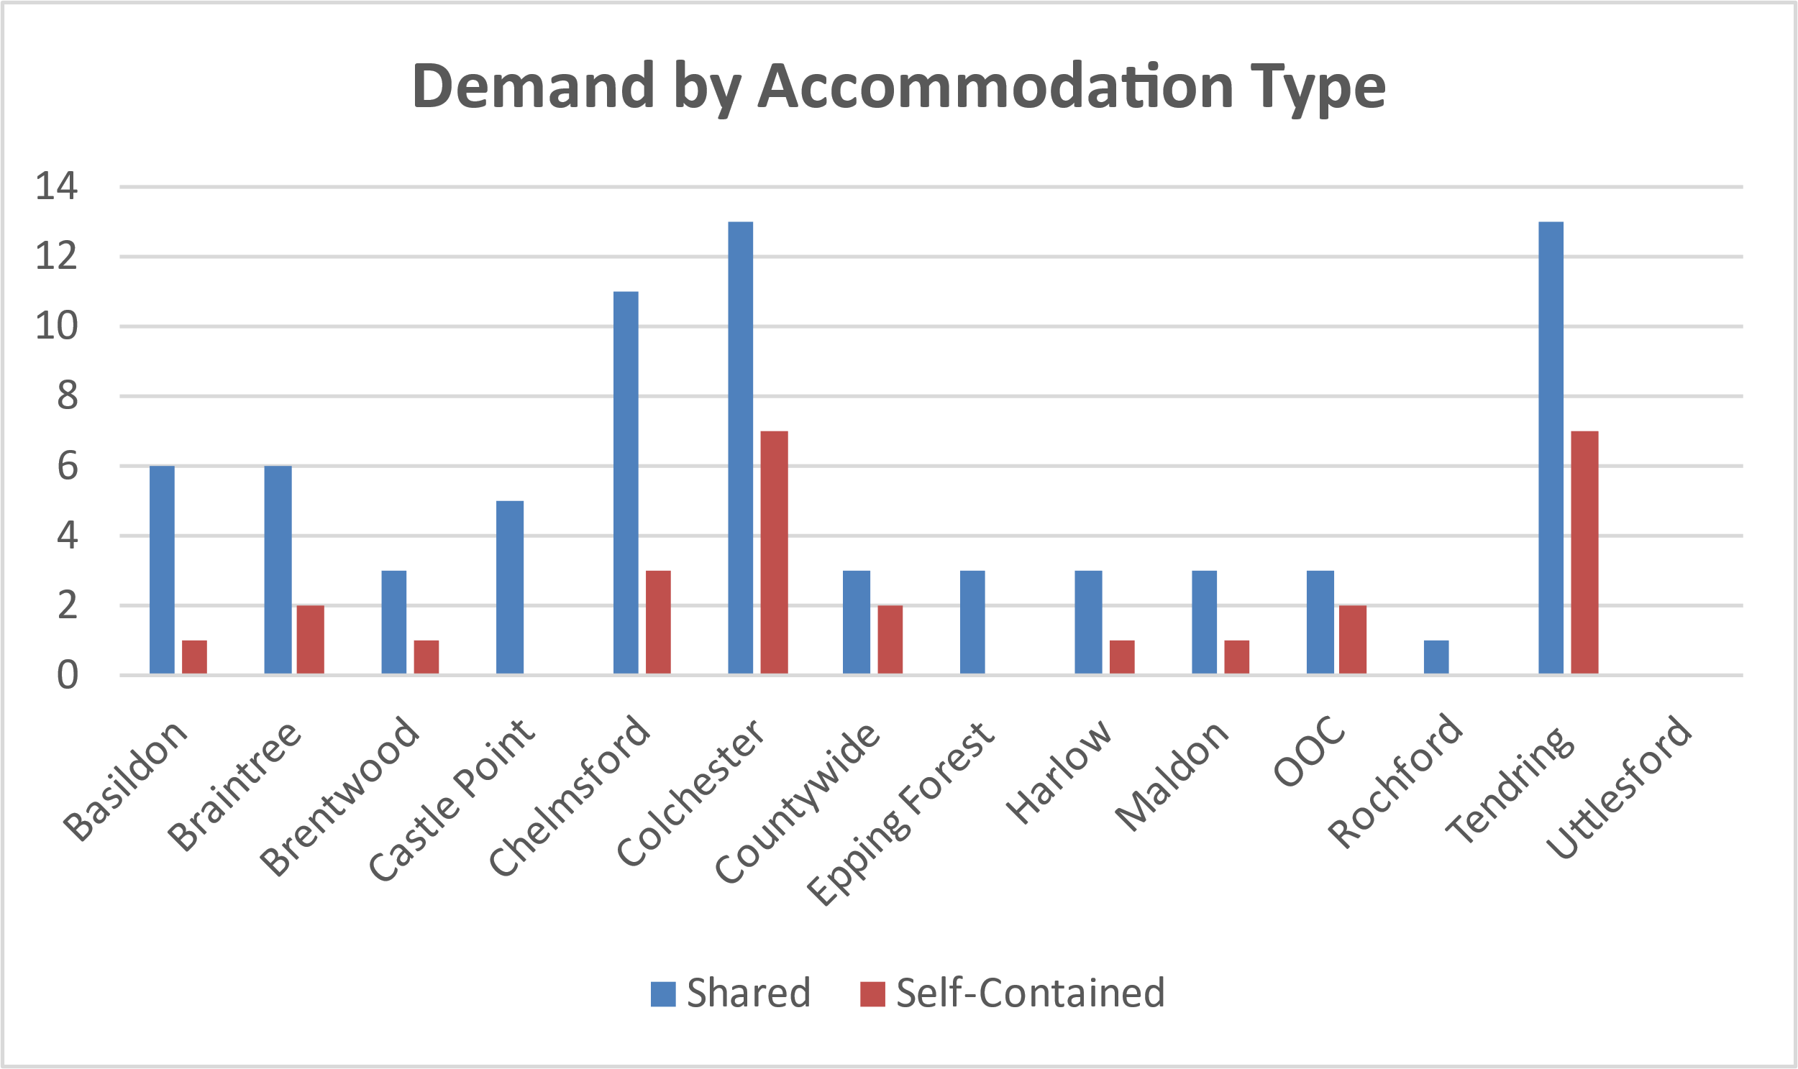
Demand by District (LDA)
Headlines
Broken down by district we can see the highest demand in Colchester (20 adults) followed by Tendring (20) and Chelmsford (14)
The highest demand for complex adults is in Colchester (10)
This has increased by 3 since the last report and Tendring has increased in demand for both complex and non-complex
Areas where more complex adults are seeking accommodation have a corresponding demand for self-contained accommodation demonstrating the importance in developing these services for complex needs

Slide 5
Demand by Need (LDA)
Complex Needs
Non-Complex
Adults | 28
Option Identified | 15
No Option Identified | 13
Shared | 13
Self-Contained | 15
Adults | 72
Option Identified | 37
No Option Identified | 35
Shared | 60
Self-Contained | 12
Headlines
46% of adults with complex needs have no option identified – a 9% increase from the previous bulletin
48% of those with non-complex needs have no option identified – an increase of 16% from the last bulletin
There is a higher proportion of complex adults (54%) that are seeking self-contained accommodation than for non-complex (17%). This demonstrates the need for self-contained services to be developed specifically for adults with complex needs.

Slide 6
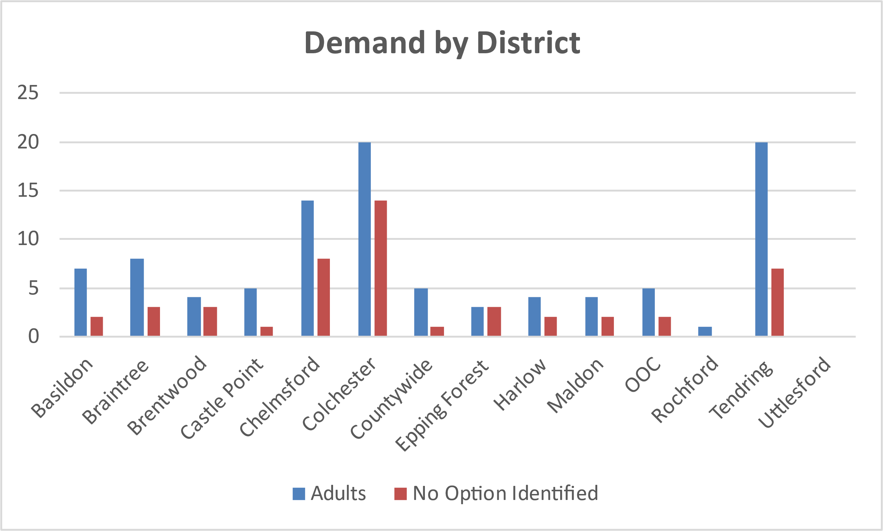
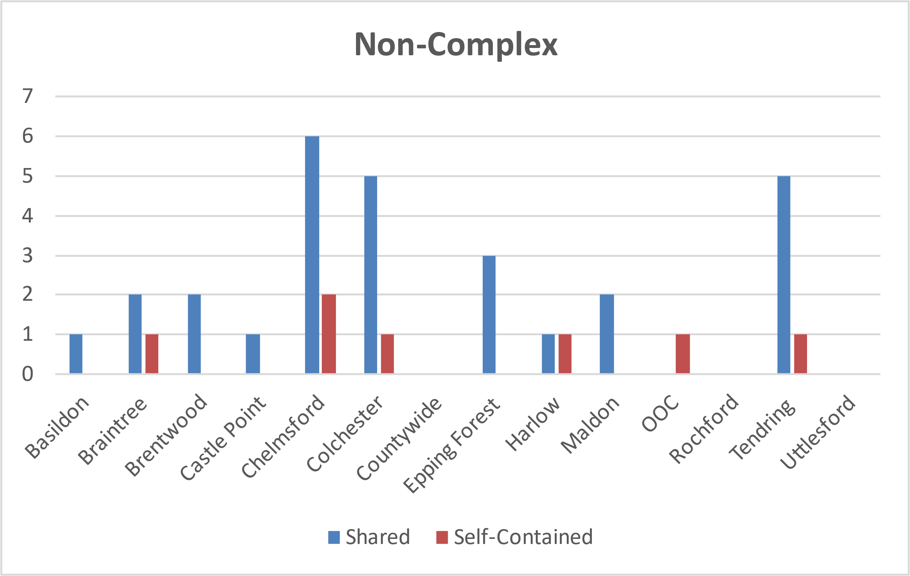
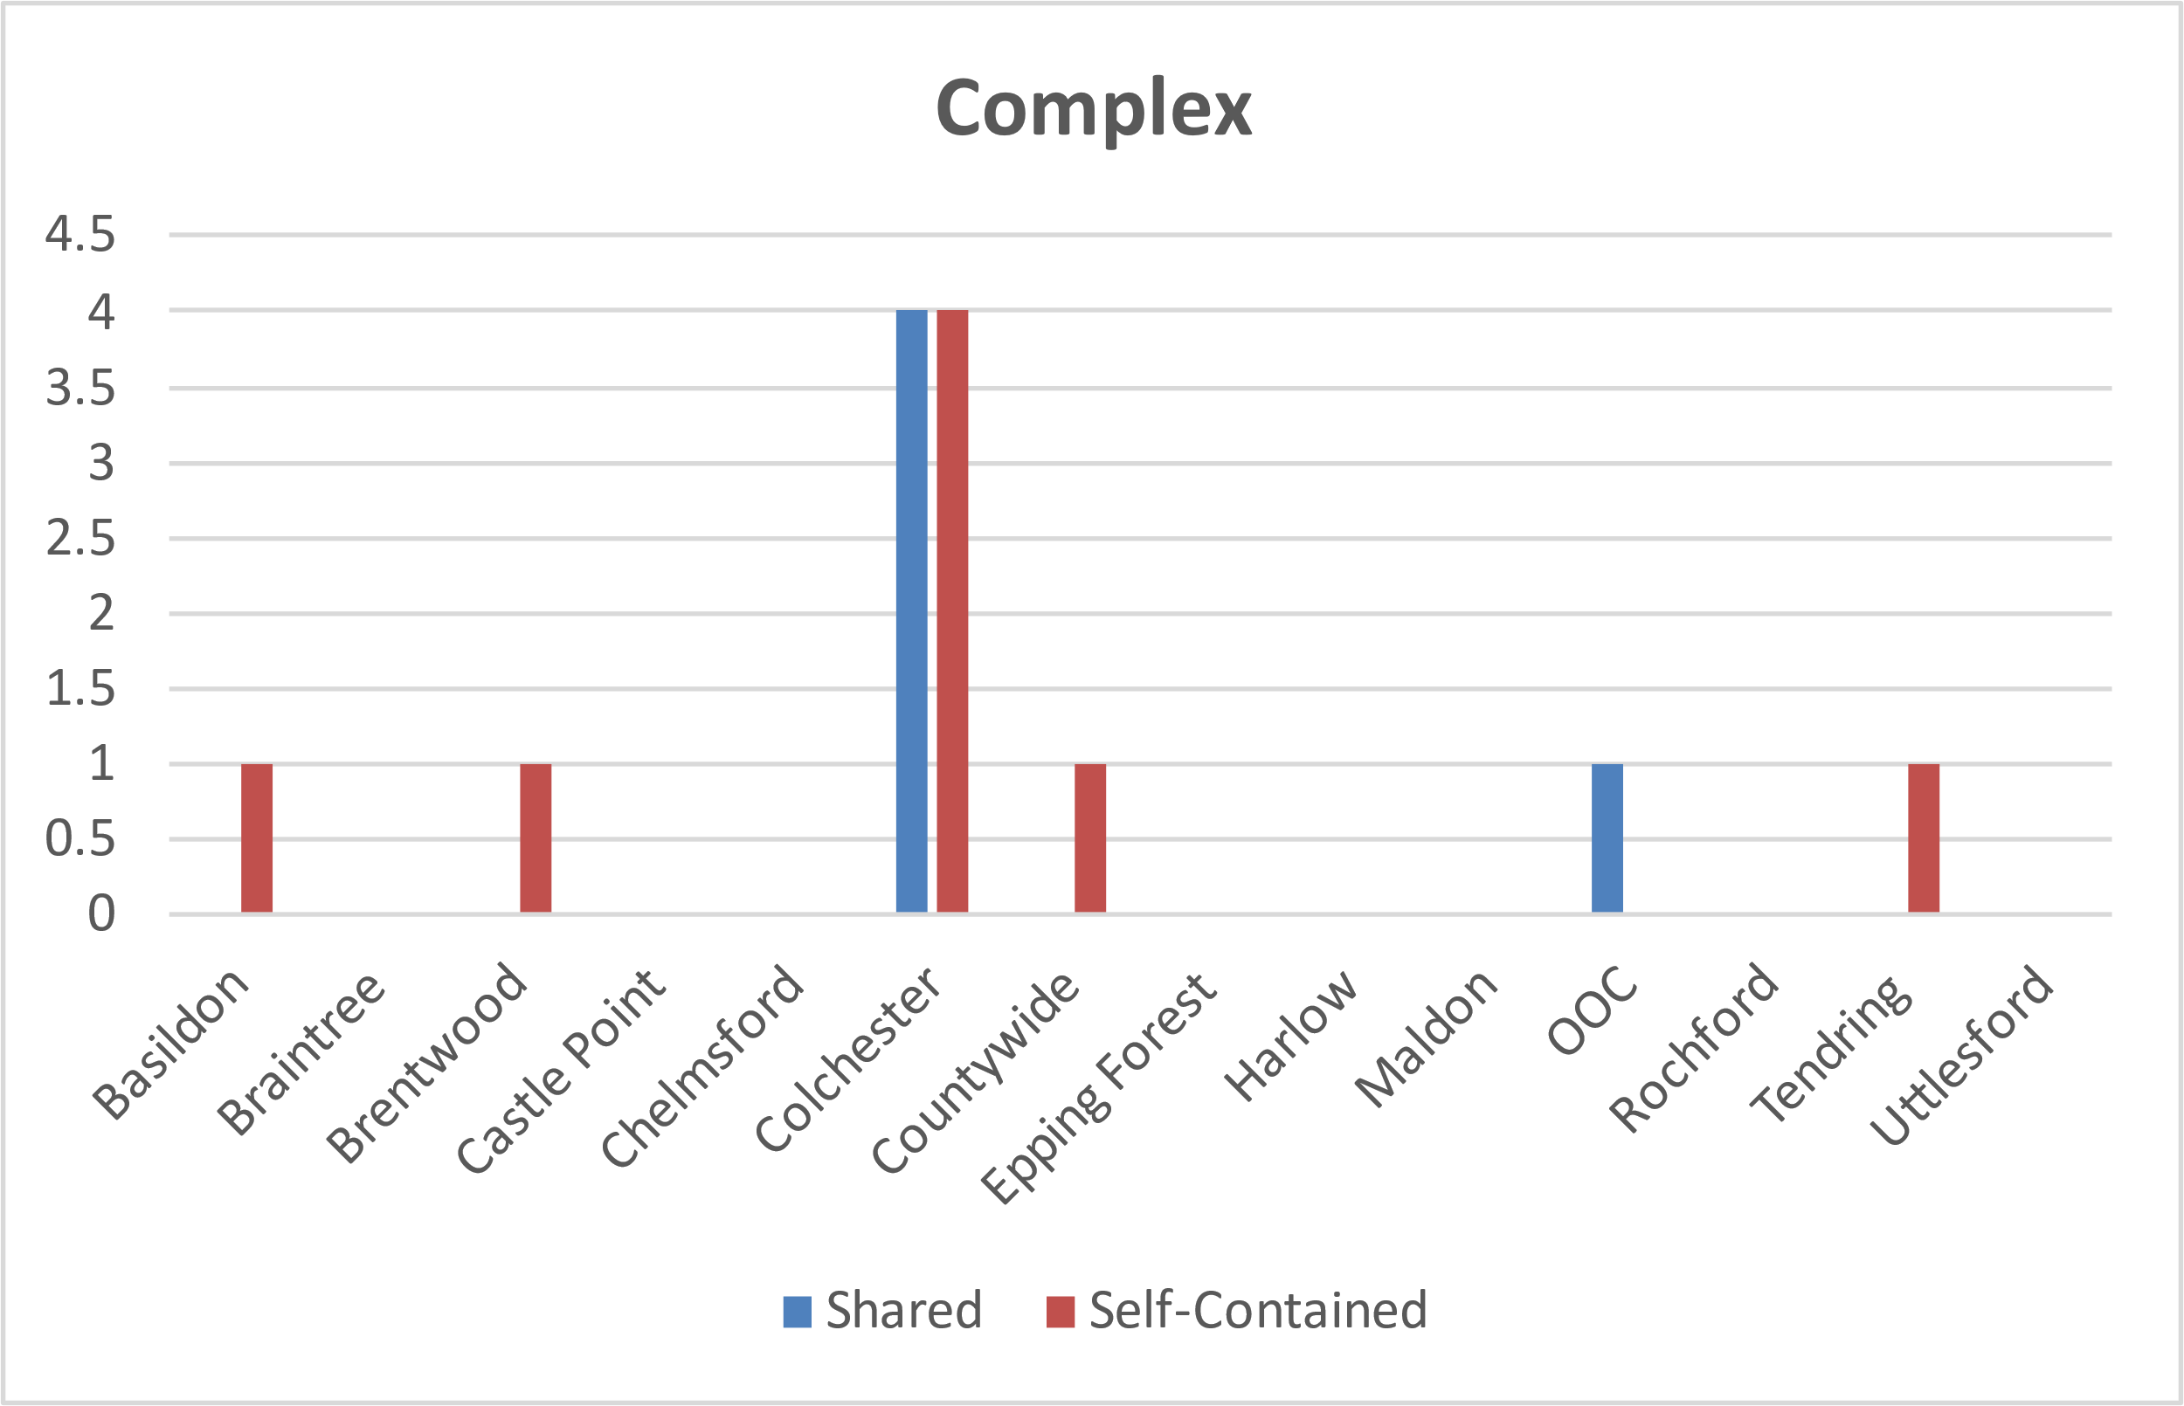
Adults with no option identified (LDA)
Headlines
Colchester and Tendring (14 adults) have the highest number of adults with no option identified, with the second highest number being Chelmsford (8).
90% of the complex adults seeking accommodation need self-contained services with need primarily in Colchester (4 adults).
Tendring shows 5 adults seeking accommodation in shared housing who currently have no viable option, demonstrating the need for services to be developed here.

Slide 7
Physical and/or Sensory Impairment (PSI) Demand

Slide 8
Demand by District (PSI)
Headlines
The level of demand is significantly lower from adults with PSI.
We can see the highest demand in Chelmsford and Colchester, with two adults looking for services, and other individuals looking also in Basildon, Tendring and Epping Forest.
Only 2 adults are defined as complex and they are both seeking accommodation in Colchester.
5 adults are seeking shared accommodation while 3 are seeking self-contained

Slide 9
Demand by Need (PSI)
Complex Needs
Non-Complex
Adults | 2
Option Identified | 1
No Option Identified | 1
Shared | 1
Self-Contained | 1
Adults | 6
Option Identified | 3
No Option Identified | 3
Shared | 4
Self-Contained | 2
Headlines
50% of adults with PSI needs have no option identified at this time, suggesting a lack of suitable services.
There is a higher proportion of non-complex adults seeking accommodation.

Slide 10
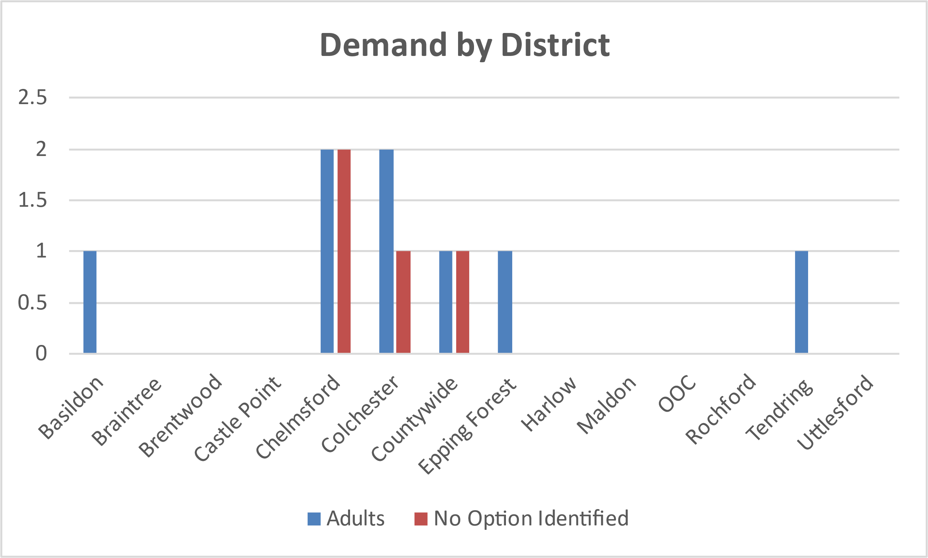
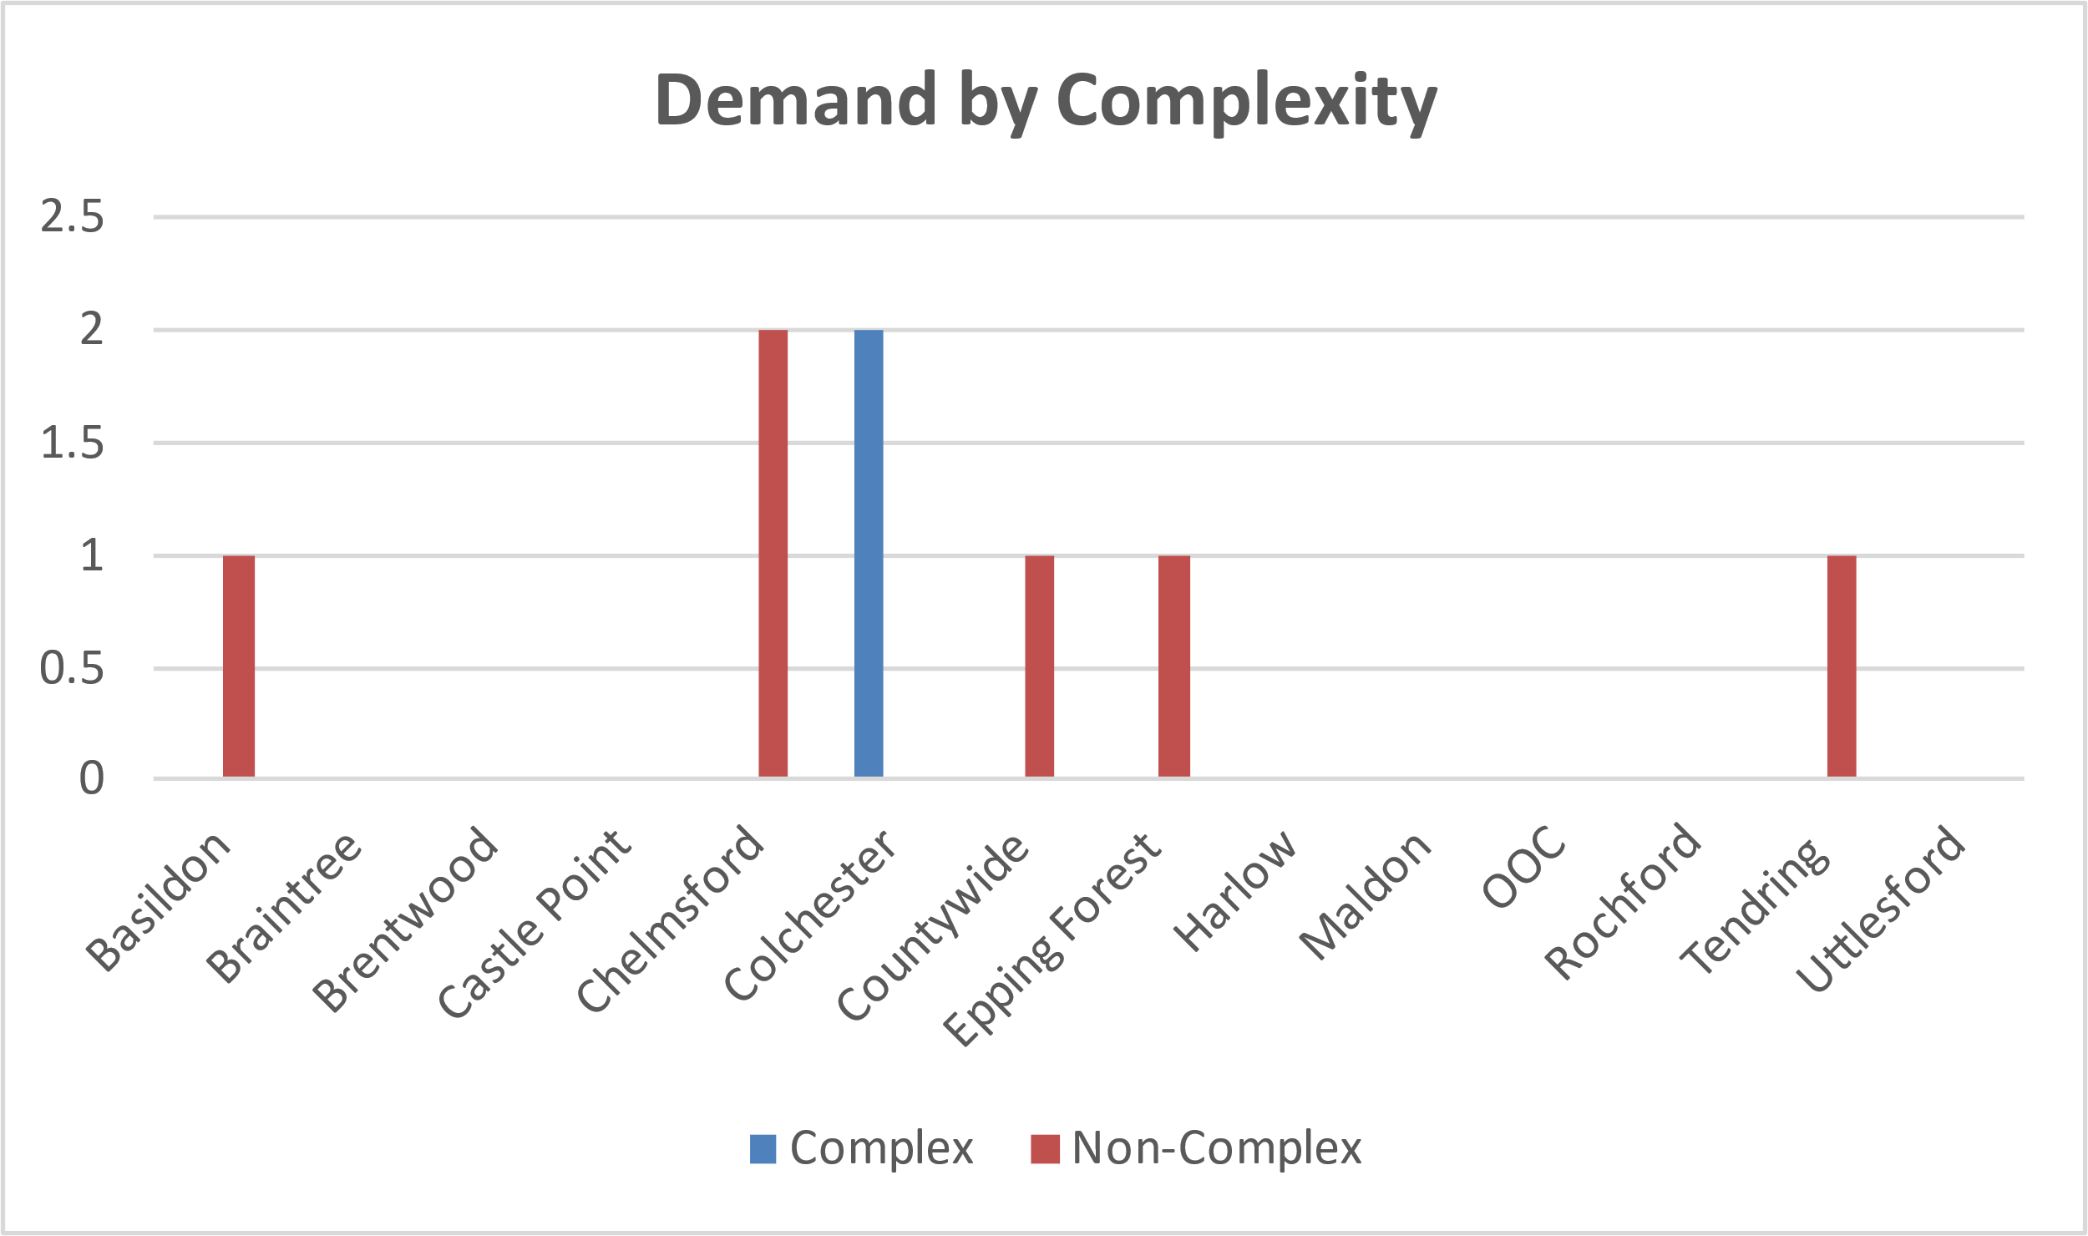
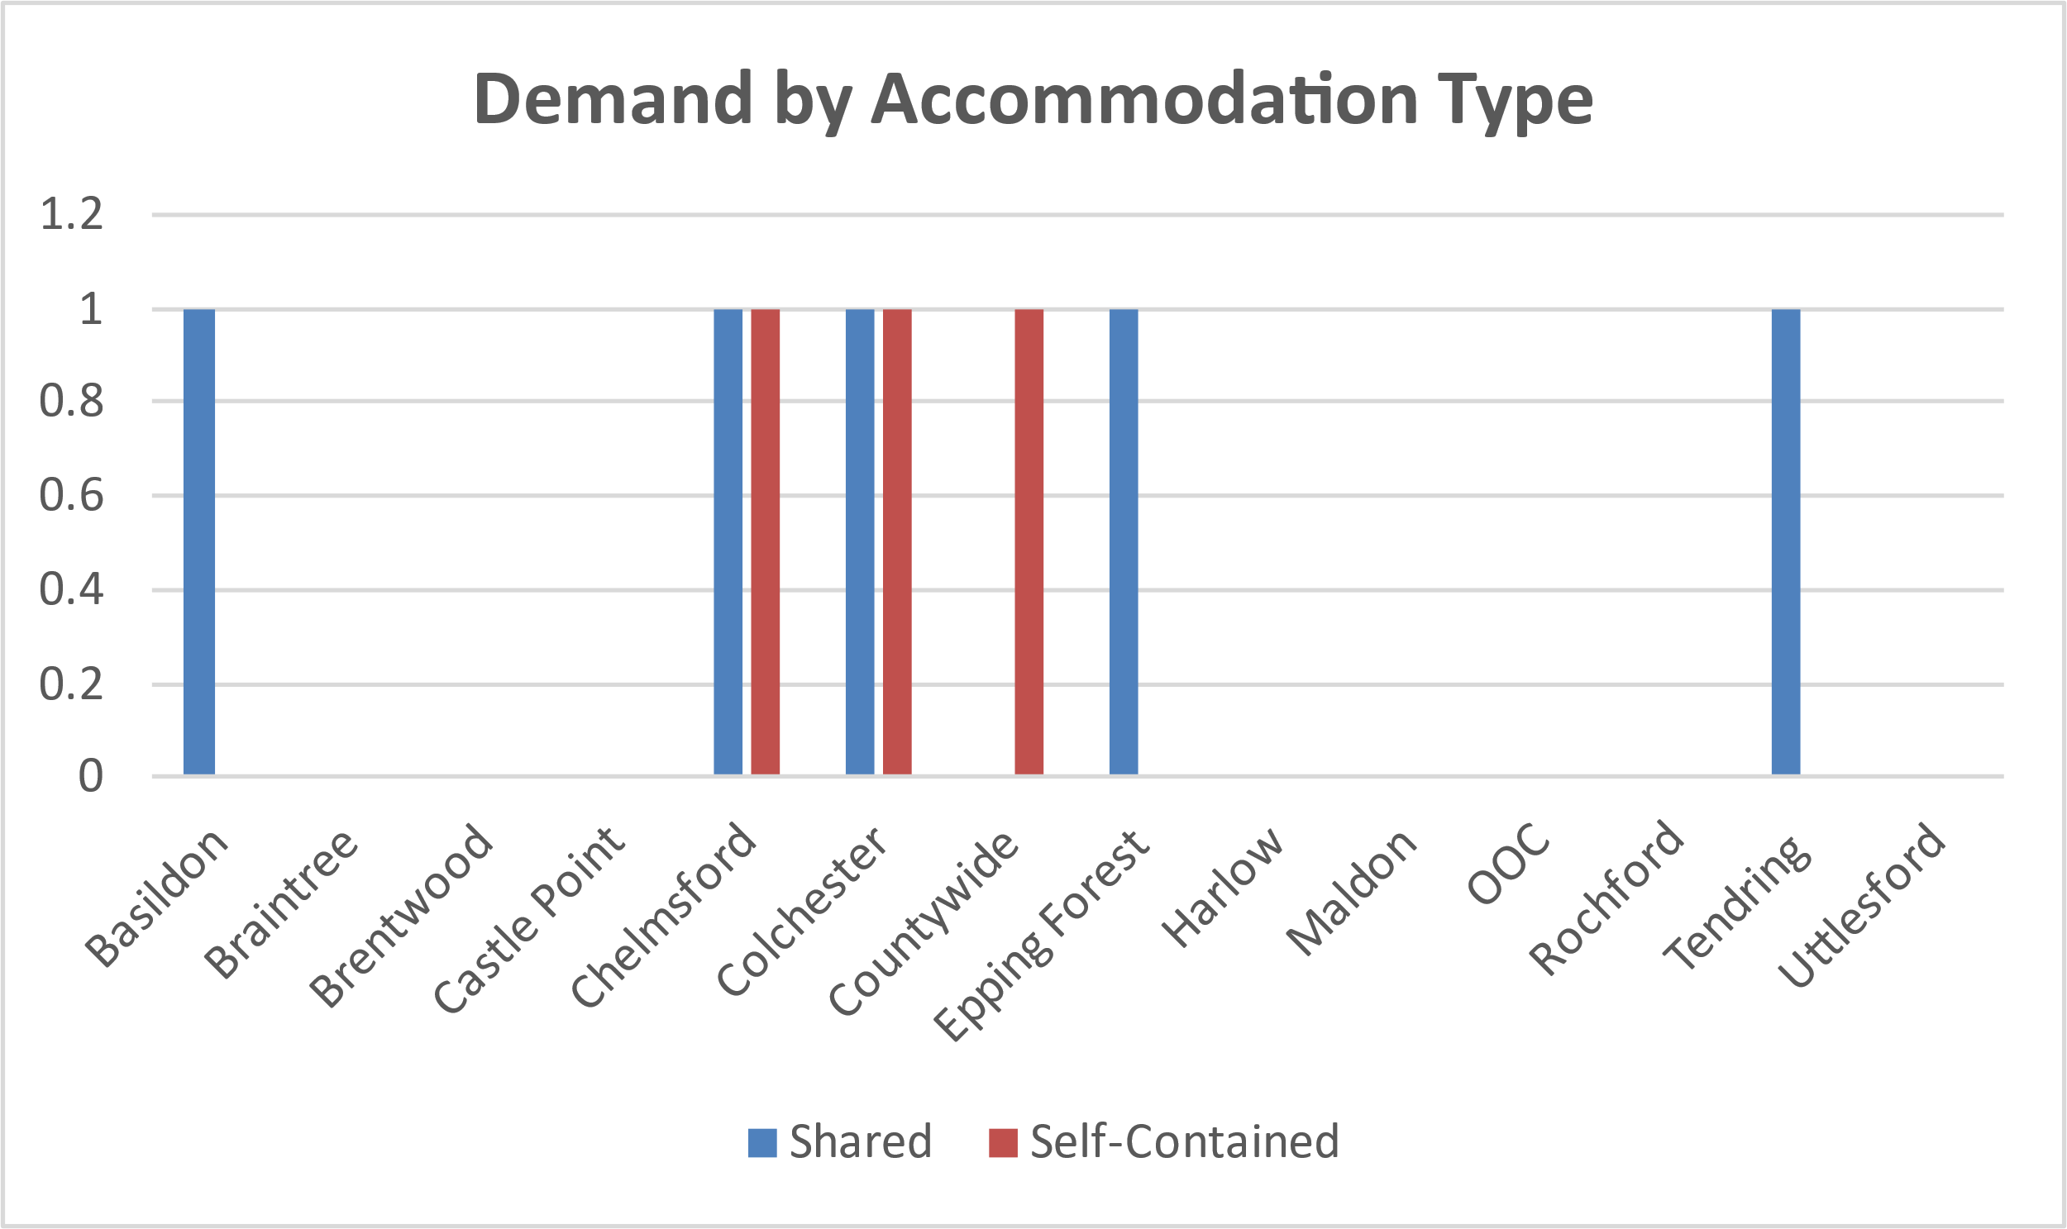
Adults with no option identified (PSI)
Headlines
There are eight adults with PSI who have no option identified in Essex
Colchester and Chelmsford are the highest areas of demand, with Colchester having nothing available currently for those who are looking for options
Only 2 adults are presented as having complex needs and are seeking accommodation in Colchester
5 Adults are seeking shared accommodation, while 3 require self-contained

Slide 11
Development Pipeline

Slide 12
Developments
If you are looking to develop services in Essex to meet any of the needs outlined within this report please get in touch with ECC directly using the below email address, and ECC colleagues will arrange a discussion with you on your proposals.
It is important that any discussion around new services is in advance of any work commencing to develop the proposed services.
Please contact specialist.accomm@essex.gov.uk to discuss proposals.

