Slide 1
Breakout 3: ECC TOMs Basics
Emma Woof – Procurement Manager Social Value

Slide 2
ECC Approach to Social Value
Essex County Council has adopted the Local Government Association’s National Social Value Taskforce National Themes, Outcomes and Measures’ (‘National TOMs’) method of classifying and evaluating Social Value, adapted to the County’s context and priorities, based on the ECC Corporate Strategy 'Everyone's Essex’
Social Value is given a weighting and evaluated in two parts, which, when combined result in one overall Social Value score:
1. Value Score (calculated using the ECC TOMs Calculator)
2. Supporting Statement Score
Value Score (out of 5)
Supporting Statement
Score (0-1)
Overall Social Value Score
(out of 5)
Notes:
Essex County Council has adopted the Local Government Association’s National Social Value Taskforce National Themes, Outcomes and Measures’ (‘National TOMs’) method of classifying and evaluating Social Value, adapted to the County’s context and priorities, based on the ECC Corporate Strategy 'Everyone's Essex’
Social Value is given a weighting and evaluated in two parts, which, when combined result in one overall Social Value score:
1. Value Score (calculated using the ECC TOMs Calculator)
2. Supporting Statement Score

Slide 3
ECC TOMs Calculator
A set of Social Value 'Themes and Outcomes'
A set of Units of Measure for each of the Outcomes:
These Units of Measure are used to compare bids on a like for like basis. They are set out as a description (the Measure) and a metric (the Unit).
They also enable us to collate the total benefits delivered by vendors to Essex communities and provide a consistent method of performance management reporting.
A set of Financial Proxies:
Each Unit of Measure is assigned a financial value. This enables us to calculate the total economic value of contributions that organisations offer.
Priority Weightings:
This is a weighting system that enables ECC to ensure its scoring system aligns to the agreed ECC Social Value Priority Measures.
A factor of 1 to 3 is applied to the Units of Measure that are listed as an ECC Social Value Priority.
When Total Social Value bid is calculated, the corresponding Financial Proxy is multiplied by the weighting before the total 'Value' score is calculated.
When ECC staff measure and report the social value delivered, they will not use the multiplier.
Notes:
A set of Social Value 'Themes and Outcomes'
A set of Units of Measure for each of the Outcomes:
These Units of Measure are used to compare bids on a like for like basis. They are set out as a description (the Measure) and a metric (the Unit).
They also enable us to collate the total benefits delivered by vendors to Essex communities and provide a consistent method of performance management reporting.
A set of Financial Proxies:
Each Unit of Measure is assigned a financial value. This enables us to calculate the total economic value of contributions that organisations offer.
Priority Weightings:
This is a weighting system that enables ECC to ensure its scoring system aligns to the agreed ECC Social Value Priority Measures.
A factor of 1 to 3 is applied to the Units of Measure that are listed as an ECC Social Value Priority.
When Total Social Value bid is calculated, the corresponding Financial Proxy is multiplied by the weighting before the total 'Value' score is calculated.
When ECC staff measure and report the social value delivered, they will not use the multiplier.

Slide 4
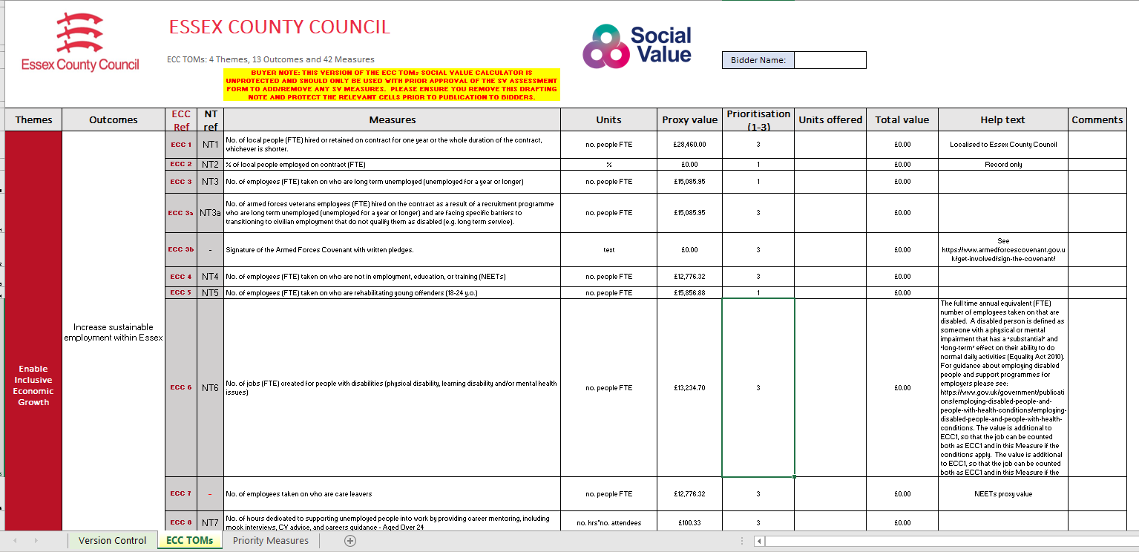
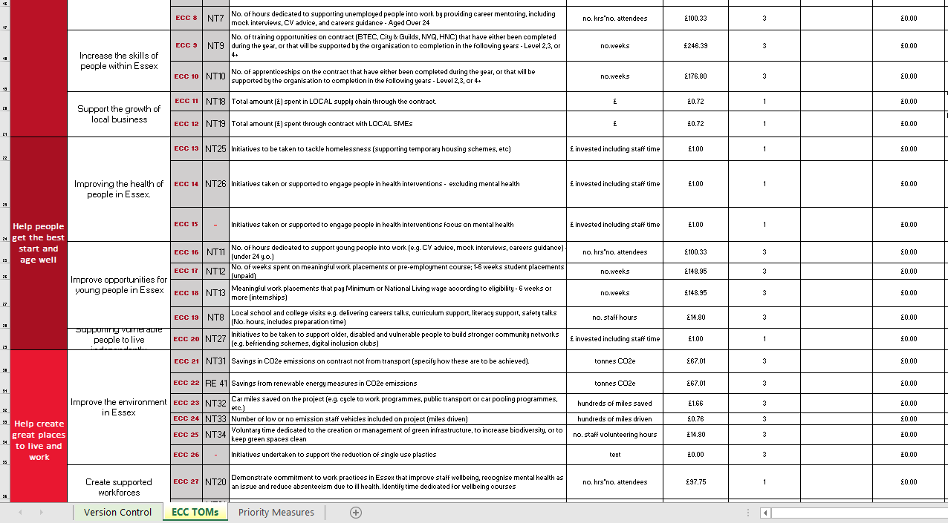

Slide 5
ECC Priorities
ECC has identified a number of priority areas, which are given a priority score of 3 within the “ECC TOMs Calculator”.
Where suppliers commit to deliver any of these ‘priority measures’ the proxy value of those measures is multiplied by 3.
The priority measures for ECC are Jobs, Skills and Climate Measures.
Bidder 1:
Jobs created for people with disabilities
Proxy Value
£13,234.70 x3
Total Social Value offered by Bidder 1:
£39,704.10
Notes:
ECC has identified a number of priority areas, which are given a priority score of 3 within the “ECC TOMs Calculator”.
Where suppliers commit to deliver any of these ‘priority measures’ the proxy value of those measures is multiplied by 3.
All of this information, and a lot of additional resources can be found on our Social Value Catalogue… next slide

Slide 6
Social Value Catalogue Social Value Catalogue | Provider Hub | Essex (essexproviderhub.org)

Slide 7
Bidder’s Guidance
1. Value Question
How to complete the ECC TOMs Calculator
Important requirements to consider when making your offer
Evaluation Criteria
How the Score is calculated
2. Supporting Statement
Supporting Statement Question
What is required
Standard Evaluation Criteria
How the Supporting Statement Score is calculated
3. Overall Social Value Score
Notes:
The Bidder’s Guidance gives bidders all of the information they will need to understand the ECC approach to Social Value, and provides transparency on our evaluation process
1. Value Question
How to complete the ECC TOMs Calculator
Important requirements to consider when making your offer
Evaluation Criteria
How the Score is calculated
2. Supporting Statement
Supporting Statement Question
What is required
Standard Evaluation Criteria
How the Supporting Statement Score is calculated
3. Overall Social Value Score

Slide 8
Social Value Scoring Methodology
Value Score
ECC TOMs Calculator
Value Score
(out of 5)
SV Units Offered
Supporting Statement Score
Qualitative evaluation of Supporting Statement
Proxy Value x Multiplier
Social Value Ratio
Moderate Supporting Statement Score
Consider robustness of Implementation Plan
Consider confidence of delivery
Total Social Value Score (out of 5)
Social Value Ratio = Total Social Value Bid / Total Cost Bid
Score Allocation method for Supporting Statement:
1 = Outstanding
0.8 = Highly Acceptable
0.6 = Acceptable
0.4 = Partially Acceptable
0.2 = Unsatisfactory
0 = Wholly Unsatisfactory
Converted into a Value Score based on Target of 50p SV in every £1 spent
Notes:
With the new Methodology we can assess the Value of Social Value in relation to the overall contract price, and based on our target to achieve SV worth XX pence in every £1 spent.
And we have a closer connection between the Supporting Statement, and the confidence it provides us with in terms of the delivery of Social Value.
Thereby, encouraging bidders to offer a decent amount of Social Value plus a solid Implementation Plan to give adequate assurances that the commitments can be delivered.

Slide 9
The Value Score
Value Score | How the Value Score is allocated | Value based on Social Value Target 50p for every £1
5 | Social Value meets Target | 50p or over per £1 bid
4 | Social Value Ratio lower than Target by 1-24% | Over 37p up to 49p of Social Value per £1 bid
3 | Social Value Ratio lower than Target by 25-49% | Over 25p up to 37p of Social Value per £1 bid
2 | Social Value Ratio lower than Target by 50-74% | Over 13p up to 25p of Social Value per £1 bid
1 | Social Value Ratio lower than Target by > 75% | Over 1p up to 13p of Social Value per £1 bid
0 | No Social Value bid | Less than 1p of Social Value per £1 bid
Social Value Bid
∑ (Units bid x Financial Proxy x Multiplier)
NOTE: The ECC target for this contract is 50p of Social Value in every £1 spend
Social Value Ratio
Social Value Bid
Tendered Price
Value Score
allocated based on Social Value Target (0-5)
Notes:
Using the ECC TOMs Calculator
We’ve verified the submission, considered all of the units offered in terms of relevance and proportionality to the contract.
We take the total ‘proxy’ value of Social Value offered
And we take the tendered price to calculate the Social Value Ratio
Then we consider the target that we are trying to achieve.
The default target is that we want to achieve 50p Social Value in every £1 spend
We’ve created a scoring methodology based on this target….
When the Social Value Ratio shows that 50p or more for every £1 of the contract value will be additional Social Value bidders score 5/5 on their Value score.
This reduces proportionately as the Social Value offered moves further below our target.
Without wanting to confuse things …. Just a point to note – if you are reducing the measures that you are including n the ECC TOMs or if you are including all of the measures and there is an opportunity in a particular market to achieve more than 50p in every £1 spent, then the target may changed – evidenced through the SVAF and with input from colleagues to develop the rationale.

Slide 10
The Supporting Statement Score
Score | Rationale
1 | Outstanding – The Supporting Statement fully addresses the Social Value commitments and specified criteria and provides relevant evidence regarding competence, capacity, and ability to successfully fulfil the delivery of the Social Value Bid and goes beyond expectations to offer an outstanding level of performance or an additional benefit which exceeds specified measures.
0.8 | Highly Acceptable – The Supporting Statement fully addresses the Social Value commitments and specified criteria and provides relevant evidence regarding competence, capacity, and ability to successfully fulfil the delivery of the Social Value Bid.
0.6 | Acceptable – The Supporting Statement addresses most of the Social Value commitments and specified criteria, but some areas contain limited relevant evidence regarding competence, capacity, and ability to successfully fulfil the delivery of the Social Value Bid.
0.4 | Partially Acceptable – The Supporting Statement covers more than one element of the Social Value commitments and specified criteria but lacks relevant evidence regarding competence, capacity, and ability to successfully fulfil the delivery of the Social Value Bid.
0.2 | Unsatisfactory – The Supporting Statement only covers a minor element of the Social Value commitments and specified criteria and lacks relevant evidence regarding competence, capacity, and ability to successfully fulfil the delivery of the Social Value Bid.
0 | Wholly Unsatisfactory – No Supporting Statement or the whole response is irrelevant to all the Social Value commitments and specified criteria.
Supporting Statement
assessed
Supporting Statement specified criteria
Supporting Statement Score
(0-1)

Slide 11
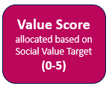
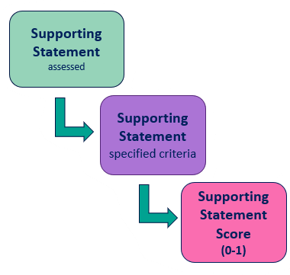
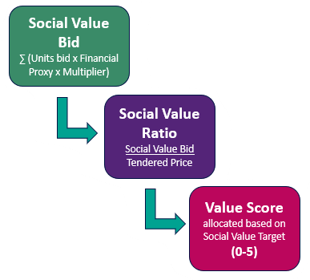
Social Value Methodology - Flow chart
Supporting Statement Score
(0-1)
Total Social Value Score (out of 5)

Slide 12
Overall Social Value Scoring Matrix
 |  | Supporting Statement Score
Value Score |  | 0 | 0.2 | 0.4 | 0.6 | 0.8 | 1
 | 1 | 0 | 0.2 | 0.4 | 0.6 | 0.8 | 1.0
 | 2 | 0 | 0.4 | 0.8 | 1.2 | 1.6 | 2.0
 | 3 | 0 | 0.6 | 1.2 | 1.8 | 2.4 | 3.0
 | 4 | 0 | 0.8 | 1.6 | 2.4 | 3.2 | 4.0
 | 5 | 0 | 1.0 | 2.0 | 3.0 | 4.0 | 5.0
Notes:
Any questions…?

Slide 13
Thank you for attending Day 1 of the Social Value Festival
Go back to the ticket page to bookmark other sessions
See too our Social Value Catalogue
Follow #EssexSocialValue

