Slide 1

Welcome

Slide 2

What does a good death
look like?

Slide 3


Slide 4
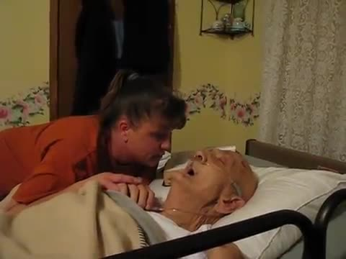

Slide 5
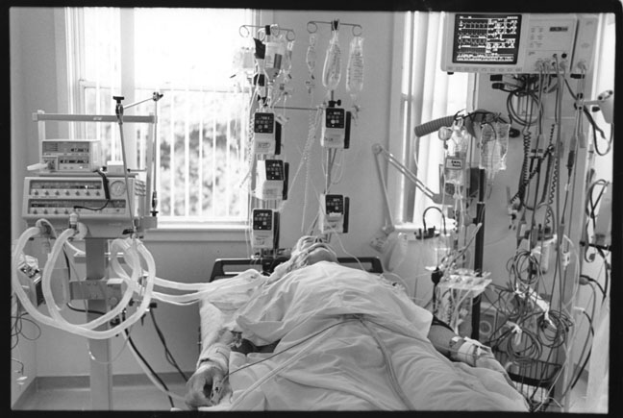

Slide 6

What does a good death look like?

Slide 7
What is a good death according to national strategy?
1. There is identification of people approaching the end of life
2. Care planning around people’s preferences
3. Co-ordination of care
4. Delivery of high quality services in all locations
5. Management of the last days of life
6. Care after death
7. Support for carers
End of life care strategy 2008

Slide 8
What is a good death according to the Enhanced Health in Care Homes Framework?
A systematic proactive approach is used to identify residents who may require end of life care
Fully funded GSF training and accreditation available 2018-2020
More people are identified by primary care as approaching the end of life in North East Essex than the England average

Slide 9
Individuals are supported to die in their place of choice
Supported by advance care planning
My Care Choices Register
Over 3300 people in North East Essex have recorded their wishes
65% of people on My Care Choices die in their preferred place of care
People on My Care Choices have only a 25% chance of dying in hospital compared to an average of 46%
19% of people on My Care Choices live in a care home

Slide 10
Support for end of life care for people in care homes should be available from other teams such as the hospital, hospices, and community nursing teams
Specialist palliative care team in hospital
Promotion of My Care Choices
Funding of care home places for people at the end of life
District nursing services
SinglePoint service
Other St Helena services

Slide 11
Care home staff are supported with education and training on palliative care knowledge and skills
St Helena currently have some funding for palliative care education sessions to be offered free to care home staff
Syringe driver training
Foundations of palliative and end of life care
Symptom control
Advance care planning and My Care Choices
Promoting Person-Centred Care at the End of Life

Slide 12

What do people want for their own end of life care?

Slide 13
Control over decisions
Cared for in place of choice
High quality care
What is important?
Support for those close to me
Access to the right services
The right people to know my wishes
Support for symptoms and needs

Slide 14
What are the barriers ?

Slide 15
What can we measure to demonstrate high quality?
What do we currently measure?
Preferred Place of Care
Hospital Admissions
A+E attendances

Slide 16
What Else?

Slide 17


Slide 18


Slide 19
Thank you

