Slide 1
Supported Living - Demand Bulletin
October 2023
Procurement Services Realising Essex's potential through our suppliers

Slide 2
Demand Overview
Change vs previous quarter
Total | 106 | -2
No Option Identified | 39 | -13
Shared | 70 | -8
Self-Contained | 36 | 6
Complex | 28 | -2
Non-Complex | 78 | 0
Headlines:
106 people are actively seeking accommodation in Essex which is a slight decrease from the previous report
37% of active referrals do not yet have an accommodation option identified
The majority of demand is for non-complex services (74%)
66% of adults are seeking shared accommodation and 34% want self-contained
Half of the demand comes from people under 35 years old

Slide 3
Learning Disabilities and/or Autism (LDA) Demand

Slide 4
Demand by District (LDA)
Headlines
Total LDA demand is 102
Broken down by district we can see the highest demand in Colchester (24 adults) followed by Chelmsford (15)
They are also the 2 districts with a growing demand since last report, whereas Tendring is decreasing
The highest demand for complex needs is in Colchester (7) but a lot of the complex demand also falls under countywide
There is a need for shared accommodation in all the districts

Slide 5
Demand by Need (LDA)
Complex Needs
Complex Needs
Change vs previous quarter
Non-Complex
Change vs previous quarter
Adults | 27 | -1
Option Identified | 17 | 2
No Option Identified | 10 | -3
Shared | 12 | -1
Self-Contained | 15 | 0
Adults | 73 | 1
Option Identified | 50 | 13
No Option Identified | 23 | -12
Shared | 55 | -5
Self-Contained | 18 | 6
Headlines
Since the last report, there is a positive trend with more Adults with an option identified and fewer without
There is still 33% of adults with LD needs have no option identified; the proportion is higher for those with complex needs (37%)
That might be due to the lack of suitable self-contained accommodation where we have a growing waiting list

Slide 6
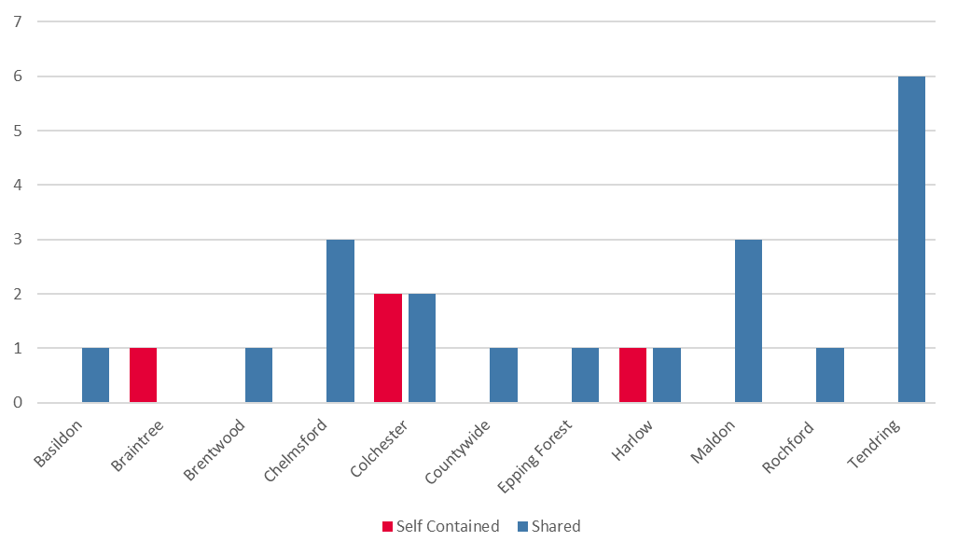
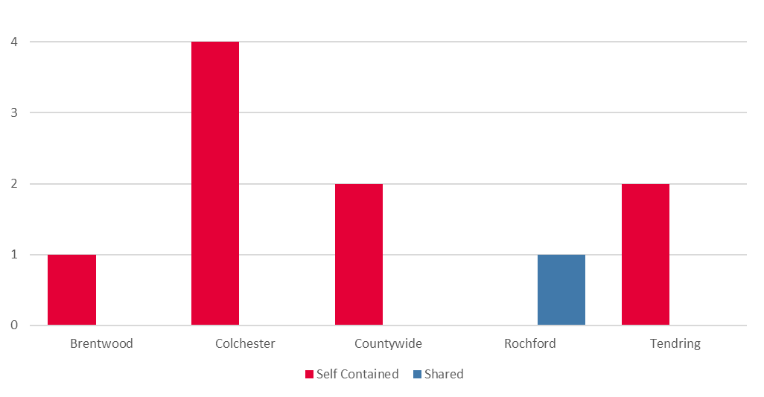
Adults with no option identified (LDA)
Non-complex
Headlines
33 LDA in Essex have no accommodation option identified
Colchester and Tendring (16 adults) are the area with most demand
For adults with non-complex needs, 83% of the un-met demand is for shared accommodation, primarily in Tendering, Chelmsford and Maldon
For adults with complex needs, there is a lack of self-contained accommodation
Complex

Slide 7
Physical and/or Sensory Impairment (PSI) Demand

Slide 8
Demand by District (PSI)
Headlines
Total PSI demand is 6, which is 2 less than at for the last report
None of the adults have got an identified option
Most of the adults have non-complex needs
There is a 50/50 split between shared and self-contained accommodation requierments

Slide 9
Development Pipeline

Slide 10
Developments
If you are looking to develop services in Essex to meet any of the needs outlined within this report please get in touch with ECC directly using the below email address, and ECC colleagues will arrange a discussion with you on your proposals.
It is important that any discussion around new services is in advance of any work commencing to develop the proposed services.
Please contact specialist.accomm@essex.gov.uk to discuss proposals.

