Slide 1
Local Government Reorganisation:
Building a Stronger Greater Essex
Provider Forum

Slide 2
A reminder… local government in Essex is changing
What is devolution?
What is LGR?
The decentralisation of powers, decision making and funding away from central Government to local democratically elected and accountable bodies elsewhere in England.
In Greater Essex, this will lead to the creation of a new single strategic authority for Essex. It will initially take the form of a combined county authority (of which ECC, Southend and Thurrock will be members). A mayoral combined county authority (MCCA) will follow in May 2026 when we expect a new mayor for Greater Essex will be directly elected by the public.
Local Government Reorganisation (LGR) refers to the process of restructuring local councils, typically involving replacing existing two-tier (county and district) structures and or merging smaller existing unitary authorities into larger new single tier “unitary” authorities.
In Greater Essex, proposals are still being developed but, if agreed by government, would see all 15 principal councils replaced with a yet to be agreed number of new unitary councils from April 2028.

Slide 3
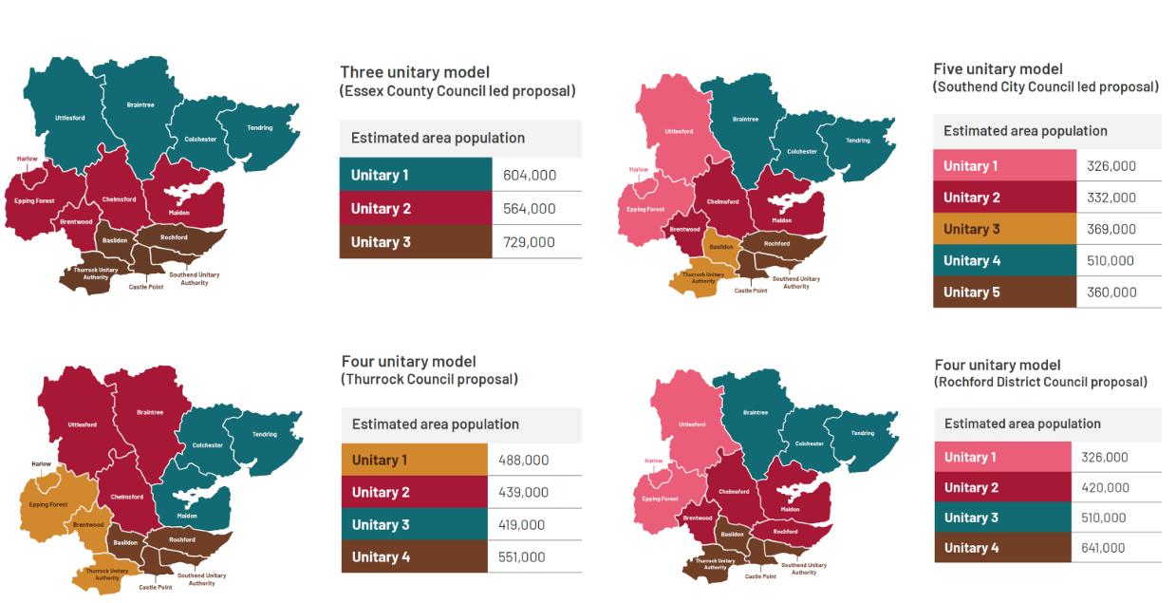
Local Government Reorganisation Four business case options from Greater Essex

Slide 4
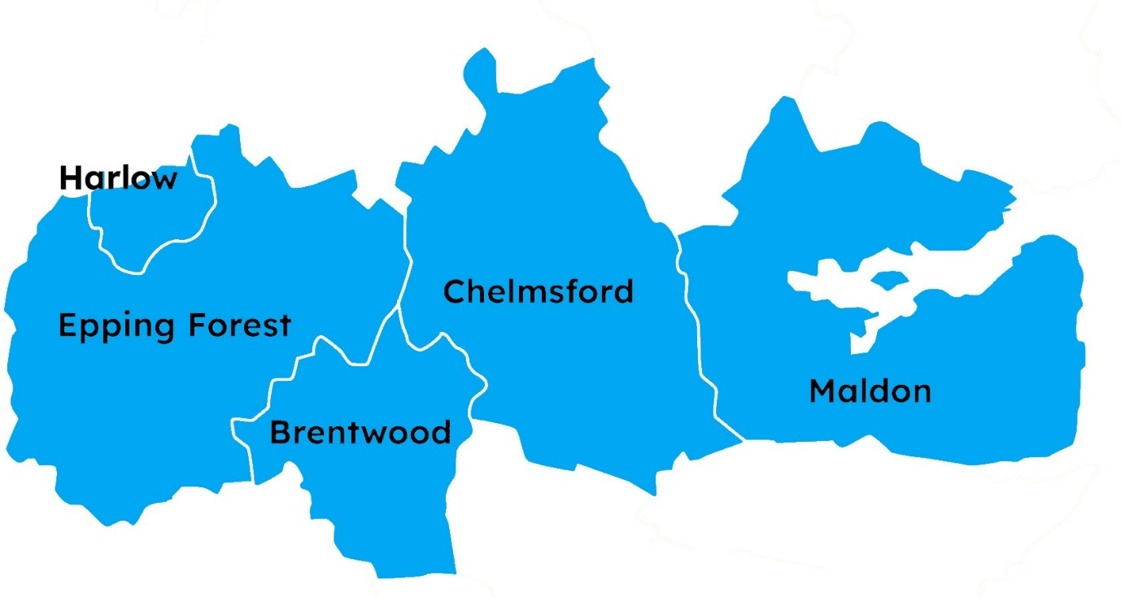
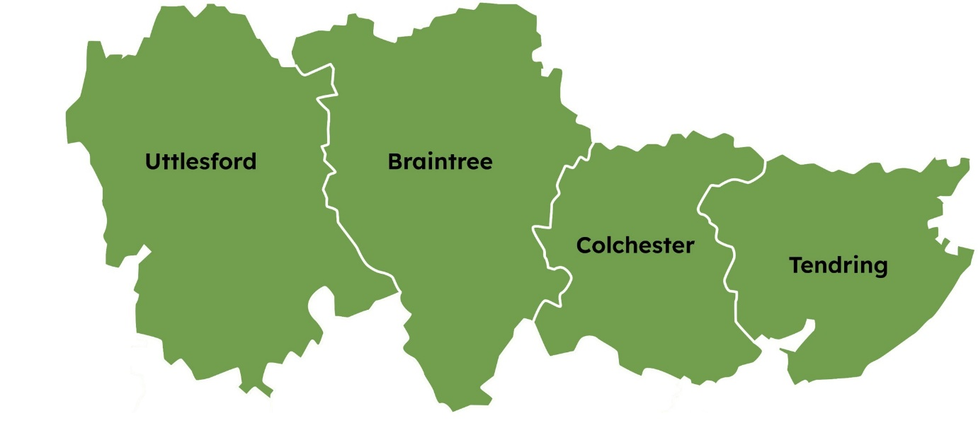

Essex County Council’s proposal:
Three New Councils for Greater Essex
North Essex Unitary
Mid Essex Unitary
South Essex Unitary
Geography: Brentwood, Chelmsford, Epping Forest, Harlow, and Maldon.
Population: 564,000; projected 4% growth by 2040
Economy: £17.6bn GVA; 259,000 jobs.
Transport links: A12 and M11 corridors and Great Eastern Main Line.
Sector strengths: Life sciences, professional & financial services, construction, digital technology.
Key growth sites: Chelmsford Garden Community, Harlow Gilston Garden Town, Dunton Hills Garden Village.
Additional homes needed by 2040: 67,000
Geography: Basildon, Castle Point, Rochford, Southend, and Thurrock.
Population: 729,000; projected 10% growth by 2040
Economy: £19.1bn GVA; 317,000 jobs.
Transport links: Thames Freeport, Southend Airport, A127, the A13 and the Essex Thameside rail corridor.
Sector strengths: Logistics, construction, clean energy, advanced manufacturing.
Key growth sites: cross-boundary linkages with Dunton Hills Garden Village and other opportunities being explored.
Additional homes needed by 2040: 77,000
Geography: Braintree, Colchester, Tendring, and Uttlesford.
Population: 604,000; projected 10% growth by 2040
Economy: £14.2bn GVA; 249,000 jobs.
Transport links: A120, A12, Stansted Airport, Harwich Port.
Sector strengths: clean energy, life sciences, digital tech, manufacturing, logistics, tourism.
Key growth sites: Tendring-Colchester Garden Community
Additional homes needed by 2040: 64,000

Slide 5
Local Government Reorganisation Why Three Unitary Councils?
Aligned to real economic geographies (North, Mid, South Essex)
Balanced size, strength & resilience
£387m savings by 2040 – payback in 2.7 years
Less disruption, lower risk, quicker transition
Any more than three unitaries…
Higher costs, diluted capacity
More complexity, slower growth
Mayor works with a fragmented, unstable system

Slide 6
Local Government Reorganisation Why Three Unitary Councils – From an Adult Social Care Lens
The proposed three unitary model creates new authorities of sufficient scale to be strategically and financially sustainable, while improving local responsiveness and democratic accountability.
It offers the best platform for the future of people services across these key dimensions:
The benefit of both scale and localism to optimise outcomes
Fair and balanced starting points for all new councils
Capacity to invest in prevention, innovation and social work practice
Simplification and better alignment with partners
Collaboration to retain the benefits of scale where it matters

Slide 7
High-level timelines (LGR & Devolution)
Local Government Reorganisation | Date | Devolution | Date
Submission of formal unitary proposals submitted | 26 September 2025 | Final Greater Essex proposals submitted to Government | September 2025
Statutory consultation on Governments preferred option | November 2025 – January 2026 | Legislation laid before parliament | Autumn 2025
Government decision to implement a proposal | March 2026 | Parliamentary scrutiny and approval | Late 2025
New Unitary Authority Elections | 6th May 2027 | Legal establishment of Greater Essex MCCA | Early 2026
Shadow period | May 2027 – March 2028 | Mayoral Election | May 2026
New Unitary Authorities go live | 1 April 2028

Slide 8
Local Government Reorganisation Find out more…
Explore the published proposal submissions, including executive summaries, on the Greater Essex Local Government Reorganisation Hub. The hub also provides latest information, news, and answers to frequently asked questions about the reorganisation process.
Your questions and feedback are welcomed as we continue to shape this future of Greater Essex.
We are currently developing a Provider FAQ to support you and ensure your voices are heard during this LGR process. While we may not have all the answers right now, your input is invaluable in helping us shape the support and information we provide.
In the first instance please share your questions, thoughts, and feedback to:
ECC Service Improvement and Assurance Team
SIA@essex.gov.uk

