Slide 1
Preparing to Bid: Social Value
Emma Woof – Procurement Manager Social Value

Slide 2
Social Value for Essex County Council
Social Value included in Procurements over £100K (ECC)
Social Value up to 20% of the evaluation
Quantitative + Qualitative evaluation of Social Value
Social Value priorities based on Everyone's Essex Strategy
Local additional benefits for Essex residents, businesses and communities in every £1 spent
Notes:
Social Value included in Procurements over £100K (ECC).
Social Value up to 20% of the evaluation
Social Value priorities based on Everyone's Essex Strategy
National Social Value Taskforce ‘TOMs’
Units of measure and financial proxies - assigns an economic value to each type of social value
Tailored to Essex Priorities

Slide 3
Steps to maximize
Social Value opportunities
Procurement Services Realising Essex's potential through our suppliers

Slide 4
Steps to maximize social value opportunities
Identify your social value strengths
Understand buyer’s social value ASK
Design your social value offer

Slide 5
1st Step: Identify your Social Value strengths
Before looking for tenders, prepare yourself.
How does your business impact local wellbeing? Social, economic, environmental?
What is part of your organisation DNA? Do you already have some social responsibility / sustainability practices in place?
How many of your workforce live locally?
How much of your supply chain is with local suppliers?
How many volunteers are you engaging?
Are you engaged with local community projects / local schools and colleges?
How could you introduce climate and environmental initiatives?
Are you already communicating it to the market and local community?
Do you showcase what you are doing?
Do you communicate using some social value narrative / measures / metrics?
Could this contract provide an opportunity to offer more social value?....
Notes:
You are probably adding value to the place you operate and surrounding communities already. Look at your own business attributes, the way your organisation operates, your goods and services:

Slide 6
2nd Step: understand buyer’s Social Value ASK
While choosing a public contract to bid for, it is important to investigate what buyers are asking for in terms of Social Value. It varies among Public Authorities and between contracts.
Look at the buyer general guidance and information regarding Social Value. They are in the format of SV Statements, SV ASKs, SV Policies, Procurement Policies and/or SV Calculators
Understand councils ‘local needs’ to identify specific priorities in your area and how your offer could address them
Look at tender documentation, every contract will have specific application of buyers’ general guidance.
Ask for clarification in case you haven’t understood any aspect of tender documentation. Public organisations expect to receive clarification questions. Questions and answers get published to everyone
Attend ‘Meet the Buyers’ events, where applicable, to understand further buyer requests
Ensure you understand the social value methodology, the quantitative and qualitative criteria, units and metrics of measurement

Slide 7
3rd Step: design your SV offer
Now that you know your strengths and what the buyer is looking for, it is time to design your social value offer following the ‘tender language’.
Every social value offer is a commitment you make upfront.
Take time to develop your social value offer.
Prioritize the social value practices that are already part of your organisation’s strengths
It must be proportional and relevant to the contract matter. It means you will select social value practices and amounts that are contract specific (quantity in units, hours, £ invested, headcount, Full-time equivalent/FTE). It is not your full corporate social responsibility or sustainability practices.
You must be able to deliver your social value commitments – these will form part of the contract.
Partnerships with local organisations can help you plan and deliver your social value offers

Slide 8
Consider the nature of the contract requirement and look at the organisational processes / resources that would be allocated in order to deliver the service / goods in the specification:
Would you need to hire workforce in order to deliver this contract?
Could they be local or from specific cohorts?
Would you need to train/upskill the allocated workforce to contract delivery?
Who are the suppliers you would assign in order to deliver this contract? Are they local? Could they be local?
Is it relevant to this contract to allocate time and investment of your volunteering/ engagement practices with the community – schools - colleges? How much would be relevant for this contract?
Ensure your social value offer follows the correct metrics of buyers’ social value methodology
Ensure you are able to demonstrate to buyer that you have the capacity and capability to deliver the social value commitments you are offering. Include evidence and explain how you are proposing to deliver
Social value commitments are part of the contract, plan in advance how you would monitor your social value delivery and communicate to buyer

Slide 9
For all the ECC measures bidders are advised to:
Include only Social Value that will have a “Local” impact (within the boundaries of Essex County Council)
– any social value offer that does not deliver benefits to the “local” area will be excluded.
Notes:
Out of the ECC TOMs – many include a specific local focus. Local businesses and SME's should be at an advantage in terms of what they can offer at this local level. Local knowledge can be used to provide strong commitments for local jobs, training, skills, apprenticeships etc.
Highlighting the ECC TOMs which have a local aspect should reassure bidders
Also important to remember that Social Value bids need to be relevant and proportionate to the contract size – not the organisation's size.

Slide 10
Social Value Opportunities for local, small businesses and Voluntary, Community and Social Enterprises
They are often integrated in the communities and understand local demands
They are often delivering social value already, such as employing local people, carrying out school visits or using local suppliers
There are advantages over some larger companies due to its level of commitment to the local community
VCSEs are likely to be locally based and have clear purposes based on social, economic and environmental wellbeing
“These things do not cost us more - it’s just about the way in which we do our normal business, but better.”
Notes:
Out of the ECC TOMs – many include a specific local focus. Local businesses and SME's should be at an advantage in terms of what they can offer at this local level. Local knowledge can be used to provide strong commitments for local jobs, training, skills, apprenticeships etc.
Highlighting the ECC TOMs which have a local aspect should reassure bidders
Also important to remember that Social Value bids need to be relevant and proportionate to the contract size – not the organisation's size.

Slide 11
Essex County Council Social Value methodology
Procurement Services Realising Essex's potential through our suppliers

Slide 12
ECC Approach to Social Value
Essex County Council has adopted the Local Government Association’s National Social Value Taskforce National Themes, Outcomes and Measures’ (‘National TOMs’) method of classifying and evaluating Social Value, adapted to the County’s context and priorities, based on the ECC Corporate Strategy 'Everyone's Essex’
Social Value is given a weighting and evaluated in two parts, which, when combined result in one overall Social Value score:
1. Value Score (calculated using the ECC TOMs Calculator)
2. Supporting Statement Score
Value Score (out of 5)
Supporting Statement
Score (0-1)
Overall Social Value Score
(out of 5)
Notes:
Essex County Council has adopted the Local Government Association’s National Social Value Taskforce National Themes, Outcomes and Measures’ (‘National TOMs’) method of classifying and evaluating Social Value, adapted to the County’s context and priorities, based on the ECC Corporate Strategy 'Everyone's Essex’
Social Value is given a weighting and evaluated in two parts, which, when combined result in one overall Social Value score:
1. Value Score (calculated using the ECC TOMs Calculator)
2. Supporting Statement Score

Slide 13
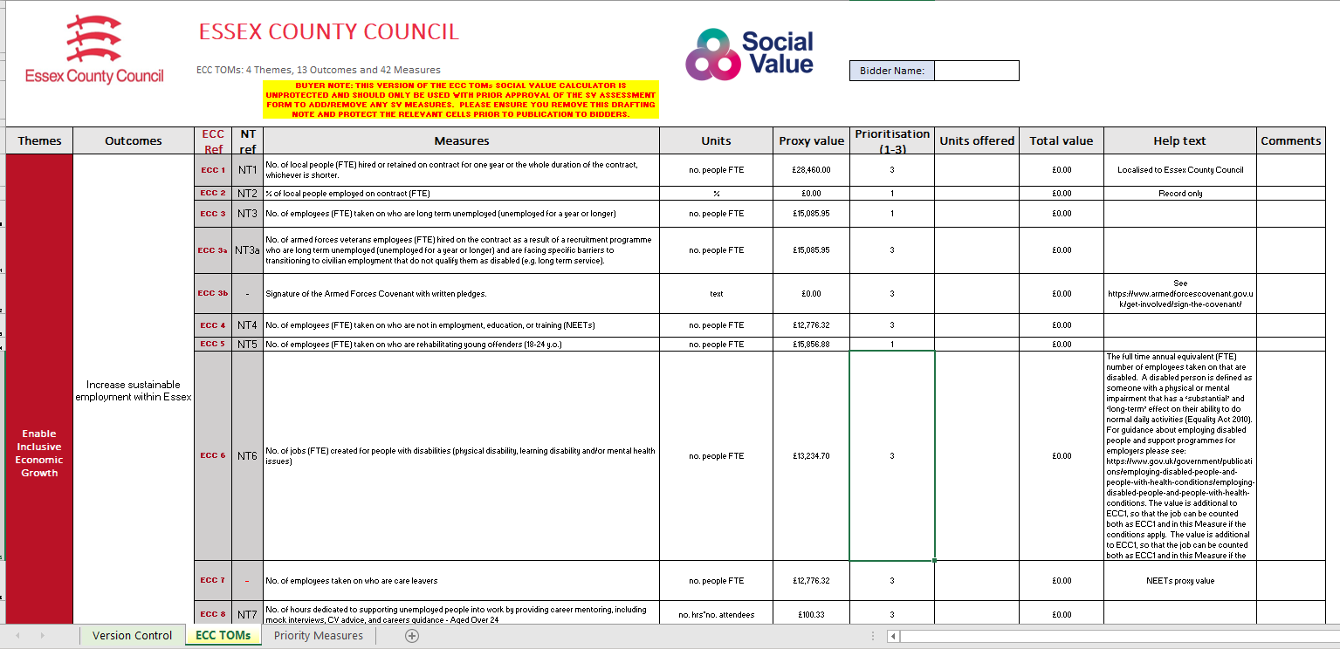
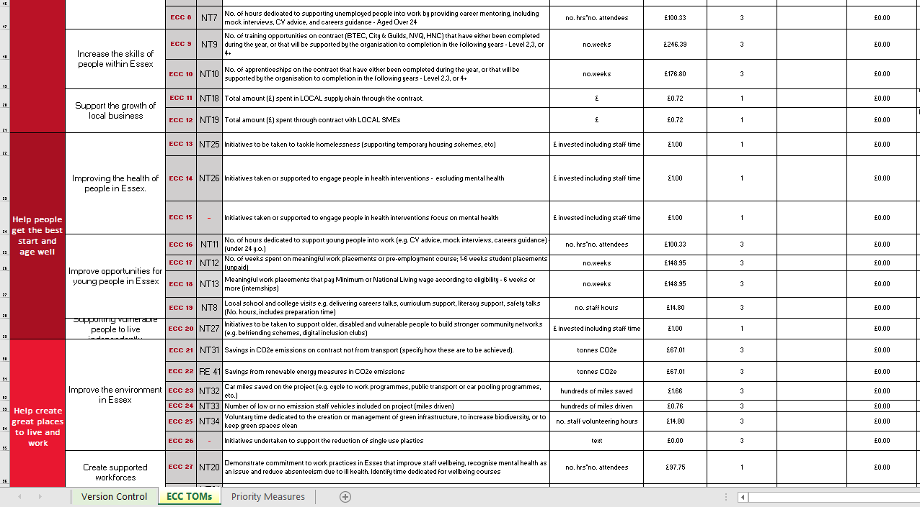
Notes:
A set of Social Value 'Themes and Outcomes'
A set of Units of Measure for each of the Outcomes:
These Units of Measure are used to compare bids on a like for like basis. They are set out as a description (the Measure) and a metric (the Unit).
They also enable us to collate the total benefits delivered by vendors to Essex communities and provide a consistent method of performance management reporting.
A set of Financial Proxies:
Each Unit of Measure is assigned a financial value. This enables us to calculate the total economic value of contributions that organisations offer.
Priority Weightings:
This is a weighting system that enables ECC to ensure its scoring system aligns to the agreed ECC Social Value Priority Measures.
A factor of 1 to 3 is applied to the Units of Measure that are listed as an ECC Social Value Priority.
When Total Social Value bid is calculated, the corresponding Financial Proxy is multiplied by the weighting before the total 'Value' score is calculated.
When ECC staff measure and report the social value delivered, they will not use the multiplier.

Slide 14
Bidder’s Guidance
1. Value Question
How to complete the ECC TOMs Calculator
Important requirements to consider when making your offer
Evaluation Criteria
How the Score is calculated
2. Supporting Statement
Supporting Statement Question
What is required
Standard Evaluation Criteria
How the Supporting Statement Score is calculated
3. Overall Social Value Score
Notes:
The Bidder’s Guidance gives bidders all of the information they will need to understand the ECC approach to Social Value, and provides transparency on our evaluation process
1. Value Question
How to complete the ECC TOMs Calculator
Important requirements to consider when making your offer
Evaluation Criteria
How the Score is calculated
2. Supporting Statement
Supporting Statement Question
What is required
Standard Evaluation Criteria
How the Supporting Statement Score is calculated
3. Overall Social Value Score

Slide 15
The Value Score
Value Score | How the Value Score is allocated | Value based on Social Value Target 50p for every £1
5 | Social Value meets Target | 50p or over per £1 bid
4 | Social Value Ratio lower than Target by 1-24% | Over 37p up to 49p of Social Value per £1 bid
3 | Social Value Ratio lower than Target by 25-49% | Over 25p up to 37p of Social Value per £1 bid
2 | Social Value Ratio lower than Target by 50-74% | Over 13p up to 25p of Social Value per £1 bid
1 | Social Value Ratio lower than Target by > 75% | Over 1p up to 13p of Social Value per £1 bid
0 | No Social Value bid | Less than 1p of Social Value per £1 bid
Social Value Bid
∑ (Units bid x Financial Proxy x Multiplier)
Social Value Ratio
Social Value Bid
Tendered Price
Value Score
allocated based on Social Value Target (0-5)
Notes:
Using the ECC TOMs Calculator
We’ve verified the submission, considered all of the units offered in terms of relevance and proportionality to the contract.
We take the total ‘proxy’ value of Social Value offered
And we take the tendered price to calculate the Social Value Ratio
Then we consider the target that we are trying to achieve.
The default target is that we want to achieve 50p Social Value in every £1 spend
We’ve created a scoring methodology based on this target….
When the Social Value Ratio shows that 50p or more for every £1 of the contract value will be additional Social Value bidders score 5/5 on their Value score.
This reduces proportionately as the Social Value offered moves further below our target.
Without wanting to confuse things …. Just a point to note – if you are reducing the measures that you are including n the ECC TOMs or if you are including all of the measures and there is an opportunity in a particular market to achieve more than 50p in every £1 spent, then the target may changed – evidenced through the SVAF and with input from colleagues to develop the rationale.

Slide 16
The Supporting Statement Score
Score | Rationale
1 | Outstanding – The Supporting Statement fully addresses the Social Value commitments and specified criteria and provides relevant evidence regarding competence, capacity, and ability to successfully fulfil the delivery of the Social Value Bid and goes beyond expectations to offer an outstanding level of performance or an additional benefit which exceeds specified measures.
0.8 | Highly Acceptable – The Supporting Statement fully addresses the Social Value commitments and specified criteria and provides relevant evidence regarding competence, capacity, and ability to successfully fulfil the delivery of the Social Value Bid.
0.6 | Acceptable – The Supporting Statement addresses most of the Social Value commitments and specified criteria, but some areas contain limited relevant evidence regarding competence, capacity, and ability to successfully fulfil the delivery of the Social Value Bid.
0.4 | Partially Acceptable – The Supporting Statement covers more than one element of the Social Value commitments and specified criteria but lacks relevant evidence regarding competence, capacity, and ability to successfully fulfil the delivery of the Social Value Bid.
0.2 | Unsatisfactory – The Supporting Statement only covers a minor element of the Social Value commitments and specified criteria and lacks relevant evidence regarding competence, capacity, and ability to successfully fulfil the delivery of the Social Value Bid.
0 | Wholly Unsatisfactory – No Supporting Statement or the whole response is irrelevant to all the Social Value commitments and specified criteria.
Supporting Statement
assessed
Supporting Statement specified criteria
Supporting Statement Score
(0-1)

Slide 17
Key tips
Read the question carefully
Look at your strengths – how can you break this down for this contract?
Ask clarification questions
Don’t overpromise – this will be part of the contract

Slide 18
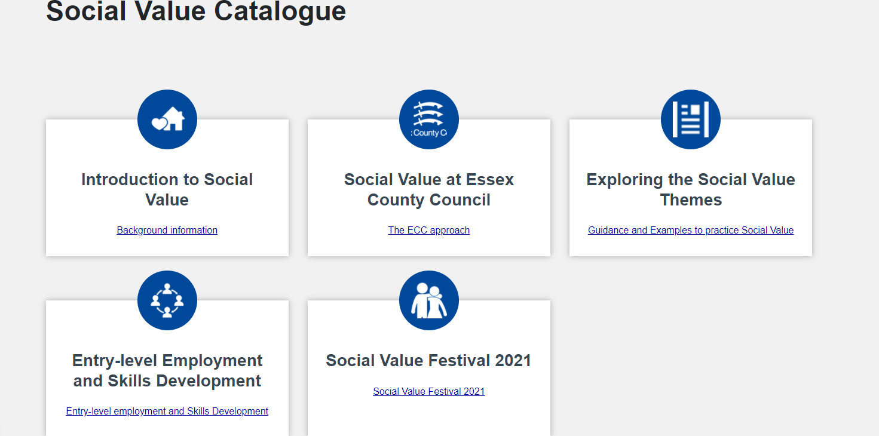
Social Value Catalogue Social Value Catalogue | Provider Hub | Essex (essexproviderhub.org)

Slide 19
Useful Resources / Articles
Social Value Catalogue | Provider Hub | Essex (essexproviderhub.org)
https://www.ukbidwriter.com/2016/09/what-is-social-value-and-how-can-it-give-smaller-companies-the-edge-when-tendering/
https://www.gov.uk/government/publications/small-and-medium-enterprises-home-office-actions-and-case-studies
https://socialvalueportal.com/wp-content/uploads/2020/07/Social-Value-Easy-Guide_For-SME-VCSE_July-2020-1.pdf
https://socialvalueportal.com/wp-content/uploads/2020/07/Social-Value-Easy-Guide_For-SME-VCSE_July-2020-1.pdf

Slide 20
Thank you for attending Day 2 of the Social Value Festival
Go back to the ticket page to bookmark other sessions
See too our Social Value Catalogue
Follow #EssexSocialValue

