Slide 1
Total Facilities Management Bidder Day 2
Presented by Elliot Smith – Head of Infrastructure Delivery

Slide 2
Introductions
ECC Team in Attendance
Elliot Smith – Head of Infrastructure Delivery
Lisa Freshwater – Facilities Manager
Cheryl Collins – Property and Facilities Officer
Catherine Martin – Procurement Specialist
Celine Couston – Procurement Manager
Natalia Rygal – Procurement Officer

Slide 3
Agenda
1
4
Welcome and Introductions
Negotiation Process
2
5
Portfolio Overview
Site Visit Briefing and Close
3
Procurement Process and Submission Guidance

Slide 4
Time | Activity | Notes
09:25 – 10:10 | Welcome and Introductions | Approx. 45 minutes
10:10-10:15 | Short Break | Approx. 5 minutes
10:15 – 11:55 | Site visit around County Hall | Approx. 1 hr 40 minutes
11:55 – 12:15 | Travel to Essex Records Office
12:15 – 12:45 | Essex Records Office visit | Approx. 25 minutes
12:45 – 14:15 | Travel to Cressing Temple & Lunch (not provided) | 1.5 allocated
14:15 – 14:45 | Cressing Temple visit | Approx. 30 minutes
14:45 – 15:10 | Travel to Freebourne's | Approx. 25 minutes
15:10 – 15:40 | Freebourne's Visit | Approx. 30 minutes
15:40 | End of day
Housekeeping
All bidders and ECC representatives will remain together throughout the day
Questions may be asked throughout the duration of the day – note that answers will be circulated to all bidders
Approximate timings are included on the agenda
Previous Market Engagement resources are available
Today's resources and Q&A will be circulated after the event
ECC representatives are available throughout the day

Slide 5




Portfolio Overview
1352 Assets make up the Essex County Council Estate, 327 Sites in scope of this Contract
Sites in scope include 74 Libraries, 18 Youth Centres, 8 Country Parks, 5 Outdoor education centres, 8 Category 1 hub sites, 25 Waste sites, 3 Park and Ride Sites, 7 Heritage Sites
The rest of the portfolio is made up of family centres, adult care, travellers' sites, highway depots, agricultural estate, residential properties etc
We believe today’s selected sites showcase the breadth and diversity of our portfolio

Slide 6
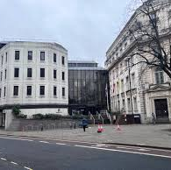
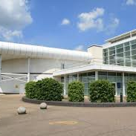
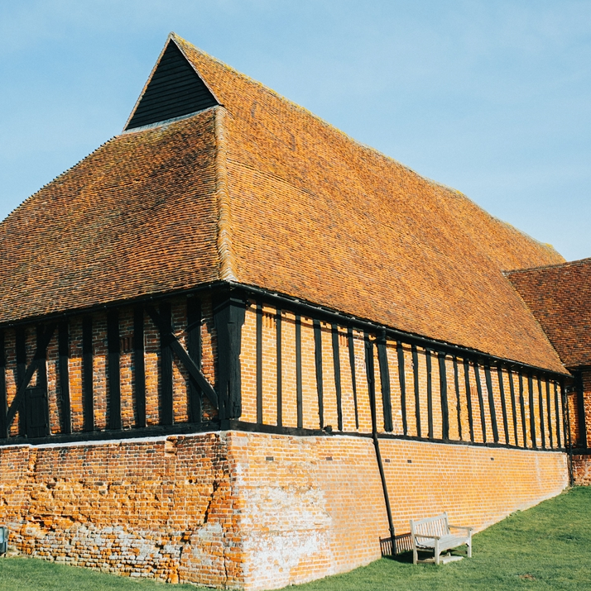
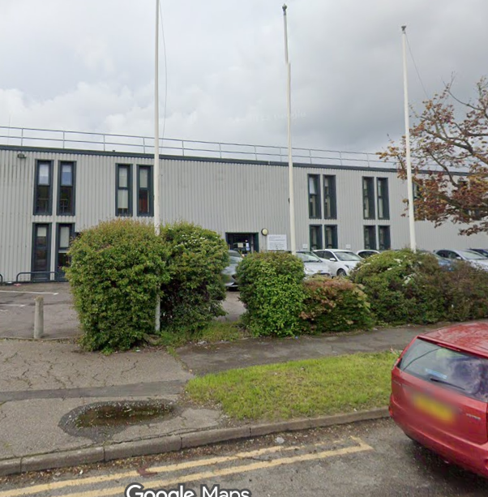
Overview of Today's Sites
County Hall
Key heritage site, including Grade II listed Blocks C and D
Our largest Site with the heaviest footfall and largest volume of maintained Assets
Essex Record Office
Purpose‑built archive with specialist conservation facilities
Heavy investment; Undergoing Salix‑funded decarbonisation
Cressing Temple Barns
Home to Grade I listed, world‑renowned timber‑framed barns, with restrictions around maintenance
Key heritage site with active conservation and public access
Freebournes
A currently unused operational building
Opportunity to assess repurposing the use of this building as part of the new Contract

Slide 7




Other Sites to Note
Essex Outdoors Centres
Extensive external grounds
Specialist facilities and equipment requiring maintenance
Waste Transfer Stations
The sites support critical waste disposal infrastructure cross county
Sites have specialist systems such as dust suppression and enhanced fire prevention
Libraries
Many are aging assets
Public-facing nature meaning deterioration can directly affect service delivery
Park and Ride Sites
Essential FM services (maintenance, security, and compliance) are required to keep these sites operational
Minimise public transport disruptions

Slide 8
Procurement Process
Presented by Celine Couston – Procurement Manager

Slide 9
Tender Timeline Overview
Stage 1: PSQ Complete
Stage 2: ISIT Underway February – May 2026
Stage 3: Negotiation June 2026
Stage 4: BAFO June-August 2026
Contract Award October-November 2026

Slide 10
Current Stage: Stage 2 - ISIT
Clarifications
Deadline 17th March
Submit as early as possible via the Open system messaging facility
Initial Tender Submission
Deadline 16th April
Intermediate Assessment
April-May 2026
No deselection past this stage
Double check formatting prior to submission
Option to award prior to negotiation
Note: Log will go out EOD daily if any updates
Docs updated and circulated every week either Monday or Friday as required
Notes:
Celine: reinforce importance of adhering to timeline

Slide 11
Submission Guidance
Tips
Pitfalls
We kindly encourage Bidders to follow the structure of the evaluation criteria when preparing their response. Although not compulsory, this can support a smoother and more efficient evaluation process.
Please ensure any graphics used are not in a way to embed significant amounts of text in very small fonts.
Submissions should use standard Word margins. Content placed outside these margins cannot be considered as part of the evaluation.
Although, last minute submissions may leave no time to confirm your documents uploaded correctly.
Avoid submitting too close to the deadline - the system runs automatic virus checks, and large files take longer to process. You are able to still submit responses while virus checks are pending.

Slide 12
Negotiation Process
Catherine Martin - Procurement Specialist

Slide 13
Negotiation Process Overview
Purpose
Explore areas where value can be added and/or costs reduced
Expectations
Bidders to provide clear, detailed rationale for each negotiation point
All points may not be negotiated
Our Position
We reserve the right to award based on initial submissions

Slide 14
Negotiation Meetings & Limitations
Meeting Structure
Same standard agenda issued 2 weeks prior
Please ensure availability between 08/06 - 26/06
No changes will be made for individual bidders, they will be made across the board
Meeting dates and times will be shared with all bidders
Limitations
Certain areas cannot be negotiated due to policy, statutory or structural constraints
We can only negotiate on areas identified on the agenda
Value Added
To be demonstrated via: Cost savings, Operational efficiencies, Risk reduction, Improved clarity or deliverability

Slide 15
Site Visit Briefing
Refer to Information Sheet – timings, site addresses, parking information, contact number
Single Group Format - we will ensure everyone is present before beginning the visit at each site
Questions may be asked throughout the duration of the day – note that answers will be circulated to all bidders

Slide 16
Short Break
Time | Activity | Notes
09:25 – 10:10 | Welcome and Introductions | Approx. 45 minutes
10:10-10:15 | Short Break | Approx. 5 minutes
10:15 – 11:55 | Site visit around County Hall | Approx. 1 hr 40 minutes
11:55 – 12:15 | Travel to Essex Records Office
12:15 – 12:45 | Essex Records Office visit | Approx. 25 minutes
12:45 – 14:15 | Travel to Cressing Temple & Lunch (not provided) | 1.5 allocated
14:15 – 14:45 | Cressing Temple visit | Approx. 30 minutes
14:45 – 15:10 | Travel to Freebourne's | Approx. 25 minutes
15:10 – 15:40 | Freebourne's Visit | Approx. 30 minutes
15:40 | End of day

