Slide 1
LDA Complex Residential Framework
Procurement Services
Realising Essex's potential through our suppliers

Slide 2
Summary
ECC worked on a proposal for a new framework for all complex residential placements to be made.
This engagement event is for the Re-Opening of the framework, as we launched the tender last summer for the framework.
Event items being presented are;-
Overview
Scope of Framework
Procurement Process & Platform
Placement Process
Development
Timescales
Questions

Slide 3



Overview
ECC are proposing to Re-Open and procure a new framework for all complex residential placements to be made through in the future
The strategic direction of ECC is to utilise residential care only for adults with the most complex needs
Because the strategic direction for ECC is clear, rather than building a framework for the entire residential market we want to focus attention on the areas that align with this, and which you currently provide in Essex

Slide 4
What we want to achieve
To shape the market in Essex to more closely match our future direction
To reduce the number of out of county placements and keep people closer to home whilst developing a prosperous local market for providers
To put the adult at the centre of a transparent placement process
To only use residential services for those adults that really need it and to maximise the use of more independent settings for everyone else
To support adults to move on from residential services when they are ready to
The framework we are proposing is a tool to help us achieve the aims we have set out and which have mutual benefit for both ECC and the market

Slide 5
Scope of Framework
This framework has been designed for providers that care for adults with very complex needs, and only adults that have been identified by Essex County Council as meeting our complexity criteria will be referred to providers under this framework.
Only providers that meet our criteria for delivery of complex services will be admitted to the framework and will receive referrals of adults that are subsequently defined as complex.
The definition ECC use for complexity can be found here [ins. Link] and example case studies of adults that would fit this criteria can be viewed here [ins. link]
Providers who join the framework will transfer their existing schemes over to the new terms and conditions of contract and specifications.

Slide 6
Procurement Process
Process
The contract will be procured through an open tender process, allowing any provider to submit a response.
At the time of tender providers will be asked to provide:
Full cost breakdowns and details of all residential homes proposed to be brought forward to the framework
A written response to tender questions designed to assure the quality of providers on our framework
Providers do not need to have existing residential homes within Essex in order to bid on the framework, and new services can be developed once a place is secured on the framework.
There will be no limit to the number of providers that can on the framework.
Costs
Cost breakdowns submitted will be benchmarked against Care Cubed and other residential services commissioned by ECC.
Costs submitted at the time of tender will be used by ECC to rank homes in order of cost and quality, and this is utilised to narrow down options in scenarios where an adult has multiple homes identified as suitable.
Where rates exceed the benchmark, this will be flagged on our framework and rates will be negotiated with the provider prior to any placements being made at that home. The Council will reserve the right not to place at any home where costs cannot be reasonably justified or are excessive, irrespective of their place on the framework.

Slide 7

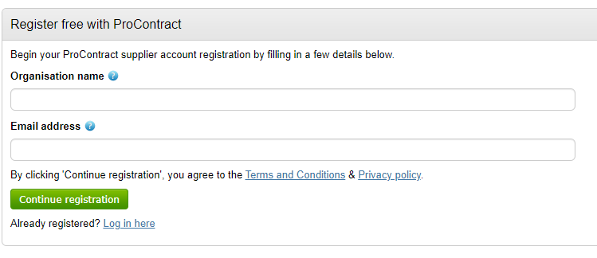
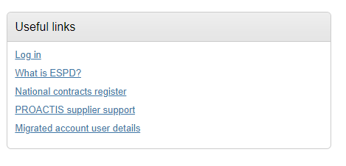
Procurement Platform
To access the bid, registration for the system will be required
https://procontract.due-north.com/Register

Slide 8
Placement Process

Slide 9
Placement Process
The placement process will be outlined in full within the tender documentation but will follow a number of principles.
  ECC will utilise a matching tool which will rule out homes that are not suitable for an adult based on defined criteria (e.g. location, type of accommodation)
  All remaining homes will be invited to express an interest in the package based on the ISP and service specification for the adult.
  Of all homes that have expressed interest, ECC will then narrow the homes to a maximum of three based on the cost and quality score awarded at the time of tender.
  The homes selected will formally assess the adult and detail how they will meet their needs.
  Each assessment will be reviewed by ECC and scored based on set criteria as to what offers the best fit for the adult.
  The cost of the proposed package will be taken into account to give a final cost/quality score to each home. The best scoring home will be selected for the placement. Cost will account for 30% of the score, with quality consideration making up the remaining 70%.

Slide 10
Placement Process
The most suitable placement will be identified based on the assessment by ECC of the provider assessment and how it will meet the adult’s needs.
Each provider assessment will be scored in line with defined criteria and this score will then be added to the score awarded for the cost of the package proposed. The provider and home with the highest score across both elements will be selected as the most suitable placement by ECC.
Providers will be expected to use their own assessment templates to consider whether they are able to meet the needs of the adult referred to them.
The proposed evaluation criteria to be used by ECC to assess the most suitable placement is listed to the left below, with the scoring for each element to the right:
Criteria 1 | Hours proposed within the package are proportionate and suitable for the adult based on their needs, with appropriate levels of core and 1:1 hours available
Criteria 2 | How the home will provide (or be adapted to provide) an appropriate, safe environment for the adult and how this will meet the needs of the adult based on the physical environment and available facilities
Criteria 3 | How compatibility with other residents has been considered and any identified risks will be mitigated by the provider to ensure a safe and suitable environment for all adults
Criteria 4 | What realistic and appropriate outcomes and goals will be set out for the adult and what is the proposed plan for their attainment
3 | Provider assessment addresses this fully and there are no doubts regarding the suitability or delivery of services.
2 | Provider assessment addresses this, but there are minor doubts regarding the suitability or delivery of the services.
1 | Provider assessment partially addresses this but there are major doubts regarding the suitability or delivery of the services.
0 | Provider assessment does not address this.
Providers will need to ensure they are covering these elements within their assessments because these will be what we are looking for and scoring when assessing where the most suitable accommodation may be.

Slide 11
Open Sourcing Process
An open sourcing process can be used by ECC in a number of different scenarios including but not limited to:
  There is no current accommodation that is suitable on the framework
  The adult(s) require a very bespoke environment and care package
  There are multiple adults to be placed at the same time and in the same home
  A placement is needed urgently and the standard placement process will not be suitable
The benefit of operating an open sourcing process under the framework would be that it goes only to those providers who are already on the framework and who are quality assured.

Slide 12
Development
One of the key drivers behind the framework is to expand the capacity of complex residential services in Essex. Providers who have met all of the relevant quality criteria and have a place on the framework are encouraged to develop new services throughout the term of the framework.
Published criteria will be included with the tender but will take account of the differing models of residential care for complex adults and the differences between every individual adult.
All new residential homes will need approval from ECC via the Accommodation Planning Board as a condition of it being admitted to our framework for placements to commence.

Slide 13
Timescales
Governance approval | July 2023
Release of tender | Week Commencing 17th July
Date for return of submissions | 28th August
Evaluation period completed | December 2023
Start of framework | January 2024

Slide 14

Questions

