Slide 1

UCRS
Kelly Carrington Matron
Paula Townes ACP
Tuwani Maara ACP

Slide 2
Introduction to servcie
Urgent Community Response
The aim is to deliver a 2-hour rapid response service 24 hours a day, 7 days a week, 365 days a year, delivering treatment to patients in their own home rather than conveying and admitting to hospital. A centralised team of Clinicians will provide the rapid 2-hour response to treat any immediate health concerns and deliver a holistic review of the patient that considers social care and localised community sector offers. Utilising current admission avoidance services to coordinate a rapid response that provides the appropriate treatment and referral into appropriate reablement care within two days of referral.

Slide 3
Introduction to servcie
The service is designed to successfully deliver a 24/7 rapid response crisis service, whilst providing a 2-hour response time via a single point of contact. To deliver the 24/7 service, the core team will be supported by existing Admission Avoidance resource such as Community Nursing, End of Life and Community Mental health services. The service will essentially run in an Alliance model and will accept inward referrals by any Health or Social Care professional, but mainly expect referrals to be received from GP’s, IRAS and EEAST initially. The Initial assessment will be completed within two hours with immediate health and care interventions provided to avoid potential hospital admission. High priority referrals will be sent to a potential range of Alliance providers to undertake the necessary interventions.
This Standard identifies nine areas that fall within the 0-year plan, led to the introduction the two-hour response criteria. NHS England 2021

Slide 4
The Nine domains:
FALLS - A fall with no apparent serious injury but requiring assessment to prevent further risks to patient.
Frailty-Related Decompensation - A sudden deterioration in a frailty-related condition resulting in reduced strength, independence, or activity.
Reduced Function/Mobility -A rapid decline in mobility or function creating an acute need for intervention to avoid admission. Provision of equipment ? Care urgently to assist patients to remain at home
Palliative/End-of-Life Crisis -When a palliative care crisis occurs, and core services are unavailable, UCRS provides symptom control and support to honour the person’s end-of-life preferences.
Urgent Equipment Provision - Immediate provision of equipment to ensure safety and optimise function, preventing admission.
Confusion/Delirium - Sudden or increased confusion, including delirium or worsening dementia (excluding sepsis), requiring assessment and support to safely manage at home.
Urgent Catheter Care -Management of blocked or painful catheters that place the patient at high risk of admission.
Urgent Diabetes Support -Urgent needs such as hypoglycaemic events (now resolved) or unstable blood glucose control placing the individual at risk of deterioration or admission. 1st insulins following hospital discharge.
Breakdown of Unpaid Carer Support - Where an informal/unpaid carer can no longer meet a person’s healthcare needs, triggering an urgent response to maintain the individual's safety and wellbeing.

Slide 5
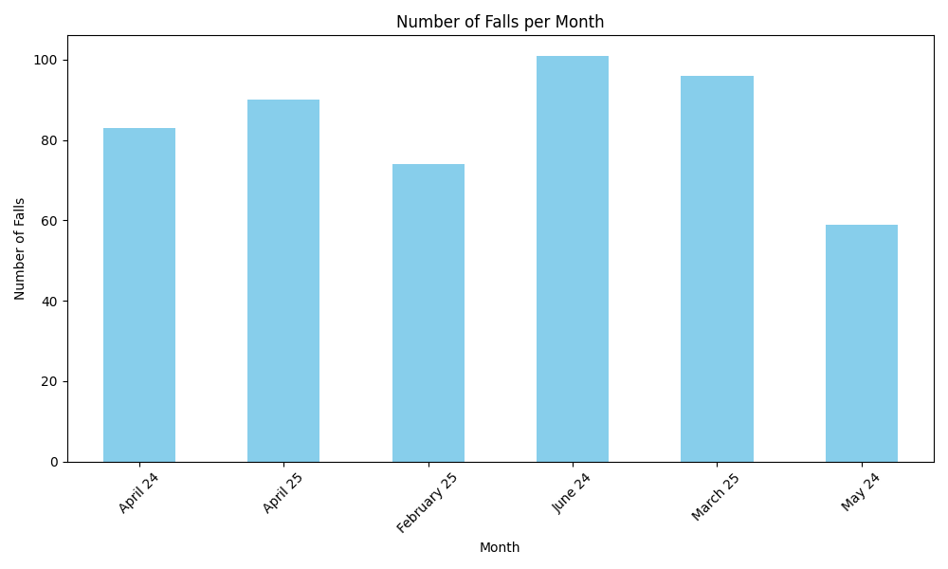
UCRS Falls Audit
This audit focused exclusively on fallers referred by EEAST through the UCCH (Cleric) pathway following a fall, where the individual remained on the floor.
Total Falls Recorded:503 incidents (6-month period)
Falls by Location
Community (Non-Care Home): 395 falls
Care Home: 100 falls
Outdoors/Inappropriate referrals: 8 entries
Care home fallers represent ~20% of fallers
Average Time on Floor (from time of 999 call): ~105 minutes

Slide 6
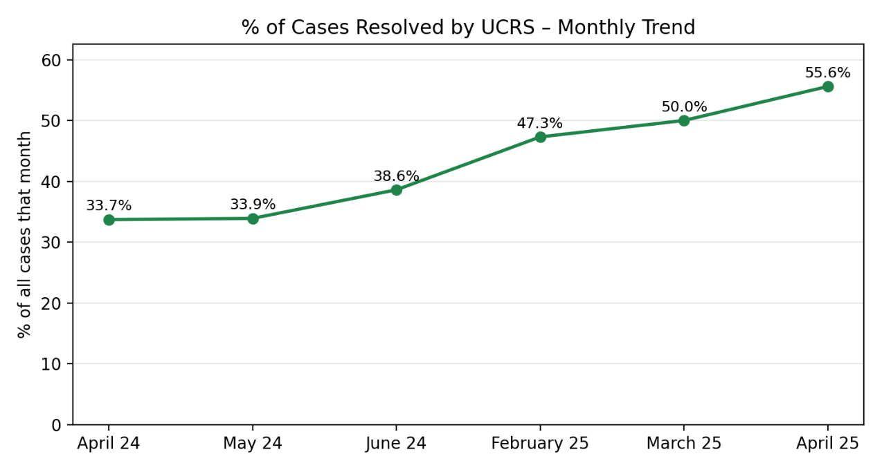
UCRS Falls Audit
The percentage of cases resolved by UCRS has shown a steady upward trend over the 12-month period, resolution rates began to increase significantly from June 2024 onward, reaching a peak of 55.6%.
This suggests improved efficiency and improved capacity over that period due to increased funding.

Slide 7

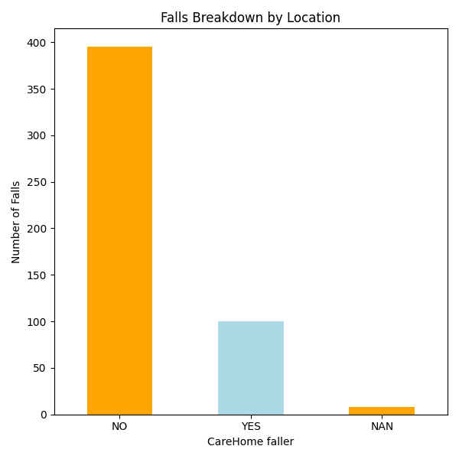
UCRS Falls Audit Care home vs Community falls (Average response times)
Location | Time till UCRS F2F (mins) | Time on Floor (mins)
Community | 258.86 | 104.75
Care Home | 185.41 | 108.18

Slide 8
UCRS Data

Slide 9














A patient’s journey Cleric Call
Old journey
Mr S (83) had a fall after being disorientated trying to find the bathroom, in the morning
He calls 999 shortly after falling over trying to get to the bathroom. He wasn’t injured but told the call handler he couldn’t get up.
The paramedics were worried that the long lie on the floor may have damaged his kidneys so took him to hospital
After waiting 2 hour in the ambulance to be handed over, A&E, no injuries were found but due to it now being the late at night and no one at home to help him he was be admitted
Mr S remain on admitted to a ward whilst a care package was organised, but due to his home being rural this took several days.
Mr S had another fall whilst in hospital and broke his hip
Mr S spent 4 weeks in hospital and was discharged to a care home and never returned home
The call handler then dispatched an ambulance to help.
Because due to demand the ambulance took nearly 6 hours to get to Mr S
New journey
Mr S (83) had a fall after being disorientated trying to find the bathroom, in the morning
He calls 999 shortly after falling over trying to get to the bathroom. He wasn’t injured but told the call handler he couldn’t get up.
The call handler assessed that the call met the criteria for transfer to the Urgent Community Response Team via Cleric
The UCR team arrived within an hour and helped the patient up from the floor
He had no injuries but told them he was scared of falling again and after he had had Covid last month found he was a little more unsteady on his feet
The UCR team arranged for the GP to visit and also for a physiotherapist and occupational therapist to visit him at home to give him some strengthening exercises and equipment to help his mobility.
A referral is made to social services for some personal care support
9

Slide 10
UCRS Data

Slide 11
UCRS Case Study
UCRS Case Study -
Date of Incident:
22/02/2025
A 73-year-old was referred to UCRS following a fall in a care home, with the extent of injuries initially unknown. Although the care home had appropriate lifting equipment and trained staff, a 999 call was made at 08:31, and the referral was passed to UCRS via UCCH at 08:40.UCRS clinician attended face-to-face at 10:05.
Time Metrics: 999 calls at 8:31
Time on Floor: 94 minutes
Time to UCRS Face-to-Face Review: 94minutes
Picked up within 2 hours of referral? Yes
Comorbidities: Dementia, Stroke, TIA, Progressive supranuclear palsy
Clinical Presentation
The patient had fallen from a chair, sustained a minor head injury, and was unable to get up from the floor. A full assessment was completed by UCRS, which identified the chair as unsuitable and a contributing factor to the fall risk. The patient did not require hospital conveyance, and care home staff were appropriately safety netted.
Intervention & Outcome
UCRS did not contact the helpline as the patient was unable to stand. Instead, a UCRS clinician assisted the patient off the floor using the care home's equipment. The clinician also reviewed the patient's chair and made a referral to neuro-rehabilitation for ongoing support. Observations were within normal limits, and a significant head injury was ruled out. The case was successfully managed and resolved within the care home.
Learning Points / Recommendations:
Care home staff could benefit from support/training in the I-stumble protocol to reduce time on floor and use existing equipment to lift none injured patients.
UCRS met 2-hour response target from time of 999 call - responded in 94mins
Early identification of fall risks led to preventative action

Slide 12

Please contact the Community Gateway team
communitygateway@esneft.nhs.uk
Phone on 0300 0032 144
Please provide the following information
Patient details including address, DOB, NHS Number & contact numbers
Relevant medical history
Current medication
Comprehensive overview of patient's condition & what is required from the service

Slide 13
Questions

