Slide 1
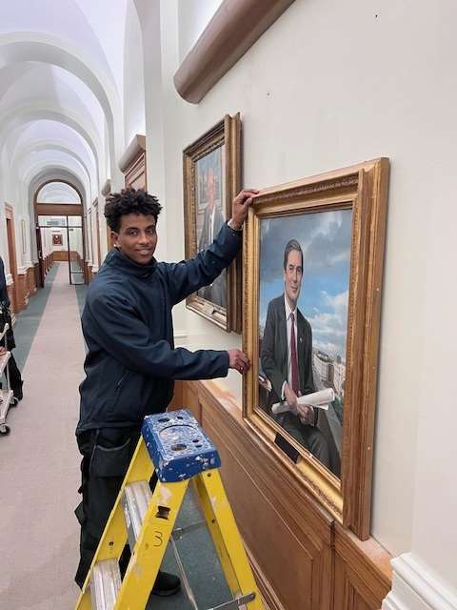

POSITIVE IMPACT OF SOCIAL VALUE - MITIE
EXTRACTS & PHOTOS TAKEN FROM MITIE’S PUBLICATION CASE STUDY
Mitie’s commitment to creating positive impact for Essex County Council has taken a step forward through investment in long term employment for Children in Care.
A further permanent engineering apprentice position has been added to our structure, supporting the Children in Care team to place care leavers.
Asmerom (pictured right), a 22-year-old from West Essex, who loves playing football and has a strong interest in plumbing, joined Mitie in Jan 2025 on the ECC contract as an apprentice on the Property Maintenance Operative (Level 2) Apprenticeship program.

Slide 2
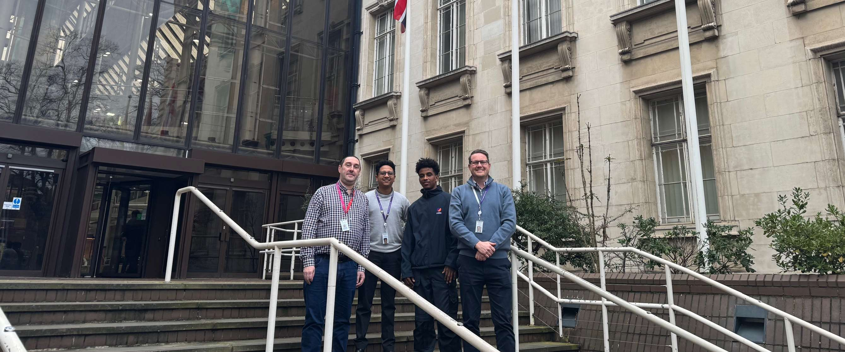
MITIE
CASE STUDY
Mitie's apprenticeship program directly aligns with ECC's "Everyone Essex" strategy, demonstrating our shared commitment to creating a "Good Place for Children and Families to Grow."
By providing employment opportunities to young people who have been in the care of ECC, we are not only investing in individual futures but also contributing to a more equitable and prosperous community.
This program is estimated to generate a total social value of £28,052, demonstrating the significant positive impact on the wider community.

Slide 3
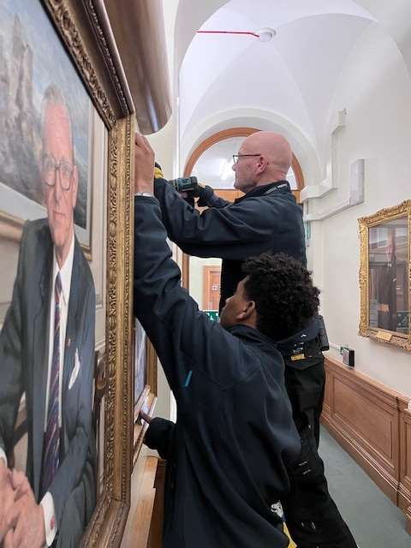
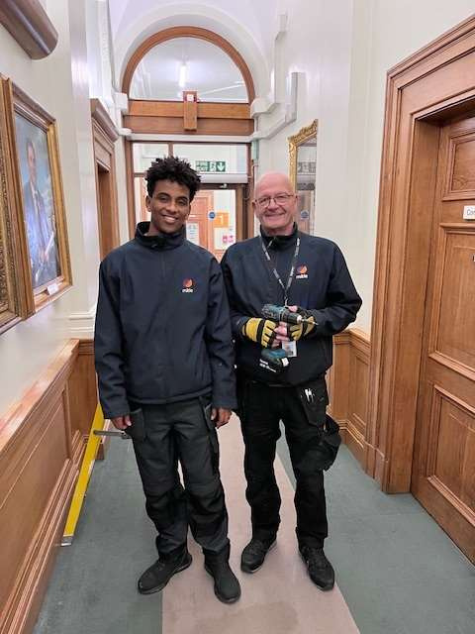
MITIE
CASE STUDY
‘Some employers just “get it” and Mitie in my opinion
are leaders in this field, they take the time to
understand what support is needed together with an intuitive led attitude to this cohort. ‘Keely Hutchings Employability Officer, Leaving & After Care Team
‘In short, Mitie are the blueprint for how Care leaver engagement and recruitment should be done, and we are eternally grateful for their support. ‘

