Slide 1



Fit for the Future:
The 10 Year Health Plan
for England.
North Provider Forum
September 2025

Slide 2
Its change or bust; We chose change
Context and Urgency: “Reform or die…” A vision for a modern, patient-powered, sustainable NHS NHS described as being “in a critical condition”: long waits, staff burnout, poor outcomes Demographic pressures and rising demand esp. complex comorbid presentations Three Shifts: Hospital to Community: Neighbourhood Health Service Analogue to Digital: NHS App as digital front door Sickness to Prevention: Genomics, early intervention, health equity

Slide 3
From hospital to community: The Neighbourhood Health Service
Care in a patient’s home if possible… in a neighbourhood health centre (NHC) when needed… in a hospital if necessary Share of expenditure on hospital care will fall over the next 3 – 4 years; proportionally greater investment in out-of-hospital care (per the Darzi Review), including Neighbourhood Health Centres: “establish an NHC in every community, beginning with places where healthy life expectancy is lowest” A shift, over time, from block payments to Year of Care Payments: An enabler for whole system rather than organisation/sector funding?

Slide 4
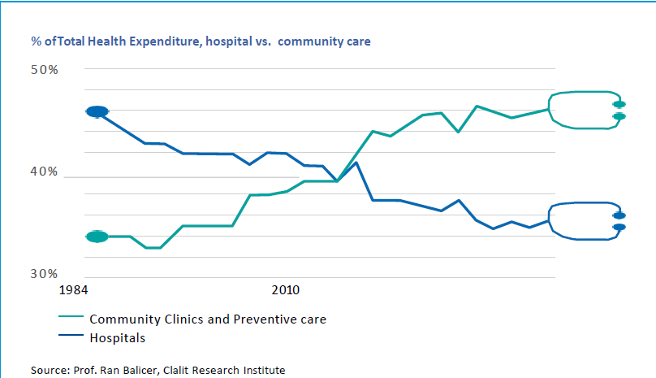
Neighbourhood Health Service – international comparisons
The Israeli health system is structured to facilitate most of the care in out-of-hospital settings and spends less per capita than the UK. They have distributed network of out-of-hospital clinics/teams delivering the volume of care.
Each team, is run by a diverse workforce providing patients access to a suite of diagnostics, services and therapies that would usually be found at specialist sites or hospitals
.
Their model includes social and primary care too
.

Slide 5
Neighbourhood Health Service – how it might work
Multi-neighbourhood providers with a 250k+ population base (PCNs currently serve around 50k pop) GP federations and examples of multi-practice working - “In some places this role is already being played by GP federations, with excellent results. We will also give integrated care boards (ICBs) freedom to contract with other providers for neighbourhood health services, including NHS Trusts”. Existing INTs models with links to reduction in UEC; Focus on frailty, reablement/rehab, EOL care, people with Long Term Conditions. No fundamental shift in how primary care is contracted “Where the traditional GP partnership model is working well it should continue, but we will also create an alternative for GPs. We will encourage GPs to work over larger geographies by leading new neighbourhood providers. These providers will convene teams of skilled professionals, to provide truly personalised care for groups of people with similar needs”. Trust led Integrated Health Organisation – emerging narrative is about a contract not a single provider approach

Slide 6
From analogue to digital: power in your hands
Digital Transformation of Services Video consultations and remote monitoring will become more widespread Digital-first primary care will be expanded AI and Advanced Technologies Generative AI Diagnostic and Robotic Surgery AI-powered diagnostic tools Integrated Digital Record A unified electronic health record (EHR) system will be implemented across NHS services Data and Analytics The NHS will use big data analytics to identify health trends, predict outbreaks, and tailor services Real-time dashboards will help clinicians and managers make better decisions. Cybersecurity and Infrastructure Digital Inclusion The plan emphasizes closing the digital divide Workforce Digital Skills NHS staff will receive training in digital tools and data literacy

Slide 7
From treatment to prevention: Power to make the healthy choice
Action on the wider determinants of poor health: An overall goal to half the gap in healthy life expectancy between the richest and poorest regions Aiming to make real a shift to a preventative model of physical and mental health care. A more preventative-focussed model of care is to be delivered at neighbourhood level, through mutli-organisational and cross-sector partnerships. The plan identifies: Tobacco and Vapes Bill: Obesity focus: food reform, GLP-1 access Expanded vaccinations and genomic screening (c.f. access from NHS App)

Slide 8
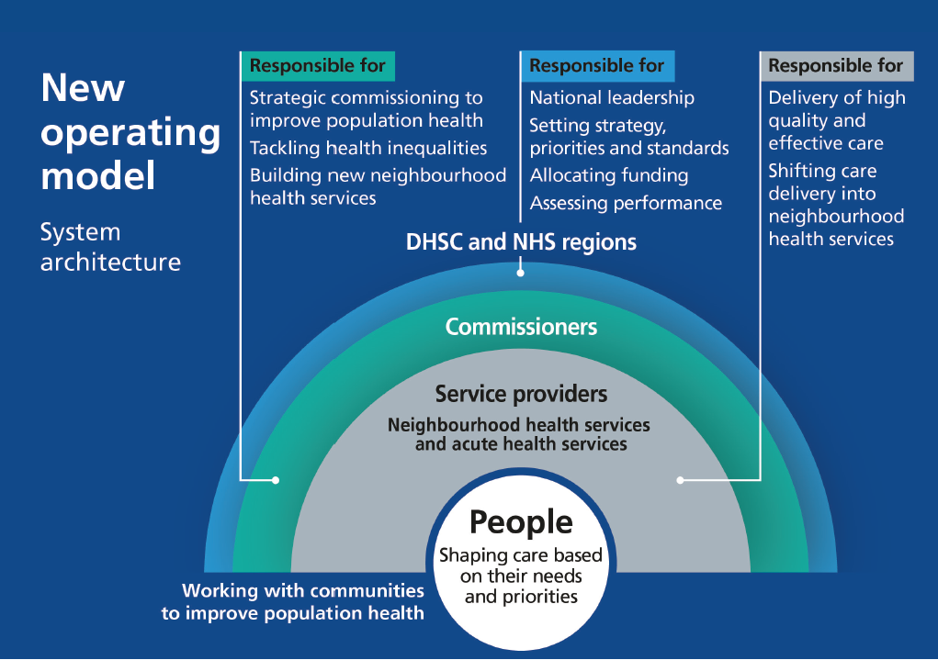
A devolved and diverse NHS: a new operating model
NHS England abolition (Spring 2027) / combine w DHSC reducing central headcount by 50% ICBs as strategic commissioners Earned autonomy / interventions where failing Refresh the NHS FT model (retain/reinvest surpluses, borrowing for capital investment) IHOs holding the entire health budget for a defined local population – designation expected 2026; operationalisation from 2027 Boundaries - ICBs coterminous with strategic authorities by the end of the plan (wherever feasibly possible) Embedding user feedback - Patient Choice Charter, starting in the areas of highest health need.; Patient Power Payments trial

Slide 9
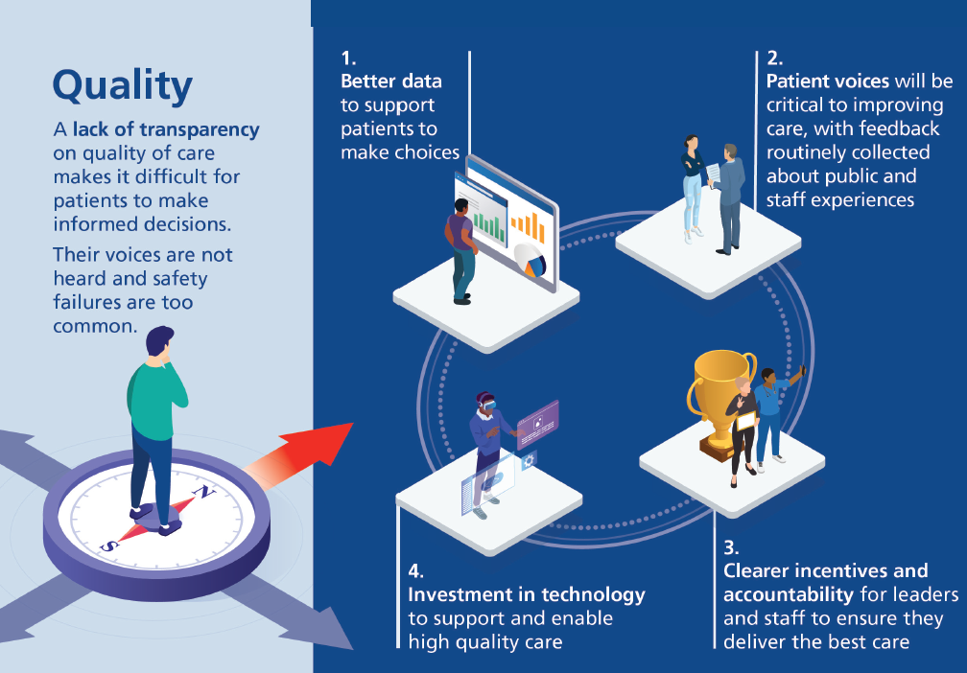
A new transparency of quality of care
League tables (Summer 2025 – ranking Trusts by key quality indicators), Maternity Outcomes Signal System – (November 2025) (National) Service Frameworks are back (2026) – CVD, MH, Frailty & Dementia in priority group. From 2027 (in areas w greatest health need) flexibilities to make additional payments to clinical teams with consistently high clinical outcomes and excellent patient feedback or are significantly improving care Patient feedback, PROMs/PREMs National independent investigation into maternity and neonatal services CQC moving to intelligence/data-led regulation model, increased time to being legal action against providers. Reform complaints process / improve response times to patient safety incidents & complaints Reform National Quality Board plus royal colleges. Persistent poor-quality care results in the decommissioning or contract termination.

Slide 10

An NHS workforce fit for the future
Community-Centric Care | Shift services from hospitals to community settings Expand Neighbourhood Health Centres open 12 hours/day, 6 days/week
Digital & AI Integration | Make AI a trusted assistant for clinicians Digitize records and streamline admin tasks
Workforce Sustainability | Reduce reliance on international recruitment to <10% by 2035 Prioritize local talent and underrepresented groups
Training & Career Development | Personalized career coaching for all NHS staff Overhaul education and training curricula
Advanced Practice & Leadership | Develop advanced roles for nurses, midwives, and AHPs Establish College of Executive and Clinical Leadership
Wellbeing & Flexibility | Introduce modern employment standards by 2026 Promote flexible working and reduce sickness rates
Equity & Inclusion | Expand apprenticeships in deprived areas Support care leavers and economically inactive individual

Slide 11
An NHS workforce fit for the future
Years 1–3: Foundation & Reform | Launch 2,000 more nursing apprenticeships Create 1,000 specialty training posts in high-need areas Begin rollout of Neighbourhood Health Centres Develop new staff standards and employment contracts Start AI integration in clinical workflows
Years 4–6: Expansion & Empowerment | Implement personalized career plans for all staff Embed lifelong learning and “skills escalators” Establish College of Executive and Clinical Leadership Expand genomic health training and advanced practice roles
Years 7–10: Innovation & Sustainability | Achieve target of <10% international recruitment Fully digitize patient records and admin systems Scale up community-based care and reduce hospital dependency Monitor and reward high-performing teams and managers Evaluate workforce impact and adjust strategy for next decade

Slide 12
Powering transformation: innovation to drive reform
5 “Big Bets”: Data – to enable earlier diagnosis and better research AI – to drive productivity, support patient choice and to liberate staff Genomics – pre-emptive personalised care Wearables – standard in preventative, chronic and post-acute NHS treatment by 2035 Robotics – transform patient care from surgery to rehabilitation

Slide 13
Productivity and a new financial foundation
2% year on year productivity gain (3 yrs). Productivity Index being developed. Aiming for surplus – majority by the end of the decade Tariff shifting from av. cost to best clinical practice Deficit support ended NHS Bodies to meet planning guidance targets – “no exceptions” Deconstructing block contracts Value-based care and productivity targets Multi-year budgets and surplus reinvestment 10 Year Infrastructure Strategy integrates health and social infrastructure alongside economic infrastructure (c.f. Anchor Institution). 5 yr capital budgets (reviewed every 2 yrs) – allocations based on population health need Requirement for NHS organisations to reserve at least 3% of annual spend for one-time investments in service transformation c.f. Innovation & Research “We have also put in place a credible plan for the New Hospital Programme…”

Slide 14
Opportunities in North East Essex
Develop Neighbourhood Health Service for NE Essex through the developing Integrated Neighbourhood Model – The importance of home care in reablement and enabling independence Integrated Healthcare Organisations – Care providers are vital and we need to think in terms of Integrated Health and Care not just integrated Healthcare Clacton and Harwich Hospitals as Neighbourhood Hubs?? Shift from hospital to community – what could more clinical support to care providers do to keep people well and in the community and to respond to urgent health and care needs without the need for hospital care Remote monitoring and the use of digital care to keep people independent

