Slide 1
Root Cause Analysis – Case Study All information is from a real case and was completed by a care home with support from Prosper
PROSPER Project

Slide 2
Main principles of Root Cause Analysis
Root Cause Analysis is a ‘No Blame’ investigation, the outcome should highlight the lack of, or failure of, a system.
There are two different recommendation that can be made by a Root Cause Analysis investigation
To amend a system currently in place that does not seem to be effective in preventing incidents of harm occurring.
To implement a system that is currently not in place, which the investigation has highlighted, is required to prevent future harms occurring.

Slide 3
Incident occurs
Complete Tabular timeline
Additional Information
Neutralise the incident
Select good practice and care delivery problems (CDPs)
Create 5 hypothesis
Wagon Wheel
Scope the 4 P’s
Analyse CDPs
Ask Why
Gather evidence
Fishbone
Make Recommendations
Create simple timeline

Slide 4
Neutralising the incident
Res X was found lying on her bedroom floor with a chest of draws on top of her legs. It was later discovered that she had a fractured hip.

Slide 5
Five Hypos
Res X got out of bed tried opening her draws, but instead pulled them over on top of her, which caused her to lose her balance.
Res X got out of bed, stumbled or tripped, tried to grab hold of the chest of draws, but pulled it over onto her.
Res X fell out of bed, tried to pull herself up on the chest of draws, but instead pulled it on top of her.
Another person was in the room, a struggle between Res X and the other person took place during which Res X fell to floor, whilst also knocking over the chest of draws.
Res X was wide awake and out of her bed. In her mind she was tidying her room by putting things away in the draws. She had all the draws open at the same time, which caused the chest of draws to topple over on to her, knocking her to the floor.

Slide 6
Scoping the four Ps
Paper | People | Parts | Place
Daily records | Night staff on duty | Chest of draws | Res X’s bedroom
Res X’s care plan | Previous day staff on duty | Bed
Risk assessments | Res X | Other furniture in room
Records from hospital | Family | Res X’s footwear
Staff rotas | Paramedics | Any mobility aids used
 | Other health professionals involved with Res X’s care

Slide 7
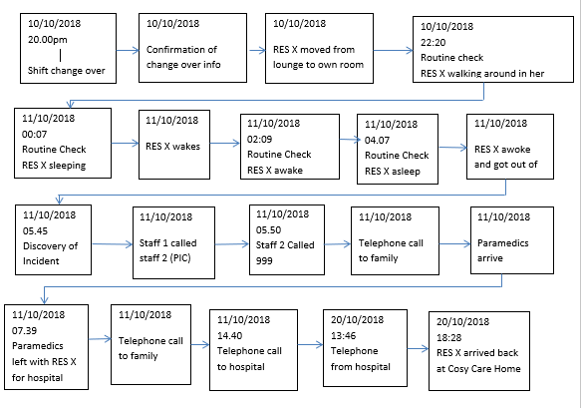
Simple Timeline

Slide 8
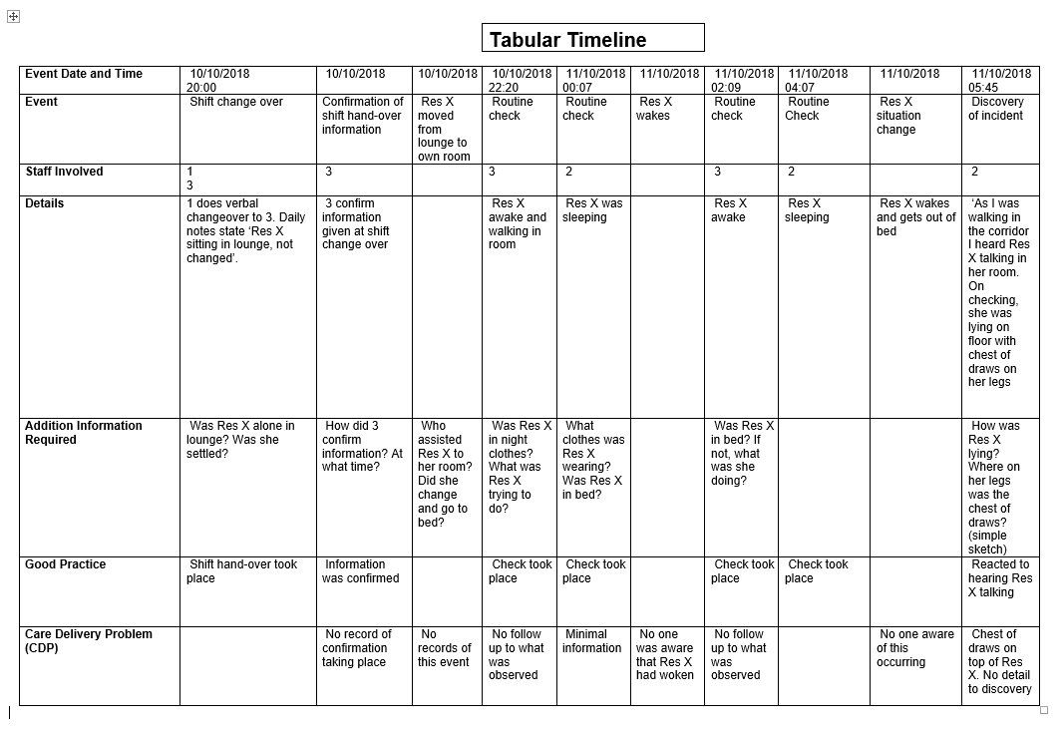

Slide 9
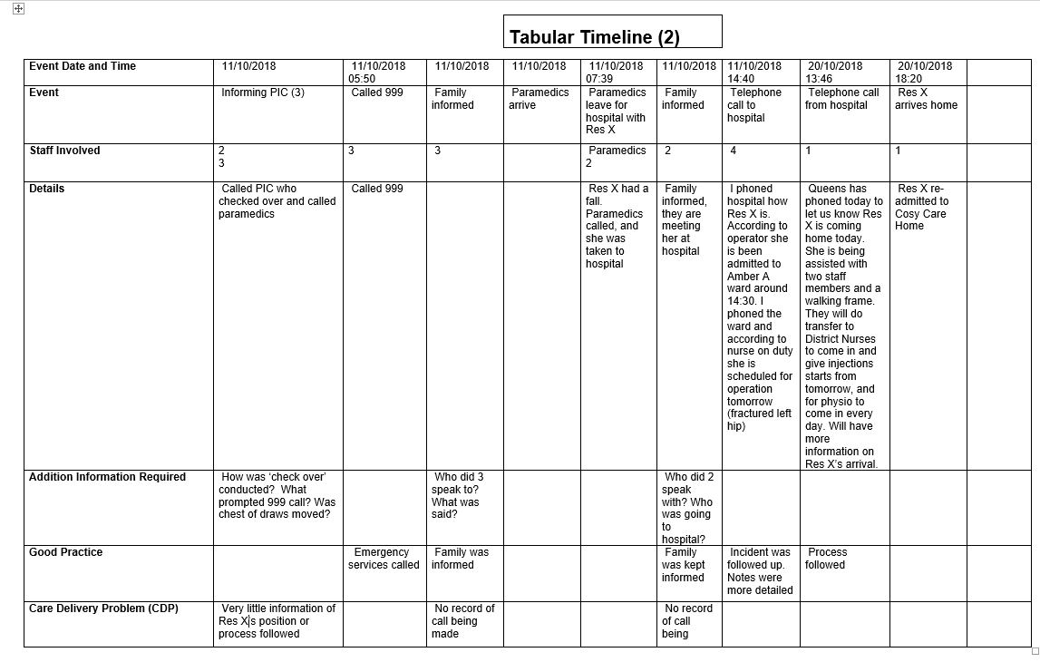

Slide 10
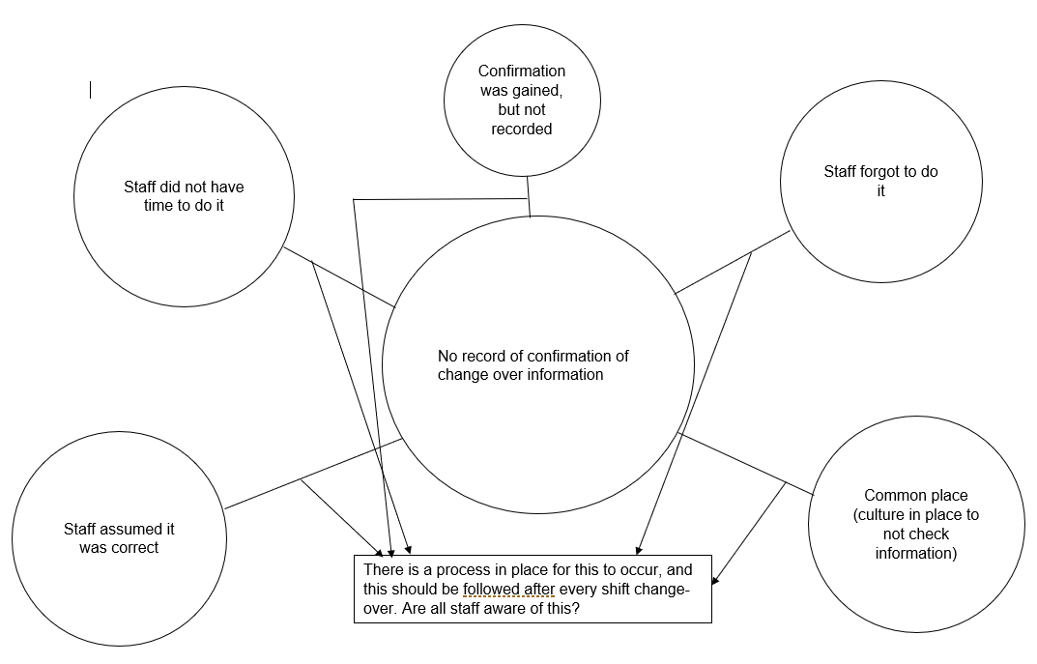

Slide 11
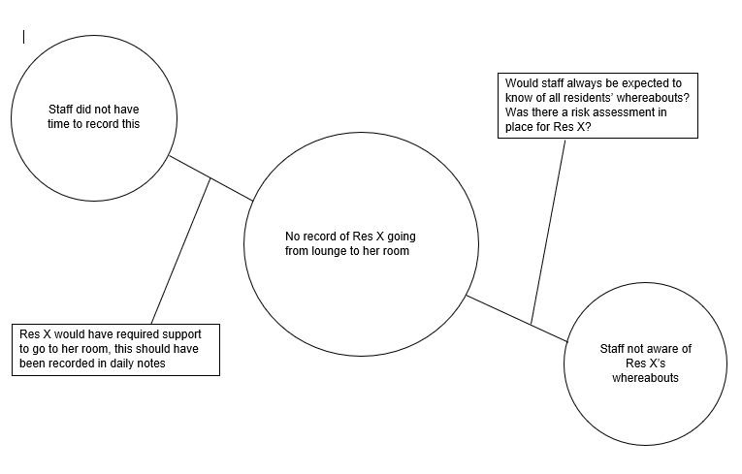

Slide 12
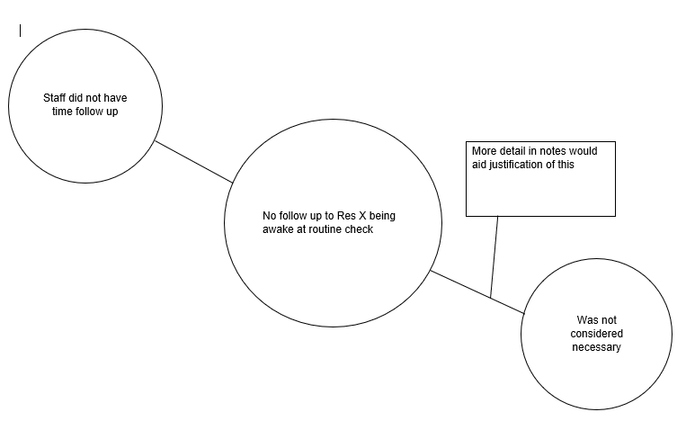

Slide 13
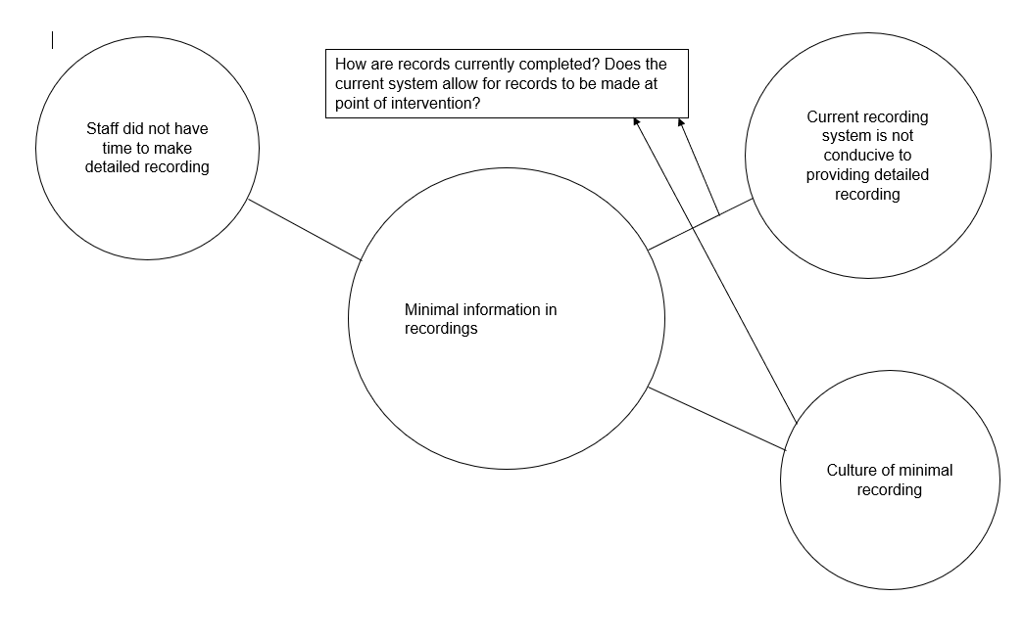

Slide 14
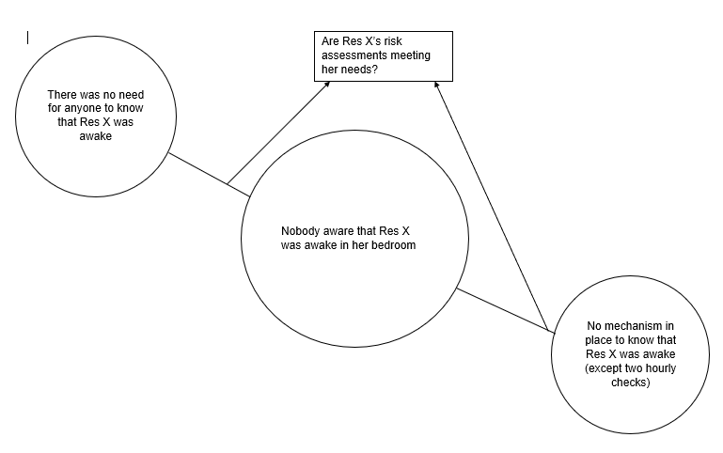

Slide 15
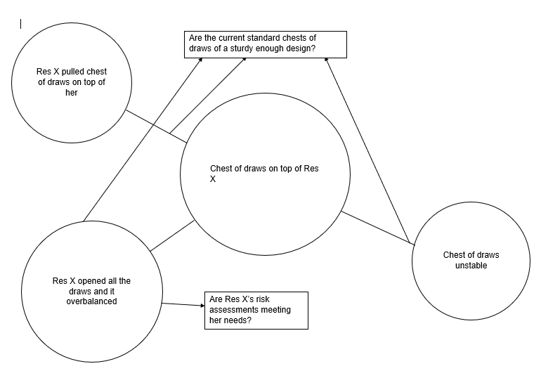

Slide 16
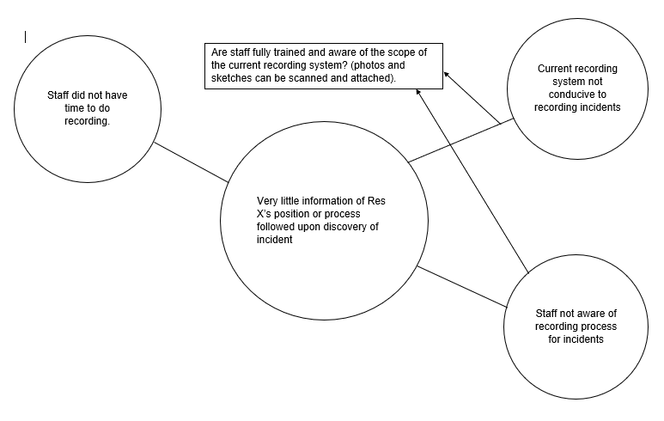

Slide 17
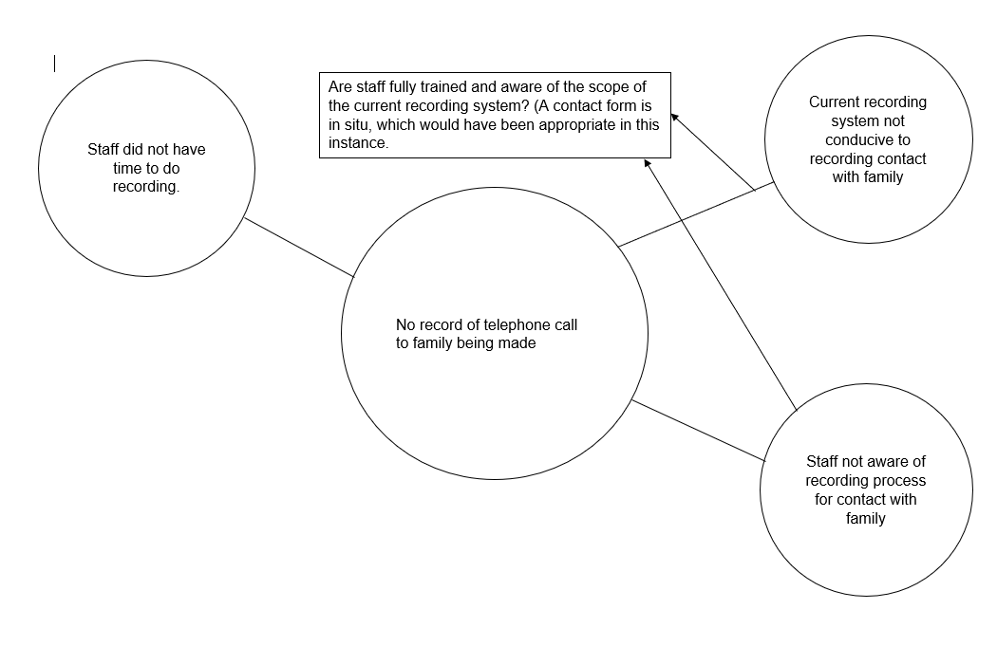

Slide 18
