Slide 1
Welcome to Social Value Fest '22
Day 1 – Social Value Update

Slide 2
Agenda
Samantha Butler
Lead, Social Value Programme
Essex County Council

Slide 3
Agenda
Welcome to Social Value Fest '22
Councillor Whitbread, Cabinet Member for Finance, Resources and Corporate Affairs
Keynote: The value of Social Value
Peter Holbrook, Chief Executive, Social Enterprise UK
ECC Social Value update: new tools and products
Samantha Butler, Social Value Lead
Breakouts

Slide 4
Welcome
Councillor Whitbread
Cabinet Member for Finance, Resources and Corporate Affairs

Slide 5
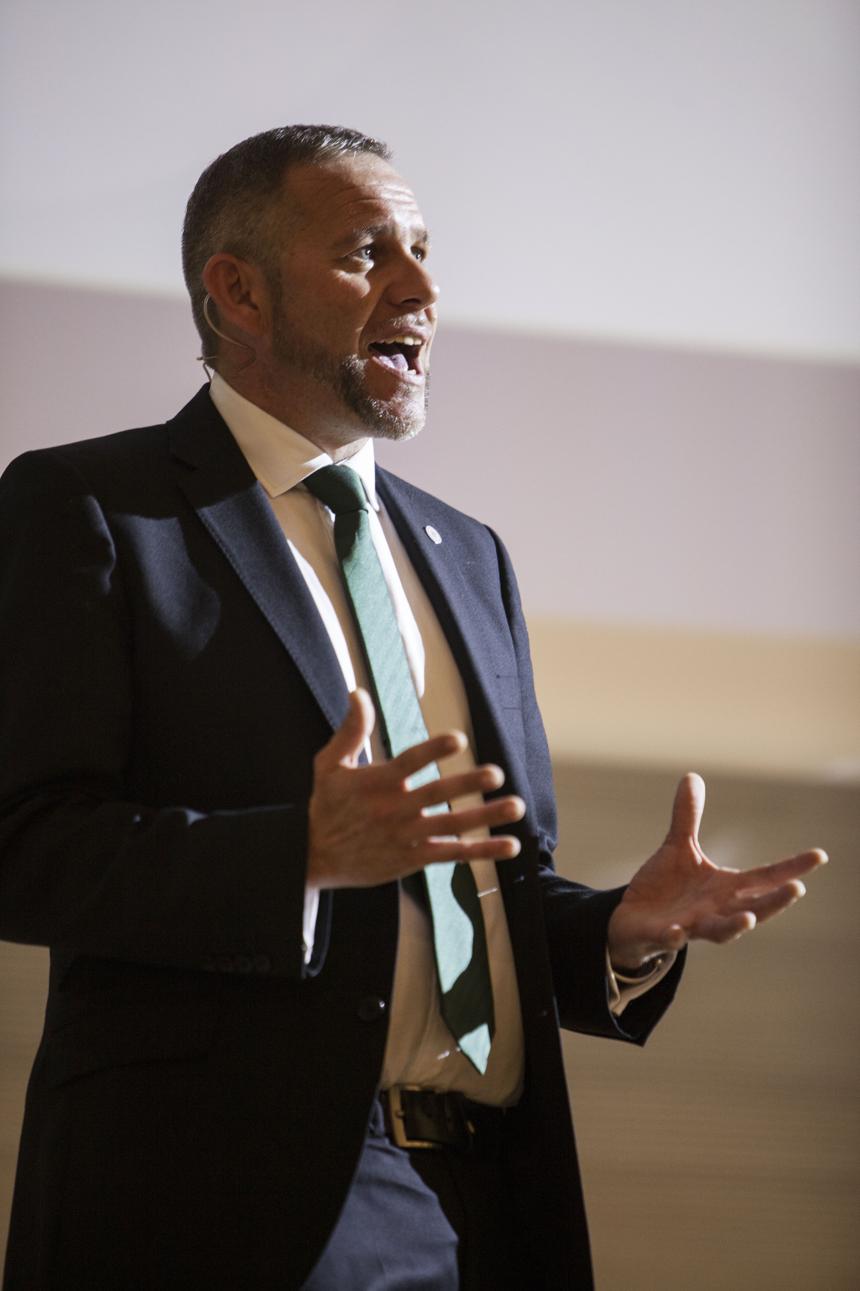
Keynote
Peter Holbrook CBE
Chief Executive, Social Enterprise UK

Slide 6
Social Value Update New products to help you, help Essex
Samantha Butler
Lead, Social Value Programme
Essex County Council

Slide 7
Agenda
Social value at ECC
Results so far
Our new tools

Slide 8
ECC Social Value Priorities
ECC priorities: Jobs and skills, young people and climate:
Apprenticeships
Kickstart placements
Employment opportunities for those furthest from the job market
Work experience placements, career advice, CV preparation
switching to electric vehicles and reducing single use plastics

Slide 9
Social Value in ECC Procurement
Corporate Social Value Policy
Social value questions in tenders for contracts over £100k
Quantitative and qualitative evaluation:
Value Score ECCTOMs: National Social Value Taskforce list, tailored to ECC
Themes, Outcomes and Measures contribute to Everyone’s Essex
A list of different types of social value
Financial proxies - assigns an economic value to each
Supporting Statement
==> Breakout 3 and tomorrow's 'how to bid' session

Slide 10
Since Sept 2020 implemented new method:
> 13,000 hours to create or maintain green space or infrastructure, increase biodiversity
>18,000 hours support for local community groups
>3500 hours volunteering hours for charities
Support for community groups and to help homelessness
> 16,000 tonnes of savings of CO2e
>2000 hours of expert advice for SMEs & VCSEs
> 12,000 hours of careers support for the unemployed
>13,000 weeks of apprenticeship and other in-work training (BTEC, NVQ etc.)
22 contracts, 101 suppliers: £497m spend: >£61m of social value

Slide 11
Tools to support for the delivery Phase
Job fairs
Reporting
Reporting tool - uses the same ECCTOMs measures
Schedule online (Social Value Catalogue)
Social Value Catalogue
Factsheets – apprenticeships, kickstart etc.
Community Market place page
Share the support offered by suppliers with potential beneficiaries
Support available to schools, colleges, charities

Slide 12
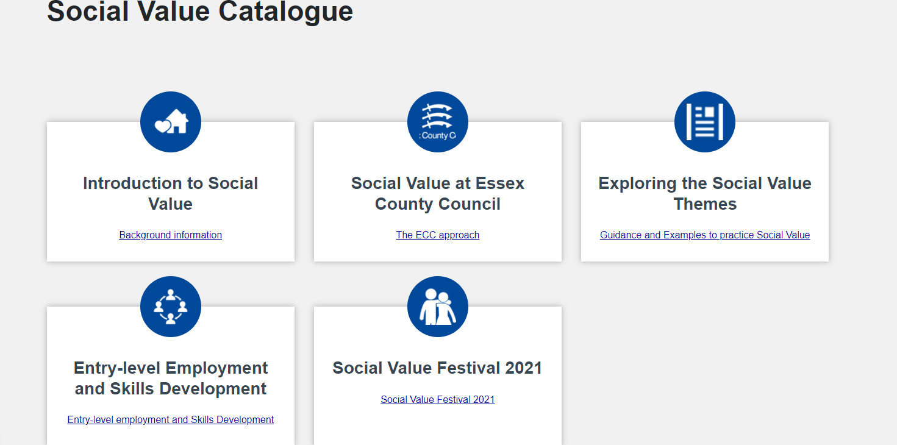
Tools: Social Value Catalogue Social Value Catalogue | Provider Hub | Essex (essexproviderhub.org)

