Slide 1
Digitising Social Care
Caroline Day, Programme Manager & East of England Regional Lead
NHS Transformation Directorate
NHS Transformation Directorate

Slide 2
Digitising Social Care Programme
The NHS Transformation Directorate brings together staff from across NHS England and the Department of Health and Social Care behind a common goal:
‘to drive innovation at scale where it can improve care for people and support staff.’
NHS Transformation Directorate

Slide 3
Digitising Social Care Programme
An adult social care system that makes best use of digital tools and technology to deliver improved care outcomes for people.
NHS Transformation Directorate

Slide 4
People at the Heart of Care
On the 1 December, The Department of Health and Social Care published the White Paper People at the Heart of Care which outlines the 10-year vision for the reform of the sector.
The White Paper recognised that when technology is embedded seamlessly into care and support services, it can help people to live happy, fulfilled lives in their homes and communities.
To support this goal, and the government’s wider ambitions for reform, the White Paper committed to invest at least £150m in digitising the social care sector.
NHS Transformation Directorate

Slide 5
Programme Objectives
80% of adult social care CQC registered providers will have adopted a digital social care record by March 2024
By March 2024 sensor based falls prevention and detection technologies, such as acoustic monitoring, will be in use in care homes for the residents they have identified as most at risk of falls, reaching at least 20% of residents nationally
Testing other types of care tech, driven by the benefits case and local need.
NHS Transformation Directorate

Slide 6
Digital Social Care Records (DSCR)
A DSCR is an electronic care planning system that supports the digital recording of care information and care received by an individual, within a social care provider setting, replacing traditional paper records
It enables an individual’s personal care and support plan to be shared in real time with authorised health and care professionals.
NHS Transformation Directorate

Slide 7
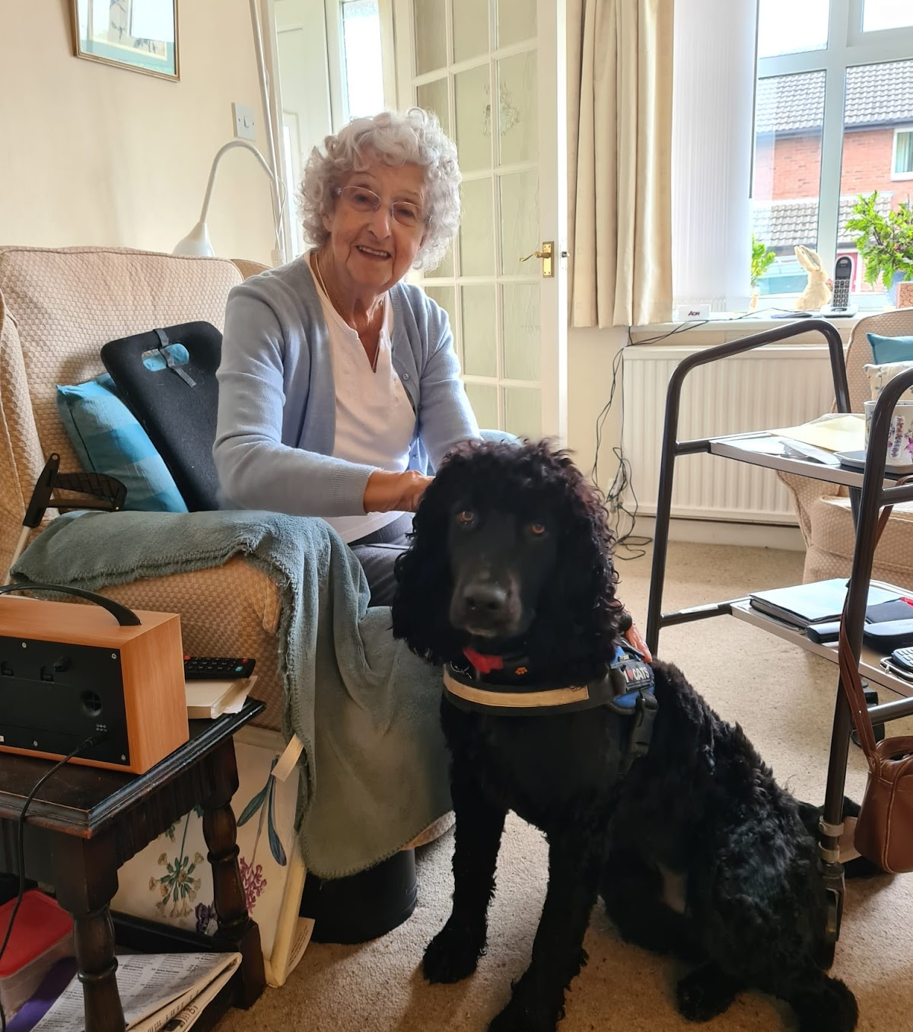
Why are we here?
Meet Beryl
93 years old, lived at home independently
Partially sighted and mobility issues
Fell and broke her left hip and fractured her wrist
Admitted to hospital for 14 weeks, unable to see family and friends
Returned home with care visits 4 times a day
Within 4 days of discharge, fell and broke her right hip, and the cycle starts again…
NHS Transformation Directorate

Slide 8
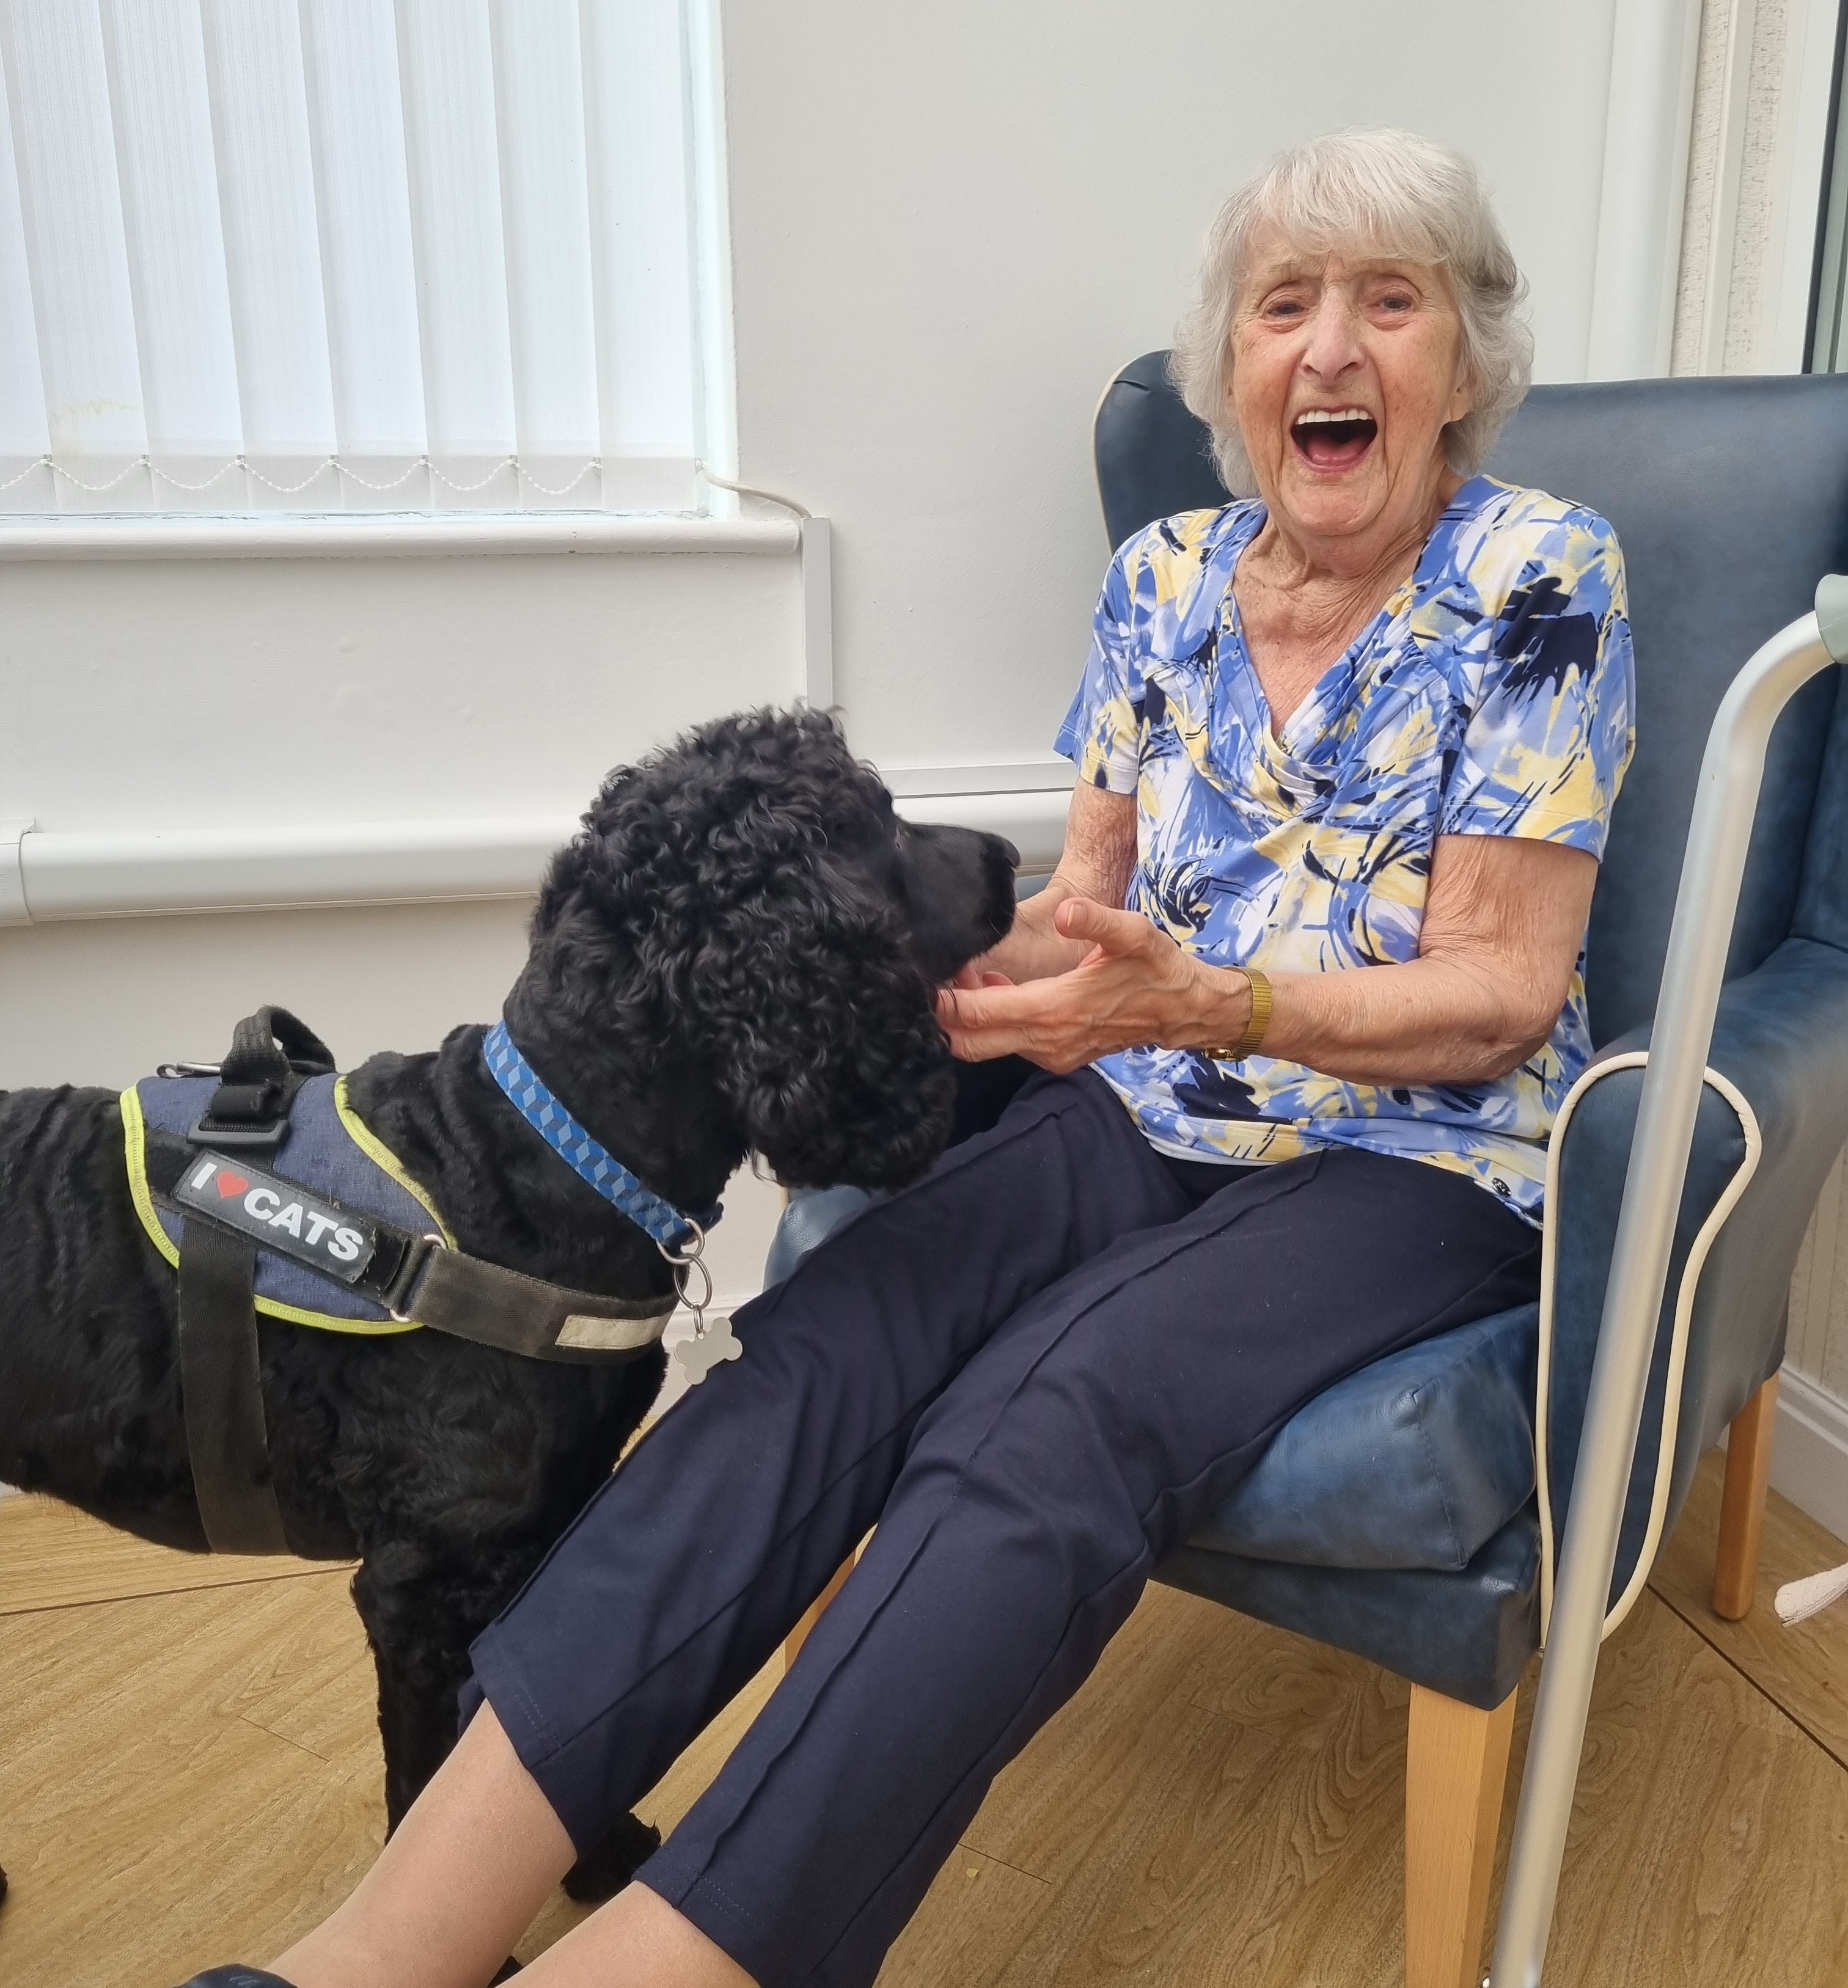
Why are we here?
During the pandemic Beryl moved to a Care Home
The home did not have technology to support Beryl to keep in touch with her family
Beryl's behaviour changed and her mental and physical health deteriorated
Her care needs grew meaning the care staff had to spend more time with her
… and then the home started to support the use of devices including iPad.
NHS Transformation Directorate

Slide 9
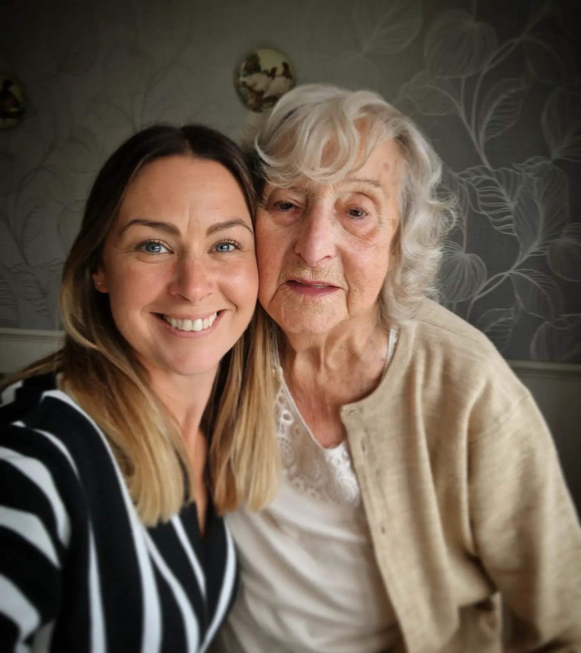
Why are we here?
Beryl now has access to her own care plan
She is able to share photos with her family via the DSCR
Her room has sensor based detection technology, helping to keep her safe at night. This helps care staff to check on Beryl only when she needs checking on, improving her quality of sleep
Beryl wants to, and can, be involved in her care.
NHS Transformation Directorate

Slide 10
Why digitise?
50% of care providers are still working from paper care records.
Therefore missing the benefits of digitising including supporting high quality and safe care, improving the efficiency and freeing up precious time with people by reducing administrative tasks.
NHS Transformation Directorate

Slide 11
Programme Strategic Benefits
Reductions in overall administrative task time
Improved management and oversight
Improved service delivered to care users
Increased compliance against Regulation and standards
Improved data quality and management
Reduced costs for paper and printing
NHS Transformation Directorate

Slide 12
Case Study
“In Hampshire and Isle Of Wight ICS, we have already seen unprecedented benefits to providing our care homes with secure access to our DSCR. Care homes can review new and existing admissions, results, meds and allergy details preventing in many cases the requirement to queue on the hospital or GP phone systems and then spend time discussing details with them. This is a time saving for the care workers, and the GP’s enabling more time care.”
NHS Transformation Directorate

Slide 13
Regulatory Compliance
“Do you have a digital social care record system?” now part of annual return to CQC
CQC actively promoting DSCRs are part of their engagement activities with care providers
NHSTD are sharing evidence base for DSCRs with the CQC to demonstrate impact on quality of care
NHS Transformation Directorate

Slide 14
What next?
Grant funding being made available now to support the adoption of digital social care records
Grant funding being made available in 2023/2024 to support the adoption of sensor based falls technology for the most at risk
Resource, support tools and templates available to help you on your digital journey
NHS Transformation Directorate

Slide 15
High Level Criteria to Secure DSCR Grant Funding
Up to £10,000 per CQC location grant funding available to Essex based care providers, including Thurrock and Southend
Funding to pay for up to 50% of first year costs to implement a new DSCR system (including licence, hardware and training costs)
Funding only to support procuring those systems on the assured list (see next slide)
Must not have purchased a DSCR before 1st April 2022
Further information including grant application forms and the link to the digital questionnaire can be found at: https://www.essexproviderhub.org/digital-social-care-records/
NHS Transformation Directorate

Slide 16
Current List of Assured DSCR Systems Suppliers
The following Digital Social Care Record suppliers have been assured by the NHS Transformation Directorate in NHS England to be on the assured supplier list.
New suppliers will continue to join, creating a vibrant marketplace of solutions to fit the diverse needs of social care providers.
Carebeans Care Software
Care Control Systems
CareVision
Eclipse by OLM
iplanit by Aspirico
Log my Care
Nourish
PASS by everyLIFE
Person Centred Software (PCS)
NHS Transformation Directorate

Slide 17
Essex Care Provider Digital Journey Questionnaire
A short 5-10 minute Digital Care Record and Falls Technology questionnaire has been issued to understand where Essex based care providers are on their digital journey, what the barriers are and how we can help.
We would greatly appreciate your help in completing the questionnaire. The link is:
https://app.smartsheet.com/b/form/aaa611b3154d47b3961b2215c3d99b88
and can be also be found on the ECC Provider Hub:
https://www.essexproviderhub.org/digital-social-care-records/
ECC are offering a £25 M&S voucher to each Essex based CQC registered organisation who completes the questionnaire
NHS Transformation Directorate

Slide 18
Supporting Information
Accessing the Digital Transformation Fund guidance: https://www.digitalsocialcare.co.uk/funding-opportunities/adult-social-care-digital-transformation-fund/
DSCR Assured Supplier List: https://www.digitalsocialcare.co.uk/social-care-technology/digital-social-care-records-dynamic-purchasing-system/
DSCR Decision making tool for care providers: https://www.digitalsocialcare.co.uk/dscr-assured-supplier-tool
DSCR Core Capabilities and Standards: Supplier Assurance Process page: https://www.digitalsocialcare.co.uk/social-care-technology/digital-social-care-records-dynamic-purchasing-system/core-capabilities-and-standards-supplier-assurance-process/
NHS Futures Digitising Adult Social Care Workspace (for ICS and regional teams – not care providers): https://future.nhs.uk/DigitisingSCRecordsDevelopment/view?objectID=30620496
NHS Transformation Directorate

Slide 19
Connect with us
england.dscr.enquiries@nhs.net
england.adultsocialcare@nhs.net
NHSTransform
www.linkedin.com/
company/transform_nhs
NHS Transformation Directorate

