Slide 1
ECC Social Value Reporting
Emma Woof – Procurement Manager Social Value

Slide 2
ECC Approach to Social Value
Essex County Council has adopted the Local Government Association’s National Social Value Taskforce National Themes, Outcomes and Measures’ (‘National TOMs’) method of classifying and evaluating Social Value, adapted to the County’s context and priorities, based on the ECC Corporate Strategy 'Everyone's Essex’
Social Value is given a weighting and evaluated in two parts, which, when combined result in one overall Social Value score:
1. Value Score (calculated using the ECC TOMs Calculator)
2. Supporting Statement Score
Value Score (out of 5)
Supporting Statement
Score (0-1)
Overall Social Value Score
(out of 5)
Notes:
Essex County Council has adopted the Local Government Association’s National Social Value Taskforce National Themes, Outcomes and Measures’ (‘National TOMs’) method of classifying and evaluating Social Value, adapted to the County’s context and priorities, based on the ECC Corporate Strategy 'Everyone's Essex’
Social Value is given a weighting and evaluated in two parts, which, when combined result in one overall Social Value score:
1. Value Score (calculated using the ECC TOMs Calculator)
2. Supporting Statement Score

Slide 3
ECC TOMs Calculator
A set of Social Value 'Themes and Outcomes'
A set of Units of Measure for each of the Outcomes:
These Units of Measure are used to compare bids on a like for like basis. They are set out as a description (the Measure) and a metric (the Unit).
They also enable us to collate the total benefits delivered by vendors to Essex communities and provide a consistent method of performance management reporting.
A set of Financial Proxies:
Each Unit of Measure is assigned a financial value. This enables us to calculate the total economic value of contributions that organisations offer.
Priority Weightings:
This is a weighting system that enables ECC to ensure its scoring system aligns to the agreed ECC Social Value Priority Measures.
A factor of 1 to 3 is applied to the Units of Measure that are listed as an ECC Social Value Priority.
When Total Social Value bid is calculated, the corresponding Financial Proxy is multiplied by the weighting before the total 'Value' score is calculated.
When ECC staff measure and report the social value delivered, they will not use the multiplier.
Notes:
A set of Social Value 'Themes and Outcomes'
A set of Units of Measure for each of the Outcomes:
These Units of Measure are used to compare bids on a like for like basis. They are set out as a description (the Measure) and a metric (the Unit).
They also enable us to collate the total benefits delivered by vendors to Essex communities and provide a consistent method of performance management reporting.
A set of Financial Proxies:
Each Unit of Measure is assigned a financial value. This enables us to calculate the total economic value of contributions that organisations offer.
Priority Weightings:
This is a weighting system that enables ECC to ensure its scoring system aligns to the agreed ECC Social Value Priority Measures.
A factor of 1 to 3 is applied to the Units of Measure that are listed as an ECC Social Value Priority.
When Total Social Value bid is calculated, the corresponding Financial Proxy is multiplied by the weighting before the total 'Value' score is calculated.
When ECC staff measure and report the social value delivered, they will not use the multiplier.

Slide 4
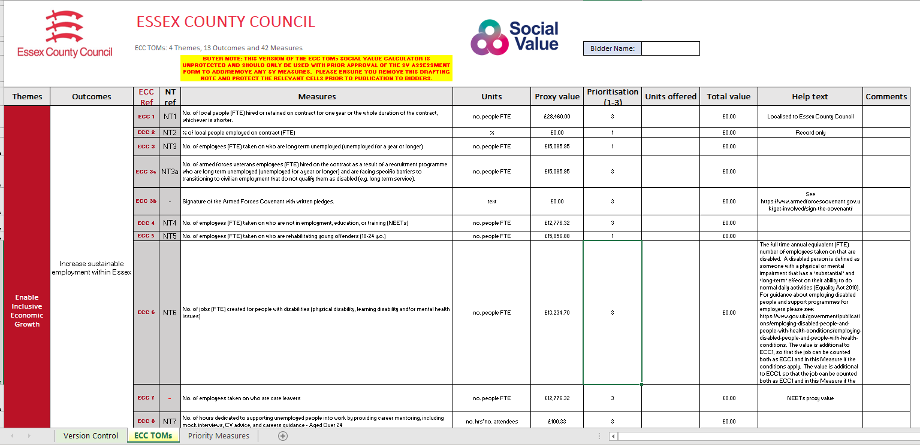
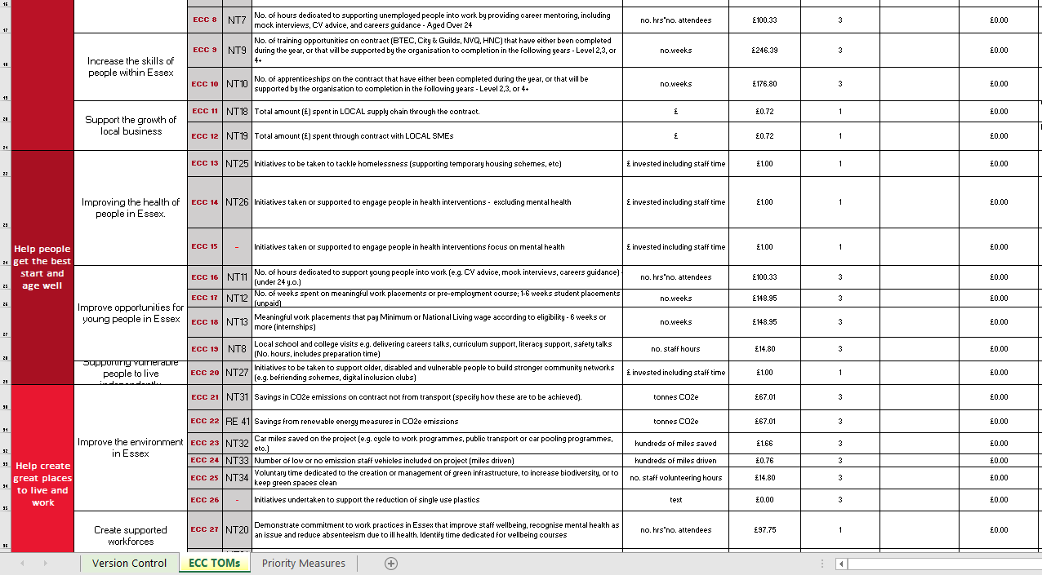

Slide 5
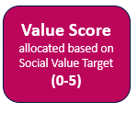
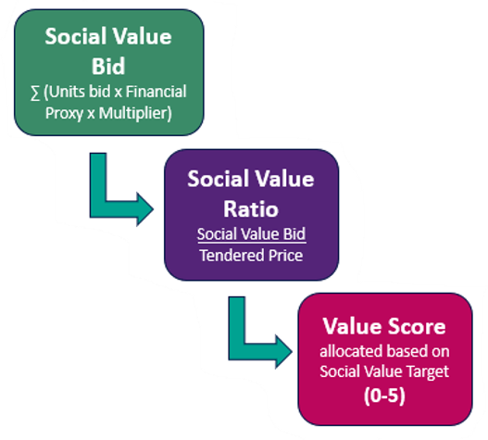
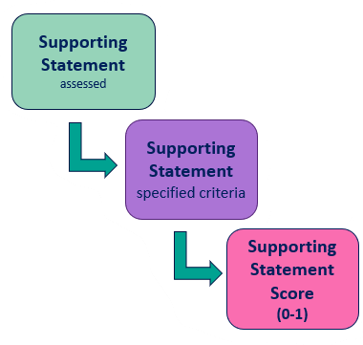
Social Value Evaluation
Supporting Statement Score
(0-1)
Total Social Value Score (out of 5)

Slide 6
Social Value at Contract Award
Social Value commitments made by the winning bidder form part of the contract:
KPI for Social Value delivery and reporting
Schedule in the Contract documentation
ECC TOMs Calculator submission
Supporting Statement
Included in Performance Monitoring
Notes:
Now looking at the Contract Award Stage –
The Winning Bidder’s Social Value commitments – the ECC TOM’s Calculator and Supporting Statement (including Implementation Plan) need to be saved in the Performance Management Schedule, alongside other contractual performance measures.
Social Value commitments made by the winning bidder must form part of the contract by including a KPI for Social Value delivery and reporting.
The winning bidder’s ECC TOM’s Calculator and Supporting Statement submission should be saved with the Contract documentation and included in Performance Monitoring.
In addition, for contract management and reporting purposes, the Buyer must create an Excel copy of the winning bidder’s ECC TOMs Calculator saved in this folder W:\O-S Procurement\5 Reporting\Power BI Reports\Cross Cutting\Social Value\Successful Tender Pledges renamed using the following naming convention:
Contract Number Contract Name #Supplier code
E.G.: ‘ECC1000408 Abacus Building Contract #SRM1000044’

Slide 7
ECC Social Value Reporting Tool
Aligned with all other contractual reporting requirements, winning bidder(s) will report on Social Value delivery and progress
ECC Social Value Reporting Tool – standardised approach for quarterly reporting
Social Value Reporting Schedule set out on the Social Value Catalogue.
ECC Social Value Reporting Tool replicates the ECC TOMs Calculator
Suppliers enter the social value delivered during the latest three-month period against each Measure to which they have made a commitment in their bid and contract.
Notes:
Aligned with all other contractual reporting requirements, winning bidder(s) will be expected to report on Social Value delivery and progress by completing the Social Value Reporting Survey quarterly.
The Social Value Reporting Schedule (outlining when reports are due) is based on quarterly reporting and will be set out on the Social Value Catalogue.
The Social Value Reporting Survey replicates the ECC TOMs Calculator, and suppliers must enter the social value delivered during the latest three-month period against each Measure to which they have made a commitment in their bid and contract.

Slide 8
ECC Social Value Reporting Tool
Overview
How to complete the Social Value Report
Community Marketplace
Reviewing and submitting your Report
Introductory questions
Questions based on ECC TOMs measures
Notes:
As part of wider contract monitoring and reporting responsibilities, from April 2022 Essex County Council (ECC) suppliers are required to use this Social Value Reporting Tool to record progress towards their Social Value commitments each quarter.
The Social Value Reporting Tool includes Themes, Outcomes and Measures which correspond to the Council’s ECC TOMs Calculator, used during the procurement process. A copy of the latest ECC TOMs Calculator can be found here on the Social Value Catalogue ECC TOMs for reference.
We recognise that to deliver some of the Social Value measures requires community engagement with Essex based organisations for example ECC19: Local school and college visits e.g. delivering careers talks, curriculum support, literacy support, safety talks, requires engagement with schools to arrange those visits. We call these ‘Community TOMs’.
So ECC has designed a ‘Community Marketplace’ area in its Social Value Catalogue to help suppliers communicate with local stakeholders efficiently and effectively. It is an online resource to assist ECC suppliers and Essex based organisations, such as schools, colleges, community organisations, social enterprises and SMEs, to make contact efficiently so they can work together to deliver social value locally.

Slide 9
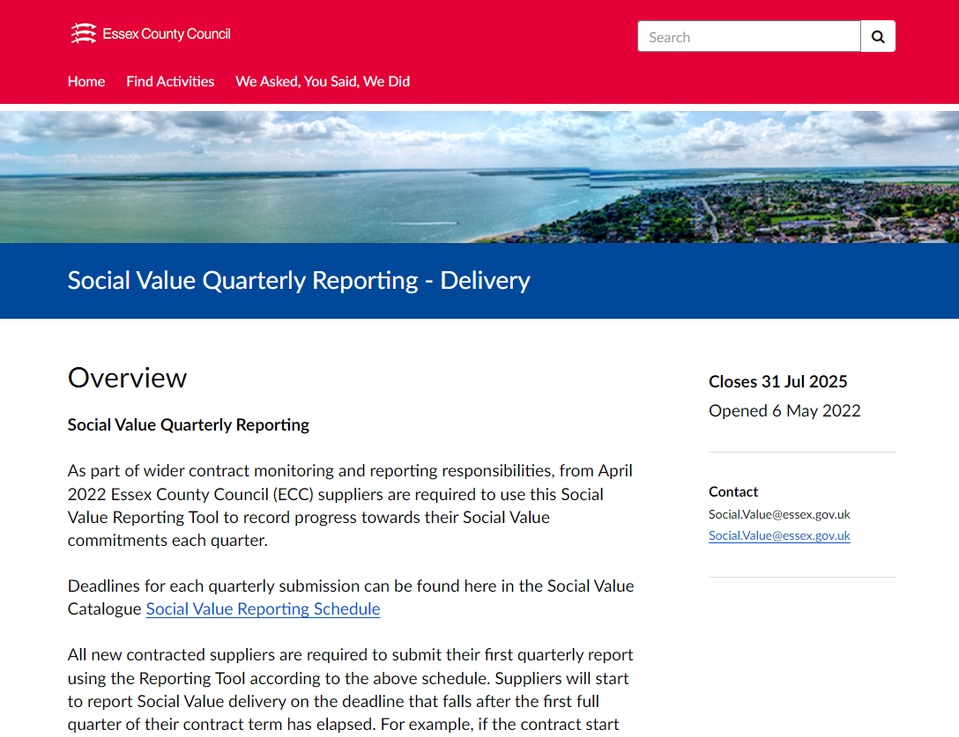

Slide 10
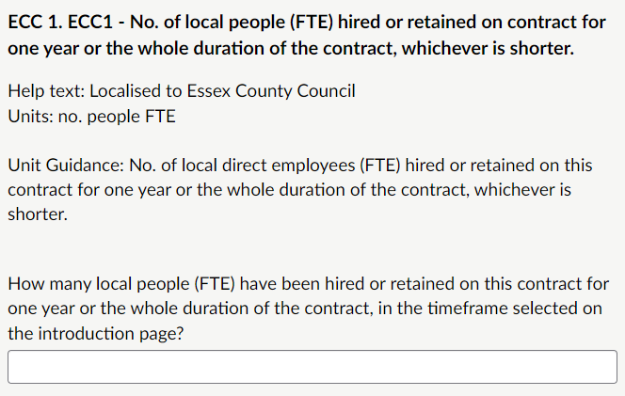

Slide 11
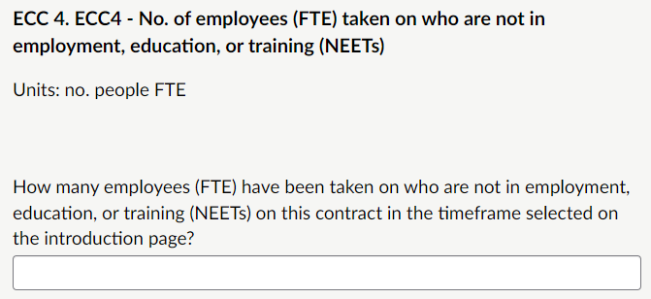
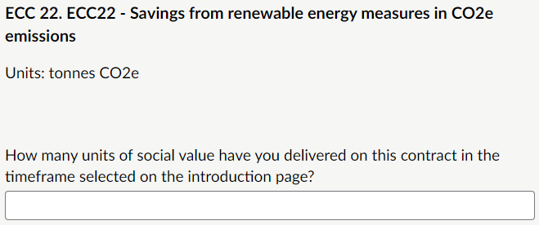
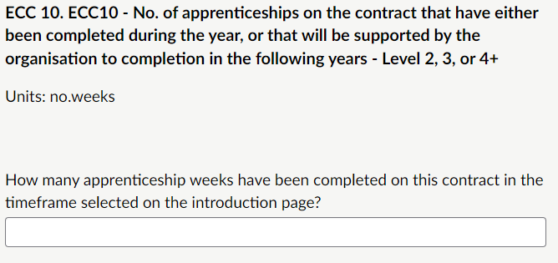

Slide 12
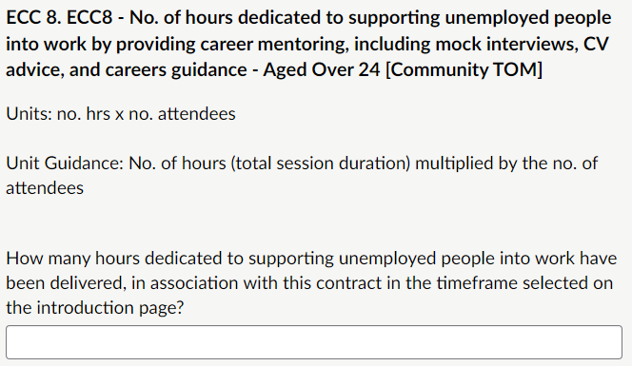
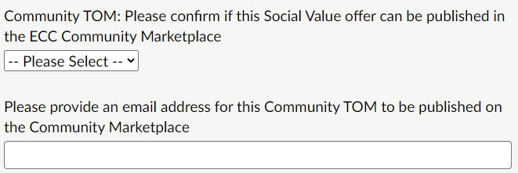

Slide 13
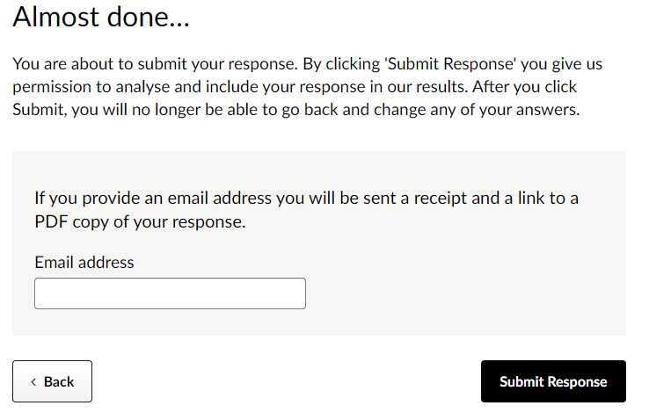

Slide 14
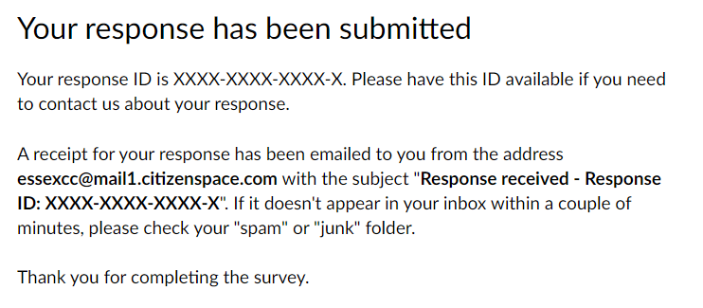

Slide 15
Social Value Performance Management
Social Value delivery measured against milestones and deliverables in the supplier’s implementation plan included in their Supporting Statement.
Remedial steps if a supplier is underperforming, aligned to the existing contract management process:
Performance Improvement Plan
Reprofile the delivery plan – the delivery plan may be reprofiled, within agreed set limits e.g., milestones must not be delayed by more than e.g. 25% of the duration of the contract.
Rectification Plan – suppliers identify alternate means to achieve the financial proxy value they bid, within the same Social Value outcome.
Rectification Plan - suppliers identify alternate means to achieve the financial proxy value they bid, within the full set of TOMs that were included with the tender.
Notes:
Social Value delivery should be measured against the milestones and deliverables set out in the supplier’s implementation plan included in their Supporting Statement.
If a supplier is underperforming, the Contract Manager should implement the following remedial steps, aligned to the existing contract management process:
Performance Improvement Plan
Reprofile the delivery plan – the delivery plan can be reprofiled, but you should set limits to this (to prevent habitual delays and non-delivery of Social Value). E.g., milestones must not be delayed by more than e.g. 25% of the duration of the contract.
Rectification Plan – suppliers identify alternate means to achieve the financial proxy value they bid, within the same Social Value outcome.
Rectification Plan - suppliers identify alternate means to achieve the financial proxy value they bid, within the full set of TOMs that were included with the tender. (Please Note: this action would need to be approved by the Head of Procurement).

Slide 16
Thank you for attending Day 2 of the Social Value Festival
Go back to the ticket page to bookmark other sessions
See too our Social Value Catalogue
Follow #EssexSocialValue

