Slide 1
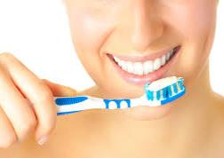
Oral Health Training
Adults with Additional Needs (ONLINE)
Essex Oral Health Improvement Team
Community Dental Services
www.communitydentalservices.co.uk
All the information contained in this training is up to date as of 15/07/2021

Slide 2
Before you start…
It is important to read all the slides and the accompanying notes below the slides in order to complete this training fully.
If you cannot see the written notes below each slide you will need to turn ‘notes’ on. This button is usually at the bottom of your screen and says ‘Notes’. Click this to turn on if needed.
If you have any questions please feel free to email or call the CDS Essex Oral Health Improvement Team. Our full contact details can be found on slide 82.
We hope you enjoy this online training toolkit.
Notes:
This is the area where you will find all the accompanying notes for each slide.

Slide 3
Who are Community Dental Services?
Community Dental Services has 8 clinics in Essex.
We provide a dental service for people with complex and additional needs (children and adults) including general anaesthetic & sedation clinics.
We provide a domiciliary service for bed bound patients.
We also have a clinic in Colchester with a tippy chair for wheelchairs.
Notes:
1. Referrals to our service need to come from a dentist or GP or patients can self refer.
2. Referral criteria information and referral forms can be found on our website: https://communitydentalservices.co.uk/patient-information/referrals/essex/

Slide 4
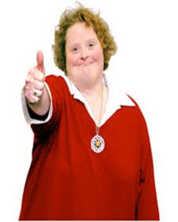
Aims of the Training
To increase your confidence in providing optimum oral care.

Slide 5
Objectives
Why oral care is important
Update on CQC oral care guidelines/policy
Brushing
Diet
Visiting the dentist and barriers to care
Conditions of the oral cavity
Alcohol and smoking
Mouth Cancer Awareness
End of life oral care
Notes:
There are also two main documents that staff need to be aware of in relation to oral care- these are:
NICE guidelines (2016) Oral Health for Adults in Care Homes: https://www.nice.org.uk/guidance/ng48
2. CQC Smiling Matters Report (June 2019)
https://www.cqc.org.uk/publications/major-report/smiling-matters-oral-health-care-care-homes
We will discuss these in a bit more detail later in the presentation.

Slide 6
Oral Care
Includes all areas of the mouth:
Teeth and gums
Hard and soft palate
Lining of the mouth and throat
Tongue
Lips
Salivary Glands
Notes:
We need to be checking all areas of the mouth and with regular reviews you will be able to note any changes or discomfort the person is in and seek professional advice.

Slide 7
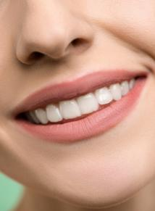
Oral Care
Good oral care is important for 5 main reasons:
Overall health
Prevention of pain and suffering
Adequate nutrition
Quality of life and comfort
Communication, socialisation and appearance

Slide 8
Impact of Poor Oral Hygiene
Disrupted sleep
Pain, discomfort, infection
Self-confidence and socialisation
Nutrition
Perception of the dentist
Huge economic cost
Pregnancy – poor oral health has been linked to premature & low birth weight babies
Notes:
Poor oral health can lead to a number a problems such as:
Disrupted sleep for example due to toothache.
It can lead to infection, pain and discomfort
It can lead to low self confidence and can effect someone’s socialisation.
Poor oral health can lead to problems with nutritional intake particularly if someone is in pain.
Perception of the dentist – We want everyone to develop a positive relationship with the dentist and to attend regularly so that problems are picked up early and preventative advice can be given.
Economic cost- Millions are spent per year on adults with tooth decay.
Pregnancy - Bacteria in the blood stream from the mouth has been linked to low birth weight and premature birth.

Slide 9
Notes:
This diagram shows us what problems poor dental health can cause.
Our mouth health has now been linked to a number of health conditions. The main factor is the bacteria in our mouth can travel around the body.
Poor oral health has now been linked to:
Aspirational pneumonia- Secretions left in the mouth can go into the lungs if someone is lying down for long periods – this can cause aspiration pneumonia.
Stroke - bacteria can travel through the blood stream and trigger inflammation alarms which can lead to blood clots.
Heart disease (inflammation of the valves) The bacteria can then start to circulate in the blood stream and can cause inflammation of the valves.
Mouth cancer
Diabetes - People with diabetes are more prone to oral health problems particularly if they have poor management of their blood sugars. Prolonged high blood sugars increase the risk of infection and periodontal disease. A person with poor oral health is also at increased risk of developing diabetes.
Tooth loss- this is caused by bacteria being left within the mouth and around the tooth surface and gum line. The gums will become inflamed and if left the gums will begin to recede. When the gum recedes, a gap appears between the tooth and the gum line and bacteria can enter into the body.

Slide 10
Oral health and links to general health
‘Putting the mouth back in the body’
Aspiration pneumonia
Probably the most common sequelae of poor oral health in aged persons is a risk of aspiration pneumonia. The risk of aspiration pneumonia is greatest when periodontal disease, dental caries, and poor oral hygiene are compounded by swallowing disease, feeding problems, and poor functional status
Dementia
The results suggest that poor oral hygiene is associated with dementia, and more so amongst people in advanced stages of the disease. Suboptimal oral health (gingivitis, dental caries, tooth loss, edentulousness) appears to be associated with increased risk of developing cognitive impairment and dementia
Diabetes
It is especially important for diabetics to take good care of their oral health to prevent complications with their disease. Because gum disease can lead to higher than normal blood sugar levels, a person with poor oral health is at an increased risk of developing diabetes
Heart disease
Gum disease (periodontitis) is associated with an increased risk of developing heart disease. Poor dental health increases the risk of a bacterial infection in the blood stream, which can affect the heart valves. Oral health may be particularly important if you have artificial heart valves
Strokes
People need to take care of their teeth because it is good for their brain and their heart as well as their teeth. A recent study has shown that oral bacteria are involved in several kinds of stroke, including brain haemorrhages and strokes that lead to dementia."
Low birth weight and prematurity
Research Links Poor Dental Hygiene to Low Birth Weight & Preterm Babies. Studies show the oral bacteria present in a pregnant woman can impact the health of her baby. More recently, researchers have unearthed more evidence which links periodontitis with low birth weight and premature birth
Notes:
This is another diagram showing some more links between oral health and general health.
Research has found that the oral bacteria present in a pregnant woman can impact the health of her baby. There is evidence which links periodontitis with low birth weight and premature birth.
This also highlights that poor oral hygiene is associated with dementia and more so amongst people with advanced stages of the disease.

Slide 11
Oral Health Risk Factors
Cognitive Disorder/ Disabilities- This may make it harder for people to understand the need for mouth care or to carry out mouth care.
Medical Conditions- Some medical conditions will make people more susceptible to oral health problems. E.g Diabetes, Xerostomia.
Physical Disabilities- This may lead to difficulties in carrying out personal mouth care or mobility problems.
( Mouth Care Matters 2019)
Notes:
There are certain groups of patients that will be more at risk of developing mouth related problems due to either one or a combination of medical, cognitive or physical disabilities:
Cognitive: This may make it harder for the child to understand the need for mouth care or to carry out mouth care. Patients with learning disabilities, Mental health conditions, Delirium, Depression, Autistic Spectrum disorders have all been found to be more at risk of oral health issues.
Medical conditions: Some medical conditions will make people more susceptible to oral health problems. For example Diabetes and Xerostomia (dry mouth) can significantly impact oral health. With diabetes oral hygiene is really important to help maintain balanced blood sugar levels. If a adult has an infection in the mouth the blood glucose levels will usually rise in response. Should the infection in the mouth become worse, there could be problems with food intake, which might affect diabetes management.
Physical disability: This may lead to difficulties in carrying out personal mouth care or mobility problems. Conditions such as muscular dystrophy and cerebral palsy for example can affect an individuals ability to complete oral hygiene tasks.

Slide 12
Oral Health & People with Mental Health Problems
Mental health conditions such as depression can cause patients to lose motivation for personal hygiene including mouth care.
May require motivation from hospital staff to encourage them to look after their mouths.
This may include daily reminders and encouraging them at different times of the day when they are more receptive.
A number of antidepressant medications can cause dry mouth.
Notes:
Mental health conditions such as depression can cause patients to lose motivation for personal hygiene including mouth care.
They may require motivation from hospital staff to encourage them to look after their mouths.
This may include daily reminders and encouraging them at different times of the day when they are more receptive.
It is also important to note that a dry mouth can be a side effect of over 400 medications and among the more likely types to cause problems are some of the drugs used to treat depression, nerve pain (neuropathy) and anxiety, as well as some antihistamines, decongestants, muscle relaxants and pain medications.
People suffering from a dry mouth are more at risk of oral health problems therefore it is really important that any patients on such medications for their mental health are aware of the importance of good oral care.

Slide 13
Oral Health & People with Learning Disability
The oral health of people with moderate – severe LD has been found to be poorer than that of the general population.
Have been found to have higher rates of untreated dental decay and severe gum disease.
Patients with LD or autism may find it difficult to communicate when they are in pain or have problems with their mouth.
May need simple reminders regarding oral care or may require assistance.
Notes:
The oral health of people with moderate – severe LD has been found to be poorer than that of the general population.
For example they have been found to have higher rates of untreated dental decay and severe gum disease.
Patients with LD or autism may find it difficult to communicate when they are in pain or have problems with their mouth.
They may need simple reminders regarding oral care or may require assistance to do it.

Slide 14
CQC Smiling Matters Report 2019
Highlighted that awareness and implementation of NICE 2016 guidelines should be a priority.
All care homes should have an Oral Health Policy (NICE 2016).
Oral Health Champion to be assigned.
Individual care plans & oral health assessment to be completed on admission.
Daily mouth care following ‘Delivering better oral health toolkit’ .
Supporting staff knowledge and skills by providing training
Notes:
The CQC Smiling Matters Report reviewed oral health in care home across England and highlighted that implementation of the NICE 2016 Oral Health for Adults in Care Homes guidelines at https://www.nice.org.uk/guidance/ng48 should be a priority and recommends that day to day oral hygiene to be of equal priority to other personal care tasks.
The report found that too many people living in care homes were not being supported with their oral health therefore staff needed better training.
Both the CQC report and NICE 2016 guidelines recommend that all care homes have an Oral Health Policy and assign an Oral Health Champion, ideally someone with interest in the subject.
The Oral Health Champion can be someone who has overall responsibility for oral health within the care setting - for example they can make sure all the oral health care plans are kept up to date, toothbrushes are changed regularly, staff are provided with oral health training and are following the Delivering Better Oral Health Tool Kit Guidelines, 2017 (which we will talk a bit more about later). This is a document produced by Public Health England and provides oral health advice from birth – adulthood.
The NICE Guidelines 2016, set out what an oral health policy should contain and the importance of oral health assessments and individual care plans. Again we will talk about this in more detail on the next slides.

Slide 15
Oral Health Assessment Tool
Assess the mouth care needs of all residents on admission.
The oral health assessment can be used as part of daily mouth care and results should be clearly recorded.
Australian Institute of Health & Welfare Oral Health Assessment tool is recommended by NICE guidelines 2016 (NG48).
Record results of the oral health assessment in the patient’s care plan.
Any areas scoring 1 or 2 on the assessment tool – seek dentist advice.
Notes:
Assess the mouth care needs of all residents on admission.
The oral health assessment can be used as part of daily mouth care and results should be clearly recorded.
The Australian Institute of Health & Welfare Oral Health Assessment tool is recommended by NICE guidelines 2016 (NG48). Please copy and paste the following link into your browser to access this: https://www.nice.org.uk/improving-oral-health-for-adults-in-care-homes
Results from the Oral Health Assessment Tool should be recorded in the person’s care plan.
Any areas scoring 1 or 2 on the assessment tool – seek dentist advice.
The assessment tool should prompt care plans and dental appointments.
The tool can be used to assess/reassess the patient as many times as required.
Oral health should be routinely checked when a resident experiences weight loss that cannot be explained through ill-health or other ongoing health conditions. This should be carried out by a dentist.

Slide 16
Care planning
Record results of oral health assessment
Record how the resident usually manages their daily mouth care and what support they need.
Record if they have dentures, marked or unmarked.
Record name & address of resident’s dentist and ensure check ups are booked & recorded.
Daily documentation of oral care and any concerns.
Review and update residents' mouth care needs in their personal care plans, as their mouth care needs change, to ensure care plans are kept up to date.
All care plans should have review dates (at least monthly).
Notes:
All patients should have an individual care plan which should be reviewed and updated with their mouth care needs as they change or at least monthly, whichever comes first. This is really important so that the care plan is always kept up to date.
The oral needs and care of each resident should be monitored daily and it’s really important that all staff know how to recognise and respond to a residents’ changing mouth care needs and who to report any concerns to, e.g. your oral health champion.
The NICE Guidelines 2016, Oral Health For Adults In Care Homes at: https://www.nice.org.uk/guidance/ng48 provide thorough guidance on what exactly should be included in an individuals oral health care plan. You will need to refer to these guidelines when writing your care plans but for example you would include things like: - the results of the oral health assessment, - how the resident usually manages their mouth care & what support they need (do they use a electric or manual toothbrush/ what sort of toothpaste do they like/ do they wear dentures), - name and address of their dentist and any dental appointments, (if they haven’t got a dentist this will need to be arranged).
With the patients’ permission it can also be useful to involve family in the initial assessment/ care planning process in order to understand to patients full oral care needs/ usual routine.
The daily mouth care provided by staff should follow each patient’s care plan and should be aligned with advice in the Delivering Better Oral Health Tool Kit (2017).
There should also be clear daily documentation of mouth care provided by staff and any observations of the mouth should be recorded including any concerns such as ulcers/ sore spots/ changes for example, so that other staff know there are concerns and can continue to monitor.
All staff should also know how to respond if a resident does not want daily mouth care or to have their dentures removed. Any refusal of care should be clearly documented and reported to a senior member of staff. Reasons for refusal of care and subsequent re-attempts to provide the care should also be documented. Familiarise yourself with the ‘Refusal of Care’ policy within your workplace.
Toothbrushes should be changed when bristles become splayed or every 3 months, whichever comes first. This should be clearly documented in care plans.

Slide 17
Notes:
This is a really great tool from Mouthcare Matters, A Guide for Hospital Healthcare Professionals (Second Edition) (2019).
This guide and the above poster can be found at: https://mouthcarematters.hee.nhs.uk/links-resources/mouth-care-matters-resources-2/ (You may need to copy and paste this link into your browser in order to access).
You could have this poster displayed within your home so you have a point of reference if a resident is showing any concerns.
It’s like a traffic light system where green is healthy, and amber or red are a cause for concern and shows what needs to be referred to a dentist.
In a healthy mouth the lips and tongue should be pink and moist. The mouth should be clean, look healthy and have saliva present. The teeth should be clean and there shouldn’t be any broken or loose teeth. Dentures should be clean and comfortable.

Slide 18
Mouth Cancer
Mouth cancer can occur in a number of places. Three signs and symptoms not to ignore & to be reported to your dentist are:
Any mouth ulcers present for over 10 days
Red and white patches in the mouth.
Unusual lumps or swellings in the mouth or head and neck area.
Early detection is so important!
Notes:
Mouth cancer can strike in a number of places, including the lips, tongue, gums, tonsils and cheeks. Three signs and symptoms not to ignore & to be reported to your dentist are:
Mouth ulcers present for over 10 days
Red and white patches in the mouth.
Unusual lumps or swellings in the mouth or head and neck area.
Early detection is crucial for survival, therefore it’s extremely important that we all know what to look out for. The key message here is “If in doubt, get checked out”.
We should all be having regular dental check ups every 6 months which should include an oral cancer screen. Mouth cancer can affect anyone.
People with dentures or no teeth can still get mouth cancer and therefore still need to have regular oral cancer screens and check ups by a dentist every 6 months.
More information on mouth cancer can be found on the NHS website at https://www.nhs.uk/conditions/mouth-cancer/ or on the Oral Health Foundation website at https://www.dentalhealth.org/mouthcancer
More information on mouth ulcers can also be found on the Oral Health Foundation website at https://www.dentalhealth.org/mouth-ulcers
For more information on how to check for mouth cancer there is an excellent section on the Oral Health Foundation website: https://www.dentalhealth.org/mouthaware
If you find anything unusual in any of these areas, or are unsure of anything, see a dentist or doctor as soon as possible.
If spotted early the chances of cure are good. Don’t hesitate to get checked.
A more detailed summary of signs and symptoms to look out for includes:
1. Any lumps, bumps, swellings, tenderness on face or neck
2. Any sores, lumps, changes in colour or texture on lips
3. Any red, white or dark patches in the cheeks or any lumps tenderness or ulcers
4. Lumps or ulcers on the roof of the mouth or change of colour
5. Any changes in colour or texture of the tongue, any lumps, swellings, or ulcers. Check top, sides and underside of the tongue.
6. Any changes in colour of the floor of the mouth, and any lumps, swellings or ulcers.

Slide 19
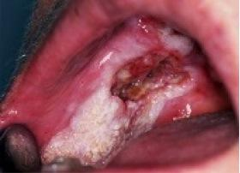
Mouth Cancer
Risk factors:
Smoking and alcohol
Low fruit/vegetable diets
Poor oral hygiene
Low immune system
Social disadvantage
Sun exposure
HPV infection
Notes:
There are several risk factors for developing mouth cancer. These include:
Tobacco and alcohol- are the leading causes of mouth cancer in the UK. Both tobacco and alcohol are carcinogenic, which means they contain chemicals that can damage the DNA in cells and lead to cancer.
Low fruit/ vegetable diets
Poor oral hygiene
Low immune system
Social disadvantage
Sun exposure – Important to use a SPF lip balm to protect the lips.
HPV Infection – The human papilloma virus (HPV) is a group of viruses that affect the skin and moist membranes inside the body, such as those in the cervix, anus, mouth and throat.
You can get an HPV infection by having sexual contact with a person who's already infected. You do not have to have penetrative sex, just skin-to-skin contact. There's evidence that in rare cases, certain types of HPV can cause abnormal tissue growth inside the mouth, triggering mouth cancer.
You can reduce your risk of mouth cancer by making healthy lifestyle choices, for example: stop smoking, making healthy food choices etc.
For girls and boys aged 12 to 13 years they are also offered the HPV vaccine as part of the NHS vaccination programme. This vaccine helps to protect against a number of cancers including cervical cancer (in the girls) but also some mouth and throat cancers caused by the HPV virus. If a young person missed the vaccine in school (and are eligible) they can have it free on the NHS up until their 25th birthday.

Slide 20
Brushing Video
Notes:
Video Produced by Health Education England:
If the video does not play when clicked please copy and paste the following link into your browser to access: https://www.youtube.com/watch?v=BapR9J86ZZw

Slide 21
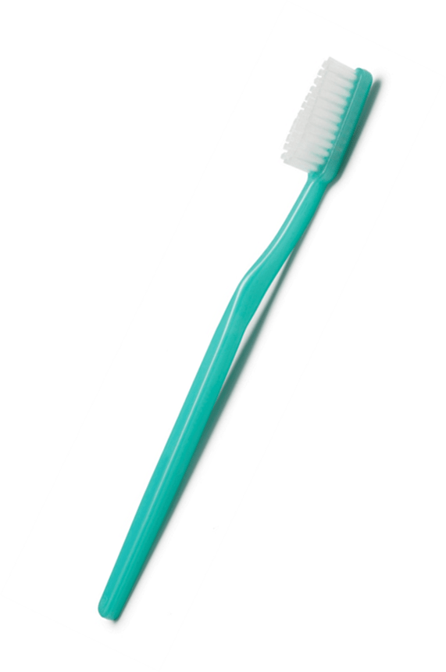
Brushing
Brush teeth in small circular motions for 2 minutes.
Include the part where the tooth meets the gum.
Brush the outside, inside and biting surfaces on the teeth.
Include cleaning the tongue.
If gums bleed brush gently but thoroughly and see dentist.
Notes:
Brushing our teeth is important in order to remove bacteria, the build up of plaque and to help prevent decay.
It is best to brush teeth in small circular motions as this will reduce the risk of tooth abrasion and also removes more bacteria. The only place you should use the back and forth motion is along the bite lines at the back.
Start by tilting the toothbrush against the teeth so that the bristles are at a 45 degree angle to the gum line, this means slightly tilting the brush up for the top teeth and slightly down for the bottom teeth.
Move the brush in small circular movements and include the part where the tooth meets the gum.
Brush the outside, inside and biting surfaces of the teeth in a methodical way.
To clean the inside surface of the front teeth tilt the brush vertically for the upper teeth and gently move the brush longways down the tooth from the gum for a few seconds. For the inside of the lower teeth tilt the brush vertically and pull the toothbrush gently upwards from the gum line for a few seconds.
Include cleaning the tongue.
Make sure you brush for 2 minutes.
If gums bleed continue to brush gently but thoroughly and refer to dentist to get checked.

Slide 22
Toothbrushing Guidance
Notes:
This toothbrushing guidance has been taken from the Delivering Better Oral Heath Tool Kit Guidelines (2017):
We should all be brushing twice a day. Brush last thing at night before bedtime and at least one other time during the day - Ideally in the morning (after eating breakfast). You should not brush your teeth for one hour after you have eaten or drank anything. If you brush your teeth before this time, you might brush away the tooth surface, which can lead to dental erosion.
Use a small headed toothbrush with medium bristles. Always replace the toothbrush once bristles become splayed, or every 3 months.
Use a tooth paste containing fluoride. For adults this should contain 1,350 – 1,500 ppm fluoride.
Spit out (if able to) after brushing and do not rinse to maintain fluoride concentration levels.
Adults to use a pea size amount of toothpaste if able to spit. If a adult is not able to spit or has swallowing difficulties they should have a smear of toothpaste. The guidance with regards to how much toothpaste a child should have can be found in the Delivering Better Oral Health Tool Kit or if anyone wants more information we can provide you with this.
Interdental Cleaning:
For older children (12 years plus) and adults cleaning interdentally is key as this is where bacteria will build up.
Interdental cleaning is where the aim is to clean the areas in between the teeth. This is to remove the dental plaque in areas where a toothbrush cannot reach.
The interdental aids you can use depends on the ability / safety of the patient as well as the interdental space they are cleaning. Seek advice from the dentist about what is best to use.
Some teenagers may not have large enough spaces in between their teeth to use an interdental brush so flossing can be a useful alternative.
Interdental brushes can be used if someone has the ability and is safe to use - Important to buy the correct size interdental brushes. Your dentist can give advice regarding this.
For safety reasons interdental brushes may not be appropriate for some children/adults with additional needs and for some patients in care home settings - especially if they need help with their oral care. Seek advice from the dentist about what is best to use and is suitable for the needs of the patient.

Slide 23
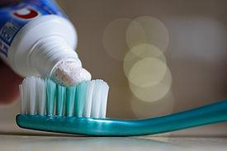
Toothpaste
Any toothpaste brand is fine as long as it has the correct amount of fluoride.
Charcoal, smokers and some whitening toothpaste do not contain any or the correct amount of fluoride and can be abrasive.
Notes:
Colgate Total Whole Mouth Health toothpaste is good as it lowers the bacteria levels in the mouth.

Slide 24
Mouthwash
Avoid mouthwash after brushing.
Use between brushing, once a day.
If mouthwash is used then ensure it contains fluoride and is alcohol free.
Chlorhexidine treatment mouthwash is for short term use. A bottle is a dose for two weeks.
If a problem still persists after two weeks consult your dentist.
Always check for allergies to Chlorhexidine products before use and record in patient’s notes.
Notes:
Mouthwash should be avoided after brushing our teeth for the same reason we should not rinse the mouth after brushing i.e. If you use a mouthwash after brushing your teeth you will wash away and dilute the fluoride concentration levels in your mouth (from the toothpaste) which means less protection for the teeth.
If you do really want to use a mouthwash it is best to use once daily between brushing, (so at a different time of day to when you brush your teeth), perhaps after lunch for example.
It is important to ensure the mouthwash contains fluoride and is alcohol free.
Mouthwash should never be used as a substitute for brushing.
Chlorhexidine (Brand name: Corsodyl) treatment mouthwash is for short term use. A bottle is a dose for two weeks. If a problem still persists after two weeks you must consult a dentist.
Always check for allergies to Chlorhexidine products before use and record in the patient’s notes.
Its important to mention also that Chlorhexidine mouthwash will stain teeth after excessive use and will also kill “healthy” bacteria and could lead to thrush.

Slide 25
Assisted Brushing
Ensure you have everything you need before you start (eg toothbrush, toothpaste etc).
Always wear PPE
Consider positioning for each patient, ideally should be upright (sitting or standing) whilst brushing to reduce the risk of choking & aspiration pneumonia.
For patients with difficulty swallowing and/or spitting and anyone who is nil by mouth or suffers from Hypersalivation use a non foaming toothpaste and tilt chin to chest during brushing. Always encourage patient to spit out after brushing.
Start in the same part of the mouth and clean each tooth in order.
Be aware of any loose teeth and brush with care.
Do not rinse after brushing – encourage patient to spit out and wipe the face with a damp cloth.
Notes:
When assisting someone with their toothbrushing there are a number of things that can help:
Firstly ensure you have everything you need before you start (Toothbrush, toothpaste, pen torch, paper towel).
Always wear your PPE.
Consider positioning for each patient:
So, ensure the person having their teeth brushed and yourself are comfortable before you start. Ideally the person having their teeth brushed should be upright (sitting or standing) to reduce the risk of choking and aspiration pneumonia.
If a person has difficulty swallowing and/or spitting, or they are nil by mouth or they suffer from hypersalivation (excessive production of saliva) tilt their head/chin down towards their chest so that no salvia or secretions enter the lungs whilst brushing. If the head tips backwards, toothpaste and saliva could get into the airway. Its also advisable to use a non foaming toothpaste for these patients. Always encourage the patient to spit out after brushing.
4. Try to start in the same part of the mouth each time and clean every tooth in order. Follow the guidance given previously with regards to brushing method.
5. Be aware of any loose teeth and brush with care.
6. If gums bleed continue to brush gently but thoroughly and refer for a dental appointment.
7. After brushing encourage the person to lean forwards to spit out rather than swallow. Do not rinse after brushing – just wipe the face with a damp cloth.
8. Keep a record of any changes seen.

Slide 26
Mouth care for patients with confirmed or suspected COVID-19
Always check with the nurse in charge before removing the oxygen mask from the patient to provide mouth care.
If possible, sit the patient upright.
These patients are more likely to cough when performing mouth care, stand to the side or behind them, take breaks to allow the patient to rest and swallow.
Do not use an electric toothbrush as this may cause droplets and splash.
If the patient can brush their own teeth give them a soft, small headed toothbrush with a smear of toothpaste (use non-foaming toothpaste if available).
If the patient can spit, give the patient a disposable bowl to spit into.
Always wear PPE.
Notes:
The Government website provides clear guidance on mouth care for a patient with confirmed or suspected COVID 19. You will need to refer to this guidance for full details if dealing with a patient in this situation as this slide is just some of the key points.
Before providing any mouth care to such patients always check with the nurse in charge before removing the patient’s oxygen mask.
These patients are more likely to cough when performing mouth care so stand to the side or behind them, take breaks to allow the patient to rest and swallow.
The advice includes things like not using an electric toothbrush for example as this may cause droplets in the air, they also advise to only use a smear of toothpaste (non- foaming if available) and to give the patient a disposable bowl to spit into. As stated there is lots of other information available including care of dentures etc in such patients on the Government website.
Please click the link below to access the Government website or copy and paste the link into your browser:
https://www.gov.uk/government/publications/covid-19-mouth-care-for-patients-with-a-confirmed-or-suspected-case/mouth-care-for-hospitalised-patients-with-confirmed-or-suspected-covid-19

Slide 27
Supporting residents who are resistant to mouth care
Notes:
Video produced by Health Education England.
If the video does not play when clicked please copy and paste the following link into your browser to access: https://www.youtube.com/watch?v=ieQJFSUlOps

Slide 28
Supporting residents who are resistant to mouth care
Most common barrier is care resistant behaviour.
Common with resident with Dementia, learning disabilities or a neuro-disability.
Not opening mouth, pushing away carer, verbally declining.
Resistance could be due to many reasons.
Resistance is their way of protecting themselves.
Notes:
One of the most common barriers reported by nurses when providing mouth care is care resistant behaviour.
This can be common with residents with Dementia, Learning dis or neuro-disabilities.
Resisting mouth care can include: not opening the mouth, pushing away their carer or verbally declining.
A resident may resist mouthcare due to confusion/disorientation, pain, feeling unwell or may perceive the action of toothbrushing as a threat.
Resistance is their way of protecting themselves.

Slide 29
Supporting residents who are resistant to mouth care cont’d….
You can support a resident in many ways.
Place the toothbrush in front of the resident or put in residents hand
Apply small amount of toothpaste to lips to remind the resident.
Develop a routine
Is there a time of day when the resident is more cooperative?
Use familiar toothbrush and toothpaste
Ensure patient is sitting up if appropriate.
Notes:
Healthcare professionals can support a resident by: Taking your time, Being kind and patient, Smiling & making eye contact, Maintain communication throughout, Use short, simple instructions, Use reminders & prompts
Place the toothbrush in front of resident or place in their hand.
You could apply a small amount of toothpaste to their lips to act as a reminder.
Develop at routine by doing mouth care at the same time each day.
Find a time of day when you know the resident will be more cooperative with personal care, such as after breakfast.
Use toothbrushes and toothpaste that the resident is familiar with
The resident should be sat up where possible to reduce the risk of aspiration.

Slide 30
Supporting residents who are resistant to mouth care cont’d…..
Face resident so they can mirror and mimic your actions.
Brush their hand with toothbrush first.
Use hand over hand technique
Use distraction techniques.
Use familiar carers.
Consider having two carers.
Some residents can be very resistant to mouth care. Stop, record and try again at a different time.
If resident refuses several times consecutively, escalate to a senior nurse.
Notes:
Stand facing the resident so they can mirror and mimic your actions.
You can gently brush the residents hand with their toothbrush
Try hand over hand technique guiding the resident to brush their teeth.
Distraction techniques can help for example playing their favourite tv/radio programme in the background.
Ask a carer or family member who the resident is familiar with to help or to carry out the care.
Two carers can be useful. One to distract or gently hold the residents hand and the other to carry out the mouth care.
Some residents can be very resistant to mouthcare. Stop if needed, record what you have done and try again at a different time.
If the resident refuses on several consecutive attempts, this should be escalated to a senior member of your team or medical team as there may be underlying problems with their mouth.

Slide 31
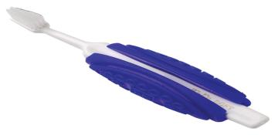
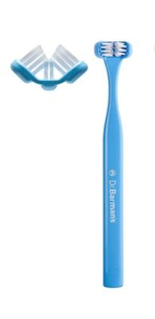
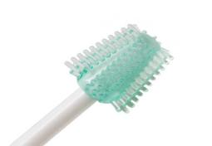
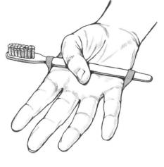
Toothbrush Aids
2
1
5.
3
4.
Notes:
Dr Barmans three sided toothbrush: This cleans all three surfaces of the teeth at the same time. This is great for anyone if access is a problem or who finds toothbrushing difficult.
Toothbrush Handle Adaptor: Great for anyone with dexterity issues or someone that still wants to perform their own oral care but may have difficulty with grip.
Electric toothbrush: This can be a helpful mouth care aid as you can just glide this over the tooth surface.
A simple elastic band: This can help someone to perform their own oral care with little assistance by attaching the toothbrush to the hand as shown in the picture.
360 mouth cleaner/ (Moutheze Oral Cleanser)- Ideal for those who have dentures to clean the mouth with (e.g. the palette, gum ridges & tongue).

Slide 32
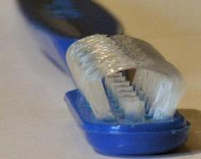
Products & Aids
1
2
3
4
Notes:
Bite Block/ Mouth Rest: - This can helpful relieve the pressure of jaw pain whilst brushing. Its softer than plastic but harder than sponge. It can be used to prop a persons mouth slightly open.
Finger guard: - to protect your finger whilst performing oral care.
Tuffed” brush. Its great for areas too big for an interdental brush but too small for a toothbrush.
4. Collis Curved Toothbrush: - The bristles part when the brush is used, allowing both sides and the top of the teeth to be cleaned. Fewer brush strokes are needed to clean the teeth and gums, helping those who tire easily or those who find oral care stressful and uncomfortable.

Slide 33
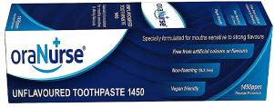
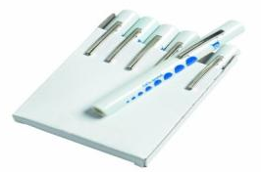
Products
Unflavoured toothpaste
Non- foaming toothpaste
SLS free toothpaste
Dry mouth gel
Water based lip balm
Pen Torch
Notes:
There are many different types of toothpastes and products out there to suit a residents needs. This includes; unflavoured, sensitive, non-foaming and SLS free.
For patients who have difficulty swallowing and/or spitting, a non foaming toothpaste is advisable.
You can buy these products from a company called OraNurse. These can be sourced from Amazon and some of the larger Boots stores. Great for those with heightened senses and for some children with autism.
Always ask the GP for advice on artificial saliva products/ dry mouth gel to ensure the product is suitable for age/ needs of the patient.
For dry lips use a water based lip balm. Avoid Vaseline especially if someone is on oxygen as it is made from petroleum which is flammable!
A pen torch is really useful for being able to see well inside someone’s mouth.

Slide 34
Infection Control
All of the toothbrushing products and aids mentioned in the presentation need to be considered in terms of infection control.
Toothbrushes should be left to airdry and replaced regularly.
Adaptations should be cleaned and left to airdry. Check regularly for damage and replace if necessary.
We would advise your infection control lead is consulted regarding the use of each product/ aid (including pen torches) and how best to ensure sanitation between uses.
All of the products/ aids should only be used by one person and not shared with others.
Notes:
All of the toothbrushing products and aids mentioned in the presentation need to be considered in terms of infection control.
Toothbrushes should be left to airdry and replaced regularly.
Adaptations should be cleaned and left to airdry. Check regularly for damage and replace if necessary.
We would advise your infection control lead is consulted regarding the use of each product/ aid (including pen torches) and how best to ensure sanitation between uses.
All of the products/ aids should only be used by one person and not shared with others.

Slide 35
Denture Video
Notes:
Video produced by Health Education England.
If the video does not play when clicked please copy and paste the following link into your browser to access: https://www.youtube.com/watch?v=aJvsFUtRL9k&list=PLrVQaAxyJE3eYeayCLSUFpxtkMxWmRo7L&index=1
Further information on denture care and the oral health care of adults in care homes can be found in the Public Health England Tool Kit at:
https://www.gov.uk/government/publications/adult-oral-health-in-care-homes-toolkit

Slide 36
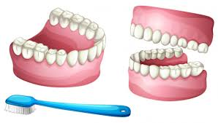
Denture Care
Dentures should be removed before brushing natural teeth.
Dentures should be worn daily and taken out at night.
Clean dentures twice a day with a separate brush.
Use an un-fragranced liquid soap or denture cleaning paste and rinse after meals.
Brush using a denture brush over a sink or bowl filled with water or a folded towel to prevent breakage if dropped.
Clean the palette, gum ridges and tongue.
Brush any remaining natural teeth with a normal toothbrush and toothpaste.
Always check the mouth for sore patches.
Notes:
Dentures should be removed before brushing any natural teeth.
All dentures should be worn daily. Dentures should be taken out at night as this reduces the risk of thrush/ gives the mouth a chance to breathe. Some residents may be reluctant but it is important we give them the option. Leaving dentures in situ can lead to denture stomatitis – mouth will be sore and inflamed.
Clean dentures twice a day with a separate brush. Use an un-fragranced liquid soap or denture cleaning paste and then rinse. Also rinse after meals. Normal toothpaste should not be used to clean dentures. Toothpaste can cause damage to the surface of the denture over time.
Brush using a denture brush over a sink or bowl filled with water or a folded towel to prevent breakage if dropped.
Clean the palette, gum ridges & tongue with soft brush or 360 brush.
Brush any remaining natural teeth with normal brush and toothpaste. If the patient does not have any natural teeth left the mouth should still be brushed with water, a toothpaste could be used at the same time to help freshen the mouth or alternatively after brushing the mouth with water a mouthwash could be used. Colgate Total Whole Mouth Health toothpaste can be useful as it reduces the bacteria in the mouth. Always encourage the patient to spit out afterwards.
Always check the mouth for sore patches- Any sore patches could be the dentures rubbing and should be checked by a dentist.
Dentures should be worn daily. This is particularly important for partial dentures which are worn with existing teeth. If left out existing teeth may move slightly into the gaps and the partial denture may no longer fit.

Slide 37
Denture Care
Clean dentures as per manufacturing instructions as this varies depending on the type of denture.
Dentures should not be soaked in a cleaning solution overnight - store dry in a named denture pot.
Clean the denture pot on a daily basis with warm soapy water.
Follow instructions on how to use fixative as too much can pose an aspiration risk.
If acutely unwell store dentures dry in a named denture pot.
Seek advice from a dentist if resident stops wearing denture.
Name dentures if possible.
Notes:
When cleaning dentures (always follow manufacturers instructions). Please note that chrome/ cobalt dentures (metal denture with acrylic teeth stuck to them) should not be soaked in sterilising solutions! Instead these types of dentures should be soaked for 10-20 minutes in Chlorhexidine Treatment Mouthwash (1-2 weekly).
Dentures should not be soaked in a cleaning solution overnight. They should be stored dry in a named denture pot. Clean the denture pot on a daily basis with warm soapy water.
Another reason dentures should not be soaked in a glass of cleaning solution over night is this can pose a risk to the resident as they may mistake this as water.
If a fixative is used follow instructions on how to apply as too much can pose an aspiration risk.
If a resident is acutely unwell they may not be able to wear their dentures – store dry in a named denture pot. Clean the pot daily with warm soapy water and the dentures should be rinsed daily under tap water and left to air dry. Once the resident is well enough to wear their dentures again sterilise the dentures before use following manufacturer instructions.
Advice should be sought from a dentist/ doctor if a patient is going to stop wearing their dentures. This is to make sure this is the right decision for that patient.
Name dentures if possible. This is important so they are not lost.

Slide 38
Plaque
What it is
What it does
Notes:
Plaque is a clear sticky film that adheres to the teeth.
If left plaque begins to harden and become what’s know as tartar.
Tartar cannot be removed with a toothbrush and must be removed by a dentist/hygienist/therapist.
If plaque is left on the gum/tooth surface it can lead to gum disease and eventually tooth loss.

Slide 39
Gum Disease
Swollen gums
Bleeding on brushing
Receding gums
Bad breath/bad taste
Wobbly teeth
Tooth loss
Notes:
If any of these signs or symptoms are noted always see a dentist for advice.
To keep our gums healthy we should ensure really good oral hygiene is followed including interdental brushing.

Slide 40
Risk factors for Gum Disease
Poor oral hygiene
Smoking
Age
Medical conditions
Pregnancy
Weakened immune system
Malnutrition
Medicines that cause a dry mouth
Notes:
There are many risk factors associated to gum disease to be aware of:
Poor oral hygiene – Gum disease can be caused by a number of factors but poor oral hygiene is the most common cause. Poor oral hygiene such as not brushing your teeth properly or regularly can cause plaque to build up on your teeth.
Smoking- Smoking hinders the blood supply within the body. Therefore you may not get the initial warning signs such as bleeding gums. Smoking also causes a lowering in immunity therefore your body is more likely to exasperate the inflammatory process to the gums if plaque is left.
Age- Natural aging can cause bone loss and also lack of immunity therefore the gums may become inflamed with a small amount of plaque.
Medical conditions-These include: Certain diseases, such as diabetes, rheumatoid arthritis and Crohn's disease
Pregnancy- – hormonal changes can make gums more vulnerable to plaque
Weakened immune system- – for example, because of conditions like HIV and AIDS or certain treatments, such as chemotherapy.
Malnutrition-Being malnourished, or having a lack of proper nutrients, can negatively affect the mouth (e.g., teeth and gums) leading to increased risk of gum disease and other oral health-related problems.
Medicines that cause a dry mouth: Saliva is very important in fighting tooth decay. It helps to fight the bacteria that form dental plaque and cause tooth decay and gum disease. You may be more likely to have gum disease if you're taking medicines that cause a dry mouth. For example: some antidepressants, antihistamines and blood pressure medications. Some high blood pressure medications are diuretics therefore these can reduce saliva flow. Other medications include: Phenytoin, a seizure medication. Cyclosporine, an immunosuppressant drug often used to prevent transplant rejection. Blood pressure medications called calcium channel blockers, which include nifedipine, verapamil, diltiazem, and amlodipine.

Slide 41
Dental Caries
Tooth
Plaque
Sugar
Frequency
Notes:
Dental caries is caused by plaque and sugar frequency. Caries is not caused by the amount of sugar you have its how often you have it.
By brushing twice daily, it removes plaque & bacteria build up.

Slide 42
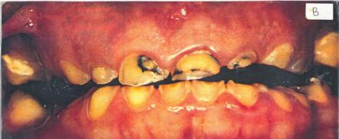
Dental Erosion
1
3
2
Notes:
Dental erosion is caused by frequent consumption of acidic foods and drinks dissolving and softening the outer hard surface of the tooth known as enamel. Dental erosion can cause pain and sensitivity and is irreversible but preventable!
Examples of acidic foods and drinks are vinegars, pickles and fruit juices.
Any fizzy (carbonated) drink (including sugar free carbonated drinks) can also cause dental erosion as they are acidic. Sparkling water also has links to dental erosion.
Although fruit squash is not fizzy it is acidic and it can therefore cause dental erosion.
Eroded teeth are then also more vulnerable to tooth decay.
These pictures show 3 examples of dental erosion:
Picture 1: This is a picture of a 12 year old with dental erosion. You can see the translucent appearance particularly towards the lower edges of the teeth.
Picture 2: This is a picture of a 18 year old who was working as a labourer and was drinking 2 litres of carbonated drinks a day (to keep hydrated). Teeth were removed and dentures fitted. Very poor hygiene was noted, erosion, tooth decay and lots of pain!
Picture 3: This is an example of someone who has been overbrushing. This is where a pressure sensor electric tooth brush can be helpful to prevent this happening.

Slide 43
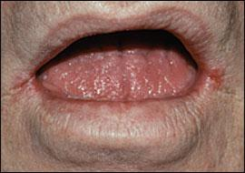
Xerostomia
Defined as a dry mouth resulting from reduced or absent saliva flow.
Saliva facilitates speaking, swallowing & eating.
Increased risk of tooth decay, mouth
infections, ulcers, bad breath & difficulty
swallowing.
Relief – keep hydrated, dry mouth
toothpaste or SLS free.
Use a pea sized amount of toothpaste if the patient can spit out. If they cannot spit out or have swallowing difficulties use a smear.
Notes:
Xerostomia is defined as a dry mouth resulting from reduced or absent saliva flow. It can be symptom of some medical conditions or it can be a side effect of some medications/treatments.
Saliva is important as it facilitates speaking, swallowing & eating.
Having a dry mouth increases the risk of tooth decay, mouth infections, ulcers, bad breath & can cause difficulty swallowing.
As previously mentioned if a patient has difficulty swallowing and/or spitting, tilt their head/chin down towards their chest whilst brushing and use a non foaming toothpaste. Always encourage the patient to spit out.
Oral care is really important for anyone suffering from a dry mouth.
To relieve a dry mouth – keep hydrated and use dry mouth toothpaste or SLS free. Follow the advice on this slide with regards to the amount of toothpaste to use.
Artificial saliva products are available but always speak to be GP first.
Sugar free sweets or gum can be used if safe for the patient.
A water based lip balm can be used to help alleviate dry lips. As stated previously do not use Vaseline on patients using oxygen.
Once the mouth is moist it is more likely to make saliva.

Slide 44
Hypersalivation
Hypersalivation is the excessive production of saliva.
Saliva is good for the mouth as it plays a vital part in neutralising acids that may decay the teeth but is not good for the lungs.
Excessive salvia poses a risk of aspiration pneumonia.
Consider positioning – ideally patient should be upright (sitting or standing) whilst brushing.
Keep chin tucked to chest whilst brushing & encourage the patient to spit out.
Use a pea sized amount of non-foaming toothpaste if the patient can spit out. If they cannot spit or have swallowing difficulties use a smear.
Notes:
Hypersalivation is the excessive production of saliva.
Saliva is good for the mouth as it plays a vital part in neutralising acids that may decay the teeth but is not good for the lungs as excessive saliva poses a risk of aspiration pneumonia.
Consider positioning when brushing – ideally patient should be upright (sitting or standing) to prevent swallowing and to reduce the risk of choking.
As described earlier for patients who suffer from Hypersalivation and are therefore at risk of aspiration pneumonia keep chin tucked towards the chest whilst brushing, encourage the patient to spit out and follow the advice on the slide with regards to the amount of non-foaming toothpaste to use.

Slide 45
Nil by Mouth (NBM)
If a patient is NBM or PEG fed oral care is still important!
Clean the teeth like you would for anybody who consumes food orally.
Consider positioning – ideally patient should be upright (sitting or standing) whilst brushing.
Use a pea size amount of non foaming toothpaste If the patient can spit out.
If the patient cannot spit out or has swallowing difficulties only use a smear of toothpaste.
Keep chin tucked to chest whilst brushing & encourage patient to spit out.
People who are not fed orally and/or suffer from dry mouth can develop an aversion or ‘sensory defensiveness’ to having their teeth and gums brushed.
Always ask the GP for advice on artificial saliva products.
Notes:
If a patient is NBM or PEG fed oral care is still important!
Clean the teeth like you would for anybody who consumes food orally.
Consider positioning – ideally patient should be upright (sitting or standing) whilst brushing to prevent swallowing and reduce the risk of choking.
Use a pea size amount of non foaming toothpaste If the patient can spit out.
If the patient cannot spit out or has swallowing difficulties only use a smear of toothpaste.
As mentioned previously keep chin tucked to chest whilst brushing to ensure no salvia or secretions enter the lungs/ airway. This helps reduce the risk of aspiration pneumonia. Always encourage the patient to spit out.
People who are not fed orally and/or suffer from dry mouth can develop an aversion or ‘sensory defensiveness’ to having their teeth and gums brushed. This can be avoided with very gradually increased amounts of regular oral care with a soft brush.
Always ask the GP for advice on artificial saliva products to reduce dry mouth symptoms and to ensure the product is suitable for the age/needs of the patient.

Slide 46
Smoking
Risk factor for Mouth Cancer.
Bad breath
Discoloured teeth
Altered taste and smell
Tartar build up
Gum and bone disease
Bone loss
Healing impairment
Hinders blood flow to the gums
Notes:
Smoking can have detrimental effects on oral health and is a risk factor for Mouth Cancer as previously discussed.
Smoking can cause bad breath, discoloured teeth, altered taste & smell, Tatar build up, gum and bone disease, bone loss and can impair healing.
Smoking hinders the blood supply to the gums. This may hide the warning signs of gum disease as the gums may not bleed on brushing.
It is therefore even more imperative that smokers maintain an excellent oral health routine and attend all dental appointments as advised by their dentist.

Slide 47
Alcohol & Oral Health
Alcohol can increase the risk of tooth decay, erosion & mouth cancer.
Some alcoholic drinks have a lot of sugar in them and some mixed drinks may contain acids.
Alcohol consumption leads to a decrease in salvia flow which also increases the risk of tooth decay.
Some alcoholic drinks can lead to staining of the teeth.
Notes:
1. Alcohol can increase the risk of tooth decay, erosion and mouth cancer.
2. Some alcoholic drinks have a lot of sugar in them, and some mixed drinks may contain acids. Alcoholic drinks such as white wine, beer and cider can be very acidic. This will cause erosion of the enamel on your teeth, possibly leading to pain and sensitivity. Many mixers and alcopops are high in sugar. This can cause dental decay.
3. Alcohol consumption leads to a decrease in saliva flow so instead of being washed away naturally bacteria clings to the enamel and this increases the risk of tooth decay. Spirits such as vodka and whiskey are very high in alcohol and will give you dry mouth.
4. Some alcoholic drinks can lead to staining of the teeth for example heavily coloured alcohol such as red wine.

Slide 48
Illicit Drugs & Oral Health
The use of illegal drugs can have an adverse effect on oral health.
Many drugs can cause a craving for sugar.
Drugs such as Methamphetamine and Heroin can also cause you to have a dry mouth.
Some drugs such as Ecstasy & Cocaine can lead to jaw clenching and tooth grinding.
Being high on drugs may lead to poor oral care e.g. forgetting to brush teeth.
Notes:
The use of illegal drugs, such as Methamphetamine (meth, speed, ice, glass and crystal), Heroin, Cocaine, Cannabis and Ecstasy can all have an adverse effect on the health of your teeth and gums.
Many drugs can cause a craving for sugar, such as sweets and fizzy drinks, which can cause tooth decay.
Drugs such as Methamphetamine and Heroin can also cause you to have a dry mouth. Because there is a reduced saliva flow in the mouth, this can also lead to tooth decay and gum disease.
Some drugs, such as Ecstasy and Cocaine can lead to jaw-clenching and tooth grinding. This can result cracked or broken teeth, as well as headaches and jaw pain.
Being ‘high’ on drugs could also make you less likely to remember to brush your teeth regularly. This could lead to gum disease, dental decay and tooth loss.
If your dentist believes that you are at a high risk of dental decay, due to either drugs, alcohol or a sugary diet, they may prescribe a high-fluoride toothpaste for you to use to help to protect the teeth.

Slide 49
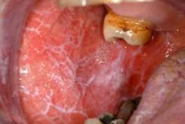
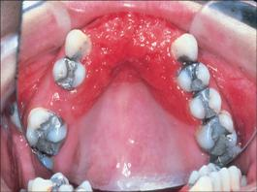
Oral Conditions
1. Periodontal disease
2. Lichen Planus
3. Stomatitis
Notes:
You may come across many of these oral conditions. You are not to diagnose but you can be aware of any changes in the mouth. If there are any concerns please seek advice from a dentist.
Picture 1. - Periodontal Disease- Gums become swollen, bleed on brushing, loose teeth.
Picture 2. - Lichen Planus-. It can be itchy and sometimes it can be caused by too much acid in the diet such as pickles and fruit juice. It can also be a sign of B12 deficiency. Sometimes it can also be a symptom of a pre- cancerous condition. Due to this, Dentists will therefore regularly monitor anyone with lichen planus for a long time . Anyone presenting with this must see a GP or Dentist for advice.
Picture 3. - Stomatitis– can be caused when keeping in dentures for long periods of time without removing.

Slide 50
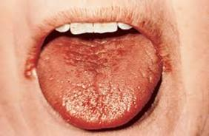
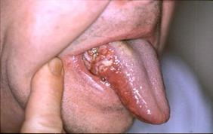
Oral Conditions
4. Oral Thrush
5. Xerostomia
6. Oral Cancer
Notes:
Picture 4. Oral Thrush- Can be caused by some medications, oxygen users or steroid inhalers.
Picture 5. Xerostomia – as discussed previously in depth. Presents as an excessive dry mouth, can be caused if you are a diabetic or take water retention medication.
Picture 6. Oral Cancer – Mouth cancer can appear in different forms and can affect all parts of the mouth, tongue, lips and throat.

Slide 51
Seizures and Trauma
Pick, Lick, Stick – Adult teeth only!
Pick the tooth up by the crown part do not touch the root.
If the tooth is dirty, rinse quickly under cold water OR if able and safe to, ask the patient to gently lick the tooth clean. Do not scrub.
Stick the tooth back in position (ADULT TEETH ONLY)
Bite on a clean handkerchief and hold in place
Go straight to a dentist
If not possible to reinsert the tooth put the tooth straight into milk
NEVER TRY AND RE-INSERT A BABY TOOTH
Notes:
Seizures are the biggest risk of tooth loss. This slide explains what to do with a knocked out adult tooth. “Pick, lick and stick”.
Never try and re-insert a baby tooth – this advice is for adult teeth only.
Pick the tooth up by the crown part do not touch the root.
If the tooth is dirty, rinse quickly under cold water OR if able and safe to, ask the patient to gently lick the tooth clean. Do not scrub.
Stick the tooth back in position (ADULT TEETH ONLY)
Bite on a clean handkerchief and hold in place
Go straight to a dentist
If not possible to reinsert the tooth put the tooth straight into milk
If able to follow this advice there is a chance the adult tooth can be saved as hopefully it will re-implant (re-grow) back.
They may need splint work afterwards and can take around 3-6 months for the tooth to be re-positioned.
The tooth may also be discoloured afterwards but they will retain the natural tooth.

Slide 53
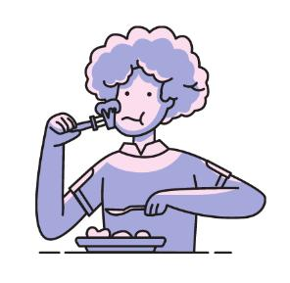
Oral Health & Eating Disorders
Without adequate nutrition the gums and tissue in the mouth can bleed easily and some may experience chronic dry mouth.
Frequent vomiting can also affect the teeth as the acid causes the enamel to weaken.
For those who vomit it is important they are advised not to brush their teeth straight after vomiting.
Instead, either use a fluoride mouthwash, chew sugar free gum or have a drink of water to help neutralise the acid.
Important for anyone with an eating disorder to maintain regular dental check ups.
Notes:
Without adequate nutrition (vitamins and minerals), the gums and tissue in the mouth can bleed easily and some people can also experience chronic dry mouth.
Frequent vomiting can also affect the teeth as the stomach acid is repetitively brought up and washed over the teeth which will cause the enamel to weaken. This could make the teeth more sensitive and will make them more vulnerable to dental erosion. This may then also affect nutritional intake especially if causing pain.
For those who do vomit it is important that they are advised not to brush their teeth straight after vomiting as this can damage the teeth further. Instead they can either use a fluoride mouthwash, chew sugar-free gum, or have a drink of water to help to neutralise this acid.
It is really important that anyone with an eating disorder maintains regular dental check ups. If needed a dentist may prescribe fluoride varnish or a high-fluoride toothpaste.

Slide 54
Diet
Important for oral and general health.
Important to be mindful of the sugar content of the food and drink we are having.
Anything sweet or fizzy is best with a main meal.
Look for traffic light markings on packaging.
Notes:
Diet plays an important part in our overall oral and general health.
It is important to be mindful of the sugar content in the foods and drinks which are consumed.
Anything sweet or fizzy or would ideally be consumed with a main meal.
The traffic light markings on packaging will indicate sugar content . Avoid anything red and anything amber should be a treat.

Slide 55
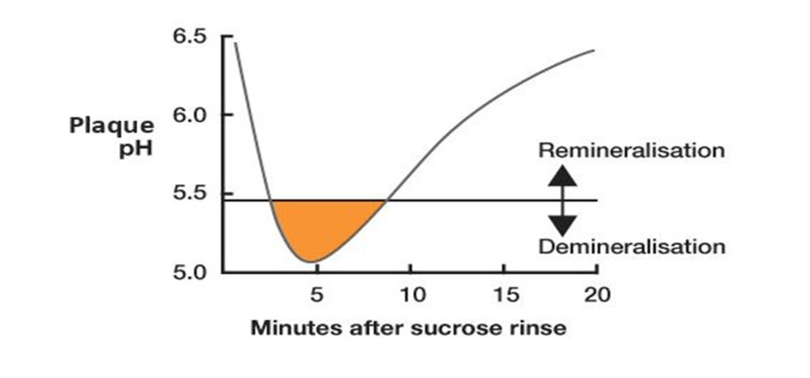
Our Mouth PH
Notes:
The foods and drinks which we consume, particularly sugary ones affect the natural PH of our mouths.
Each time a sugary or acidic food or drink is consumed the mouth pH drops below 5.5 as you can see in this graph. This is called an acid attack.
After each acid attack the mouth pH slowly rises to a safe level (above pH5.5), this is when saliva can re-mineralise the teeth.
Therefore, it is best to wait 1 hour after eating to brush your teeth. It takes this amount of time for the mouth to re-neutralise.

Slide 56
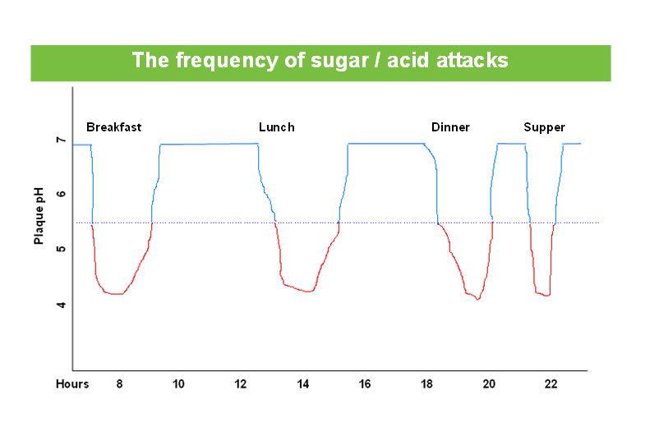
Mouth PH after meals
Notes:
Ideally our eating/drinking pattern would look something like this….lots of time in the blue where our mouth PH is above 5.5.
we should preferably aim for no more than 4 acid attacks per day. E.g. Breakfast, lunch, dinner, supper.
By limiting the number of acid attacks this helps to reduce the risk of tooth decay.

Slide 57
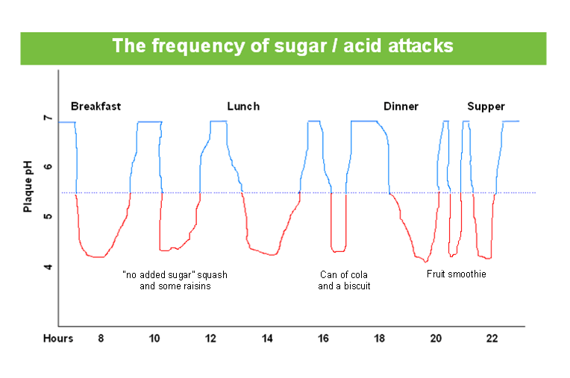
Mouth PH after excessive snacks
Notes:
However, for many, their eating/drinking patterns look more like this.
You can see from this graph the effect on our mouth PH when excessive sugary snacks and drinks are consumed. This causes numerous “acid attacks” and will not give the mouth time to neutralise and therefore increases the risk of tooth decay.
At night time the saliva also decreases so whenever we are having an acid attack our mouth can’t neutralise it.

Slide 58
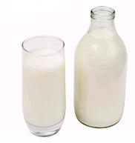
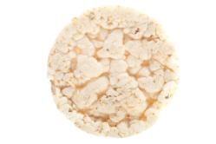
Tooth friendly foods/drinks
Notes:
Safer snacks for our teeth are things like: Fresh fruit and vegetables, breadsticks, low fat cheese, crackers, milk, water, non-sweetened popcorn and Greek yoghurt.
Although fruit and vegetables still have natural sugars in them these are classed as “tooth friendly” and should be incorporated within meals and snacks.

Slide 59
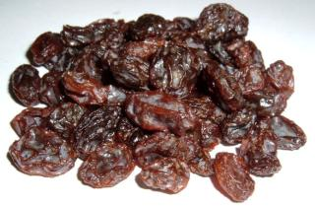
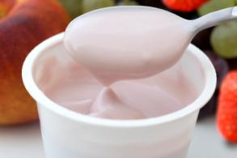
Tooth unfriendly foods/drinks
Keep to mealtimes!
Notes:
As previously mentioned, fruit has natural sugars in it, but dried fruit is sugar enhanced. For example, raisins are extremely high in sugar and will stick to the tooth surface.
Fruit smoothies are full of sugar. If having fruit have it in it’s purist form eg: an apple or a banana.
A glass of orange juice has nearly as much sugar as a can of coke and flavoured water also has sugar in it.
Lots of yoghurts are high in sugar so Greek yoghurt is best.
Highlighting tooth friendly snacks and drinks to residents/ staff can help people make healthier choices.
However, there may be residents who are nutritionally vulnerable and at risk of dehydration who may need to have high sugar foods or drinks. It is therefore essential that professional nutrition advice from a dietician or doctor is always followed in this case..
Because some patients may need or choose high sugar foods or drinks such as smoothies, fruit juice or tea/coffee with added sugar, a thorough mouthcare routine should be provided to minimise any potential harmful effect to the teeth. It may also be helpful to get input from the residents dental team, for example they may decide that a high fluoride toothpaste is needed for such patients.

Slide 60
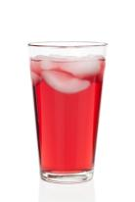
Tooth friendly drinks
Notes:
Ideally plain water is the best form of hydration. It quenches thirst and doesn’t mask hunger or make us feel full.
Milk is also great in the diet (as a source of calcium) but not during the night or just before bed after brushing as it contains natural sugars and may cause tooth decay.
It is important to note that ‘No added sugar’ drinks are not the same as sugar free. Sugar free is best.
Fizzy drinks tend to be high in sugar and acidity which can lead to tooth decay and dental erosion as previously discussed.
If an adult likes to drink tea or coffee then have it without sugar.

Slide 61
Medication
Some medicines can cause oral health issues particularly gum disease.
Always tell the dentist what medications you are taking.
Ask for sugar free/ low sugar medicines to help prevent tooth decay.
Notes:
Some medicines can cause oral health issues especially with the gums, therefore its really important to tell the dentist what the patient is taking.
Some medicines come in a sugar free/low sugar option so request this if possible.
Liquid medication and nutritional supplements may be prescribed by a doctor or dietitian for various medical reasons. It is important that patients have these as prescribed.
Nutritional supplements can have a high sugar content and often patients may sip these throughout the day, therefore it is important that a thorough oral health routine is maintained to help protect the teeth.
It may be helpful to get input from the residents dental team, for example they may decide that a high fluoride toothpaste is needed.

Slide 62
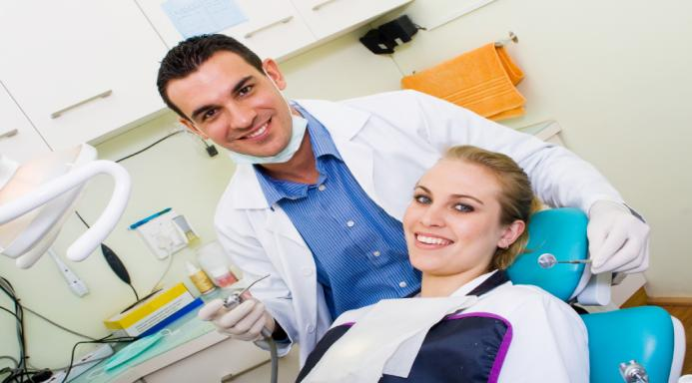
Dentist Visits

Slide 63
Visiting the Dentist
Dental care in the home if they meet the criteria.
Preparing for the visit – list of medication, exempt etc
Has the resident got capacity to consent to treatment?
Family and friends could help
Information to take home
Dementia Friendly Dentistry – Check who is registered.
Notes:
As discussed previously the CQC/ NICE guidelines recommend that all residents need to be having dental check ups.
It is better for residents to see their normal dentist if possible as this will be quicker and for patients with dementia it might be more familiar for them.
CDS can provide dental care within the care home if they meet the criteria.
Ensure you have all relevant paperwork when attending a dental visit. It’s really important to take along a list of the medications that the resident is on and or information on exemption from payment if it applies.
Before the visit consider, Have they got the capacity to consent to treatment? If not you would need to look into someone that can make a decision on their care on their behalf.
See if family and friends can help take them to their dental visits and explain to them the importance of oral care.
When visiting the dentist ask them to give you some information to take back with you so you can update the team.
Look on the local Dementia Action Alliance and see who is registered as dementia friendly. They will be able to accommodate quiet hours and will ensure no black mats on entry, dementia friendly signage etc.

Slide 64
Dental Visits
Check ups should be every 6 months unless stated otherwise by the dentist for all adults & children.
If the patient does not have any teeth they still need to visit the dentist every 6 months for oral screening.
Fissure sealants and fluoride application are available at the dentist’s discretion to provide extra protection to patients that need it.
A high fluoride toothpaste can be prescribed if the patient is a high risk of caries
Notes:
Dental visits should take place every 6 months unless stated otherwise by a dentist for all adults and children.
Dental checks should still take place even if the resident has no teeth and wears full dentures. Part of the dental visit includes an oral screening which is really important as mentioned previously.
Fissure sealants and fluoride application are available at the dentist’s discretion to provide extra protection to patients that need it.
A high fluoride toothpaste can be prescribed if the patient is a high risk of caries

Slide 65
Dental Visits
Dental care is free for all up until the age of 18 or 19 (if full time education).
There is NHS availability – You can get advice from NHS 111 and www.nhs.uk
Pregnant women and new mothers are exempt from payment up until the babies 1st birthday.
Notes:
Dental care is free for all up until the age of 18 or 19 (if full time education). There are some circumstances where an adult will be exempt from payment please visit the NHS website for exemption criteria.
There is NHS availability – You can get advice from NHS 111 and www.nhs.uk
Pregnant women and new mothers are exempt from payment up until the babies 1st birthday.

Slide 66
Barriers to Dental Care
Communication and mental capabilities
Behaviour problems
Seizures- mouth trauma and injury
Unusual responses to stimuli
Unpredictable body movements
Tooth eruption maybe delayed due to phenytoin
Dental caries
Periodontal disease
Nil by Mouth PEG fed

Slide 67
Barriers to Dental Care
Anxiety
Diabetes
Epilepsy
Down Syndrome
Cerebral Palsy
Gastroesophageal Reflux
Dysphagia
Gingival Hyperplasia
Dementia
Notes:
Anxiety – is one of the biggest barriers as many people may feel anxious about going to the dentist.
Diabetes – the dental visits may need to be timed around the residents diabetic medication and meal/snack times.
Epilepsy - residents with poorly controlled epilepsy may feel afraid to go to a high street dentist and may feel more comfortable in a specialist setting.
Down’s Syndrome – people living with Down’s syndrome generally have an enlarged tongue. This can cause excessive salvia and difficulties with brushing.
Cerebral Palsy- people living with Cerebral Palsy may have difficulty with brushing due to dexterity issues.
Gastroesophageal Reflux- if a patient suffers with acid reflux they may be more prone to dental erosion.
Dysphagia- residents following a stroke can suffer from difficulty or discomfort in swallowing . For toothbrushing tilt the head towards the chest to prevent chocking.
Gingival Hyperplasia- is where the gum overgrows. It can be linked to diabetes and diabetic medication. This could make brushing uncomfortable
Dementia- residents living with dementia could refuse oral care. Look for dental practices who have ‘Dementia Friendly status’ and follow the guidance as previously discussed in regards to residents who may resist oral care.
There are a number of different approaches we can use to try and help dental attendance and encourage good dental care, for example different communication techniques.

Slide 68
Communication
Use the “show tell how” approach.
Ask the dental practice for pictures of the dental practice and dentist before the visit.
On our website we have a virtual tour of several clinics.
Ask the dental practice if they can accommodate a quiet hour for your child to attend.
Notes:
Communication techniques include the “Show, Tell, How” approach. This is where you talk the patient through each stage. e.g. “This is your toothbrush which we are going to use, we will use it to make you teeth clean/shiny, let’s see if we can make your teeth clean/shiny”.
Pictures and virtual tours can be really helpful in preparing someone for a dental visit.
A virtual tour of several CDS clinics can be found at https://communitydentalservices.co.uk/clinics/essex/
Some dental practices offer a ‘quiet’ hour once a week which can be really helpful for children or adults with sensory needs.

Slide 69
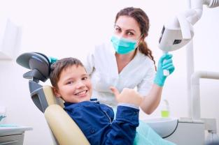
Helpful Tips
Headphones
Weighted blanket
Keep to daily routine
Tinted glasses
Praise and reinforce good behaviour
Several attempts may be needed.
Be patient.
Notes:
There are several tips that can help with dental attendance for children or adults with behaviour and stimuli barriers:
Headphones/ music can be a useful distraction and can also help relax patients.
The use of a weighted blanket may help the patient feel more relaxed.
Try and stick to the same routine daily as this may help make the patient feel more at ease.
Tinted glasses may help when at the dentist to reduce excess stimuli.
Praise and reinforce good behaviour after every step.
It may take a few attempts to successfully visit the dentist. Try at a different time if needed.
Minimise stress as much as possible so that the experience is positive. Be patient.

Slide 70
Dementia Friendly Communities
Community Dental Services have obtained Dementia Friendly Community Status across four of our Clinics. (We are working towards all 8 clinics)
Become a dementia friend https://www.dementiafriends.org.uk/
Work towards making your workplace dementia Friendly. https://www.dementiafriends.org.uk/WEBArticle?page=dementia-friendly-communities#.Xx7jdZ5Kg2w
Notes:
Community Dental Services have proudly obtained Dementia Friendly Community Status across four of our clinics so far and we are working towards all 8 clinics.
You can become a dementia friend by completing a free course by following the link: https://www.dementiafriends.org.uk/
You can also work towards making your workplace ‘Dementia Friendly’, further information can be found on this link: https://www.dementiafriends.org.uk/WEBArticle?page=dementia-friendly-communities#.Xx7jdZ5Kg2w

Slide 71
Oral Health & End of Life Care
Notes:
We will now discuss why maintaining oral health during end of life care is important..

Slide 72
Why is it important?
Eating and drinking
Speaking and socialising
Being pain free
Overall quality of life
Maintaining dignity
Notes:
Why is oral health important in end of life care?
It is important for many reasons:
For eating and drinking
Speaking and socialising
Being pain free
Maintaining dignity

Slide 73
Affect on Oral Health
Bad breath/ taste
Loose teeth
Oral thrush
Ill fitting dentures
Dry mouth
Excessive salivation
Notes:
The end of life process can have the following effects on oral health:
Bad breath-This can be caused by dry mouth or the natural process of end of life
Loose teeth- teeth may become loose due to different conditions
Oral thrush- due to the bodies natural process - people receiving end of life care could be more prone to oral thrush
Ill fitting dentures- due to weight loss or tooth loss this could effect the denture fit and can also effect nutrition
Dry mouth- can be caused by dehydration. We recommend saliva replacement gels to lubricate the mouth.
Also try to slightly elevate the resident to stop excessive saliva causing a chocking hazard.

Slide 74
Aspiration Pneumonia
The bacteria present in dental plaque has been associated with aspiration pneumonia.
Aspiration pneumonia is a lung infection that develops after you inhale food, liquid, or vomit into the lungs.
Patients lying down for long periods of time are more at risk of aspirating oral secretions.
All patients should ideally be upright (sitting or standing) when brushing to reduce the risk of choking and aspiration pneumonia.
Bacteria can colonise in an endotracheal tube or tracheostomy.
Good oral health can reduce the risk of acquiring aspiration pneumonia.
Mouth Care Matters (2016)

Slide 75
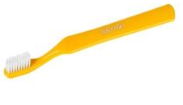
End of life products
1. Moutheze Oral Cleanser
2.Child/junior toothbrushes (extra soft)
3. Dent-O-Care Fingertip toothbrush
Notes:
The mouth is more likely to be sore in end of life care. Everything is shutting down, their immunity is low and they are more susceptible to bacteria and infections in the mouth. The following products that could be used are:
1. 360 mouth cleaner (Moutheze Oral Cleanser)- - good for end of life care if the mouth is sore. It can be used to clean and lubricate the mouth.
2. Extra soft toothbrush- A babies brush is fine as the gums may be sore.
3. Dent-O-Care Fingertip Toothbrush: can be used as a gentler way to massage tender gums. Its flexible brush that fits over your finger and is made from super soft PVC-free silicone and is latex free. Assess suitability of product on patient – do not use on anyone with risk of biting.

Slide 76
End of life care
Encourage plenty of fluids if safe for resident.
Sucking on ice chips if safe for resident.
Water based lip balms for dry lips are recommended.
Vaseline is not water based and contains petroleum which is flammable (avoid using if resident is on oxygen).
Notes:
Encourage plenty of fluids only if it is safe for the patient- small sips, little and often.
Sucking on ice chips can help hydrate the mouth, again this must be deemed safe for the resident.
For dry lips you can use a water based lip balm. As mentioned previously Vaseline must not be used if the resident is on oxygen.

Slide 77
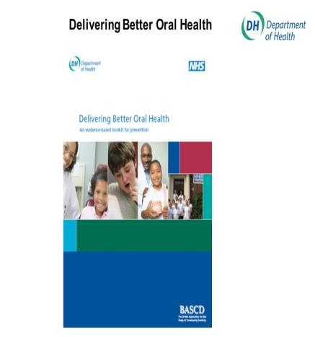
Useful Resource
The Department of Health document Delivering Better Oral Health provides guidelines for all ages on oral care and is a really useful reference.
Evidence based guidelines
Includes fluoride recommendations for all ages
Eatwell Guide
Notes:
This is the Department of Health document that we mentioned at the beginning of the presentation called Delivering Better Oral Health which provides guidelines on oral care for all ages and is a really useful resource. https://www.gov.uk/government/publications/delivering-better-oral-health-an-evidence-based-toolkit-for-prevention
It includes evidence-based guidelines, fluoride recommendations for all ages and information on the Eatwell Guide.

Slide 78
Dental Neglect
This NICE 2021 Safeguarding Adults in Care Homes guidelines highlight that neglect can include things like residents not being supported to present themselves the way they would like (for example haircuts, makeup, fingernails and oral hygiene and care).
Dental neglect may occur in isolation or may be an indicator of a wider picture of maltreatment.
Failure to respond to a known significant problem is a form of neglect.
Failure to provide someone (who is unable to do it themselves) with adequate oral health products such as a toothbrush/ toothpaste is also a form of neglect.
Notes:
The NICE 2021 Safeguarding Adults in Care Homes guidelines are available online at: https://www.nice.org.uk/guidance/ng189 and provides a comprehensive policy on Safeguarding which should be followed in conjunction with any local policy in place at your work place. For the purposes of this training we have purely focused on dental neglect but this policy provides further information on keeping adults in care homes safe from all forms of abuse and neglect.
These guidelines highlight that neglect can include things like residents not being supported to present themselves the way they would like (for example haircuts, makeup, fingernails and oral hygiene and care).
Dental neglect may occur in isolation or may be an indicator of a wider picture of maltreatment.
Failure to respond to a known significant problem is a form of neglect.
Failure to provide someone (who is unable to do it themselves) with adequate oral health products such as a toothbrush/ toothpaste is also a form of neglect.

Slide 79
Common Signs of Dental Neglect
Several failed dental appointments with no explanation.
Poor general and dental hygiene.
Poor oral hygiene, possibly leading to gum disease or decayed teeth.
Weight loss, malnourishment or dehydration – e.g. is the patient having difficulty eating/ drinking due to untreated dental issues?
Untreated medical and dental problems e.g. persistent toothache left untreated or untreated dental disease.
Changes in behaviour – e.g. face banging, or refusing food for example in non-verbal patients.
Lack of oral health products when the patient is not able to source these themselves.

Slide 80
Safeguarding Concerns?
Your work place should have either a safeguarding lead or a senior member of staff that you would feel comfortable approaching with any safeguarding concerns.
Your work place should have a policy in place for safeguarding children and vulnerable adults with a procedure to follow if you have concerns, including the names of local authorities to contact. This should be easily accessible and/or displayed clearly.
If dental treatment is needed refer to a dentist/ organise this.
Keep records and monitor progress.
Safeguarding is the responsibility of everyone and any issues must not be overlooked or ignored.

Slide 81
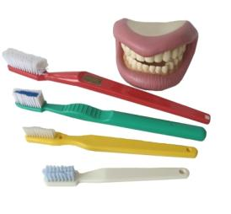
How we can support you
Oral health resources
Advice and Support
Oral Health Training
Accreditation
Mobile dental unit
CDS clinics/ Domiciliary visits
Lots of Oral Health information & resources on our website www.communitydentalservices.co.uk

Slide 82
Oral health team contacts
Contact:
Claire.Hobbs@cds-cic.co.uk 07443499333
Toyah.Khan@cds-cic.co.uk 07880163908
Notes:
These are our contact details please feel free to ring us or email us with any questions or if you need any support with regards to oral care.

Slide 83
Thank you!
Please complete your evaluation form here:
https://forms.office.com/Pages/ResponsePage.aspx?id=BGTVb1eNdkuheiLEHw6uPemj0uKHIaBDnO-NigVx3RZUMkhISzJXVE9KSjhTV000Slg2WkFNUFc1Qy4u
Please complete your quiz here:
https://forms.office.com/Pages/ResponsePage.aspx?id=BGTVb1eNdkuheiLEHw6uPemj0uKHIaBDnO-NigVx3RZUNDJYWEFVQ0RURE9DRU00NUtUVDk1WDNGVS4u
Notes:
Thank you for completing our online training toolkit.
We would be really grateful if you could complete our evaluation form and oral health quiz- Your feedback is really important to us.
Please click on the above links to complete these. Alternatively you can use your phone to scan the QR codes on the next 2 slides to complete.
Once the evaluation and is quiz is completed we will issue you with an Oral Health Training certificate.
Please contact us if you need any support/ help completing these. Our contact details are on slide 68.

Slide 84
QR Code for Evaluation
Notes:
Please scan the above QR code on your phone in order to complete our evaluation form.

Slide 85
QR Code for Oral Health Quiz
Notes:
Please scan the above QR code on your phone in order to complete our oral health quiz form.

Slide 86
References
Mouth Care Matters (2019) Mouth Care Matters, a guide for hospital healthcare professionals. Second Edition. Online at: https://mouthcarematters.hee.nhs.uk/links-resources/mouth-care-matters-resources-2/
NICE Oral Health Assessment Tool. Online at: https://www.nice.org.uk/improving-oral-health-for-adults-in-care-homes
Wrigley Oral Healthcare ,(2016). The Stephan Curve. Online at:
https://www.wrigleyoralhealthcare.co.uk/research-and-evidence
CQC Smiling matters, Oral Health Care in Care Homes. (June, 2019) Online at: https://www.cqc.org.uk/publications/major-report/smiling-matters-oral-health-care-care-homes

Slide 87
References
Alzheimer’s Society. Dementia Guide. Online at:
https://www.alzheimers.org.uk/publications-about-dementia/the-dementia-guide
NHS Choices. Find Dentist Services. Online at: https://www.nhs.uk/Service-Search/Dentists/LocationSearch/3
Dementia Friendly Communities- https://www.dementiafriends.org.uk/WEBArticle?page=dementia-friendly-communities#.Xx7jdZ5Kg2w
Dementia Friends- https://www.dementiafriends.org.uk/

Slide 88
References
Denture care - (Video produced by Health Education England):
https://www.youtube.com/watch?v=aJvsFUtRL9k&list=PLrVQaAxyJE3eYeayCLSUFpxtkMxWmRo7L&index=1
Brushing in residents that are orally defensive- (Video produced by Health Education England):https://www.youtube.com/watch?v=ieQJFSUlOps
Public Health England (2020) Adult Oral Health in Care Homes Toolkit. Online at: https://www.gov.uk/government/publications/adult-oral-health-in-care-homes-toolkit
How to brush your teeth animation (Health Education England,2018) https://www.youtube.com/watch?v=BapR9J86ZZw

Slide 89
References
NICE (2016) Oral Health for Adults in Care Homes. Online at: https://www.nice.org.uk/guidance/ng48
Delivering Better Oral Health. Third Edition. (Public Health England) 2017 Online at: https://www.gov.uk/government/publications/delivering-better-oral-health-an-evidence-based-toolkit-for-prevention
https://www.gov.uk/government/publications/covid-19-mouth-care-for-patients-with-a-confirmed-or-suspected-case/mouth-care-for-hospitalised-patients-with-confirmed-or-suspected-covid-19
NICE (2021) Safeguarding Adults in Care Homes. Online at: https://www.nice.org.uk/guidance/ng189

